Slide 1
Inspiring possibilities vicki mcdonald
National Library of the Philippines | ASEAN
Capacity Building in Library Services:
Re-framing Libraries, Setting the New Normal
17 November 2021

Slide 2
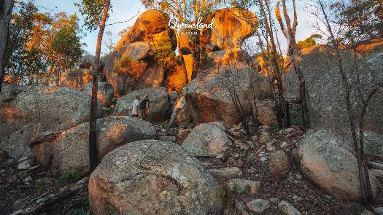
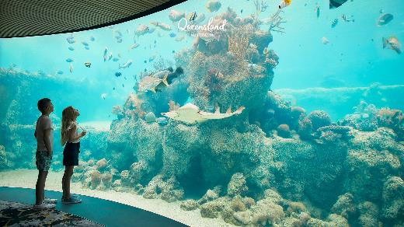
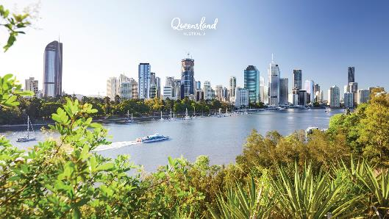
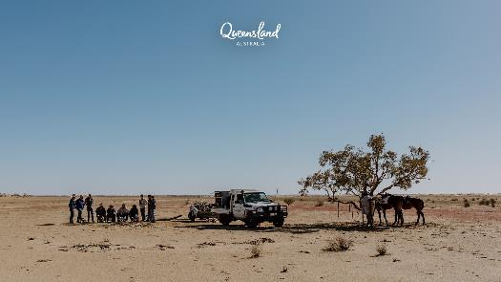
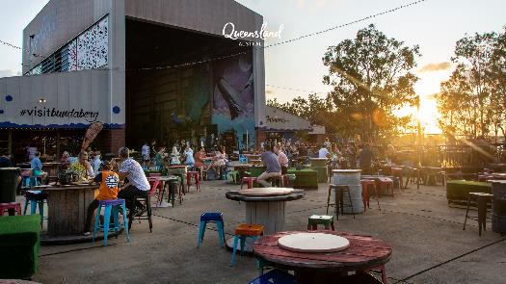
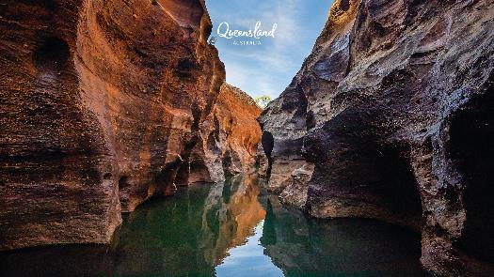
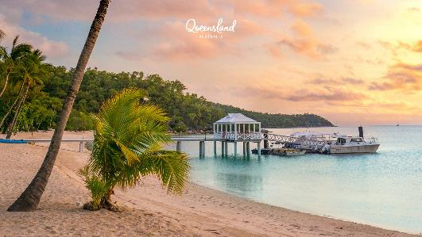
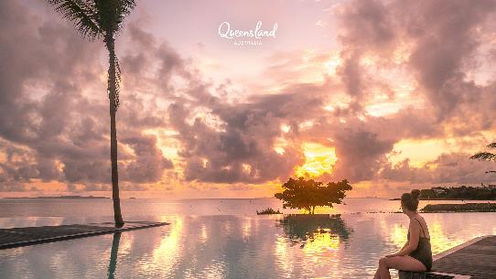
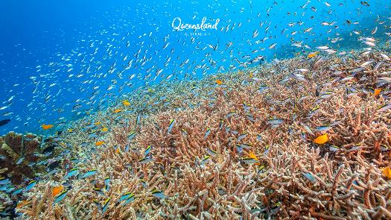
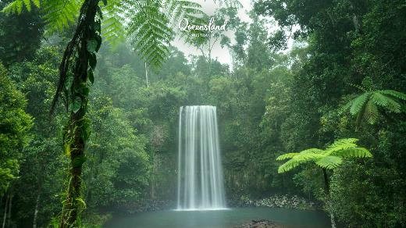
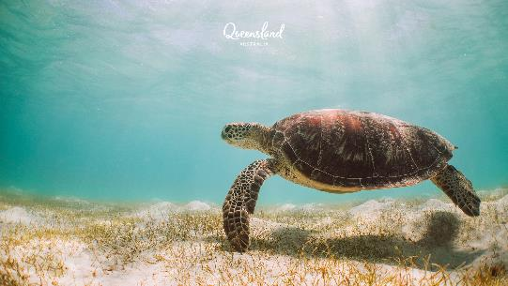
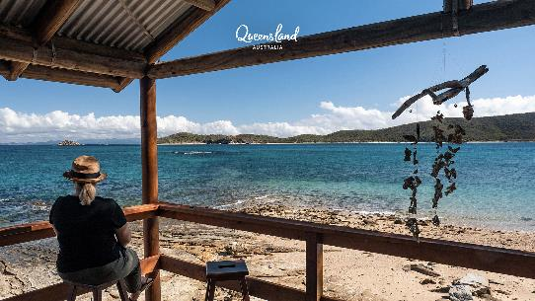
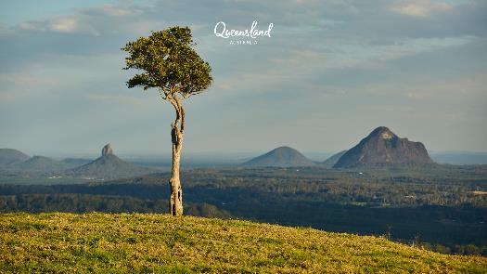
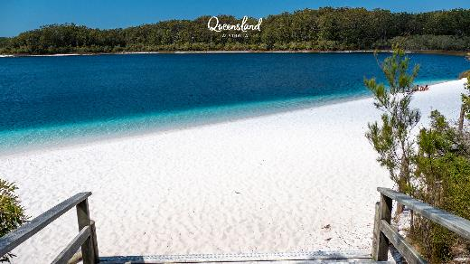
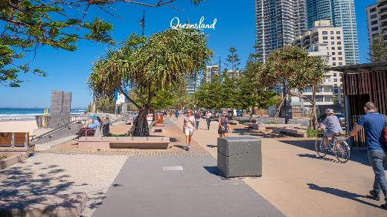
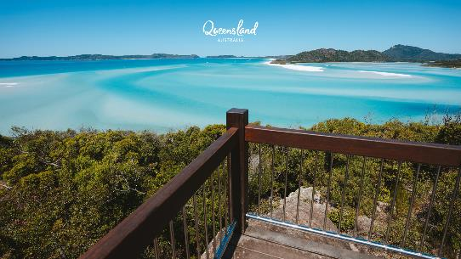

Slide 3
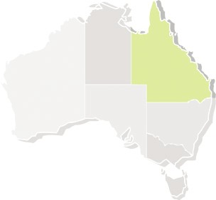
QUEENSLAND – the facts
Size:1.85M square kilometres
six times the size of The Philippines
Population:
5.185 Million (Queensland)
First Nations: Aboriginal and Torres Strait Islander peoples
~3% of the population

Slide 4
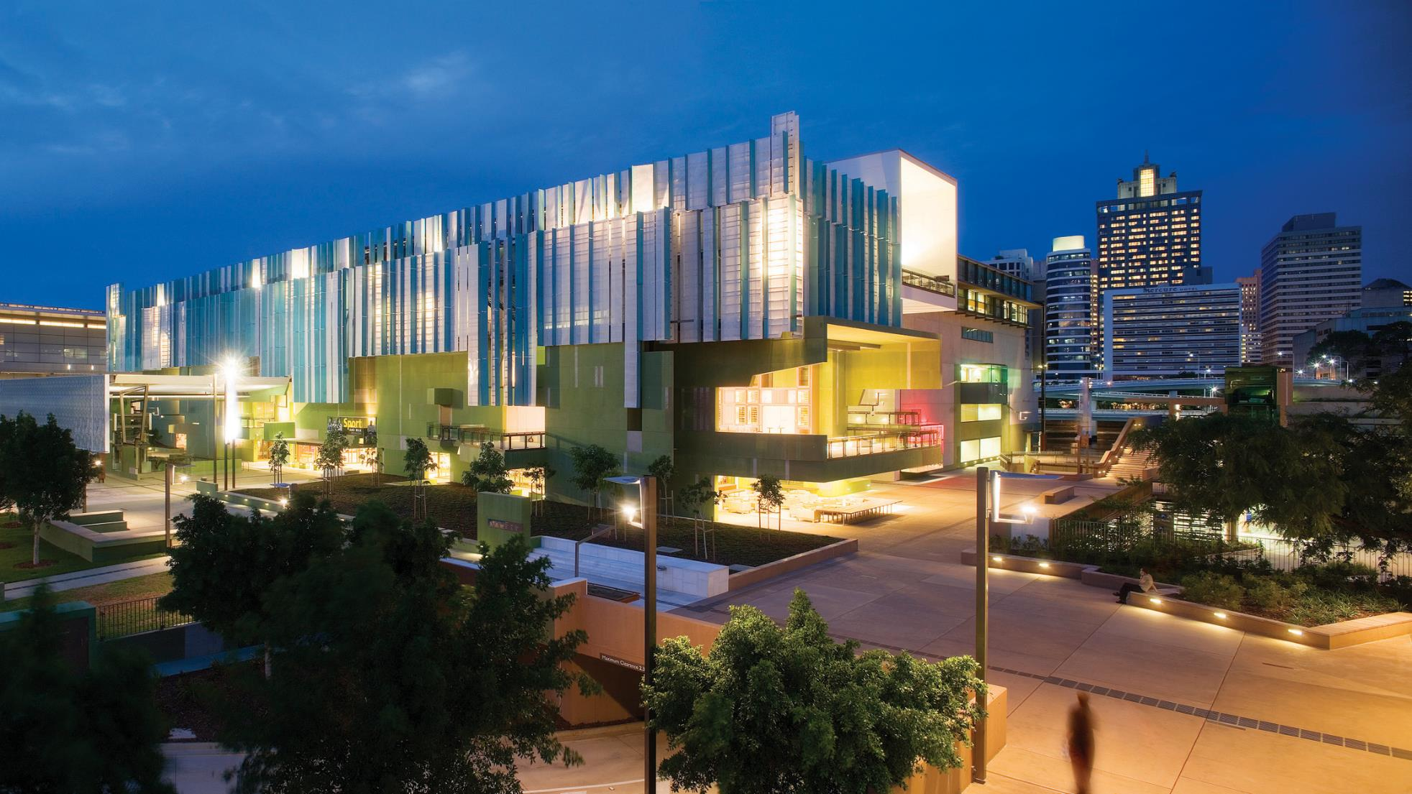
State Library of Queensland. Photo by Jon Linkins

Slide 5

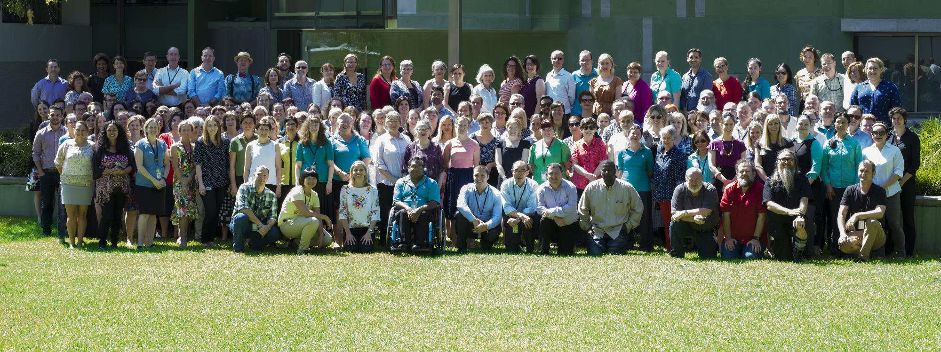
Why do we work in libraries?
State Library of Queensland staff
November 2016

Slide 6
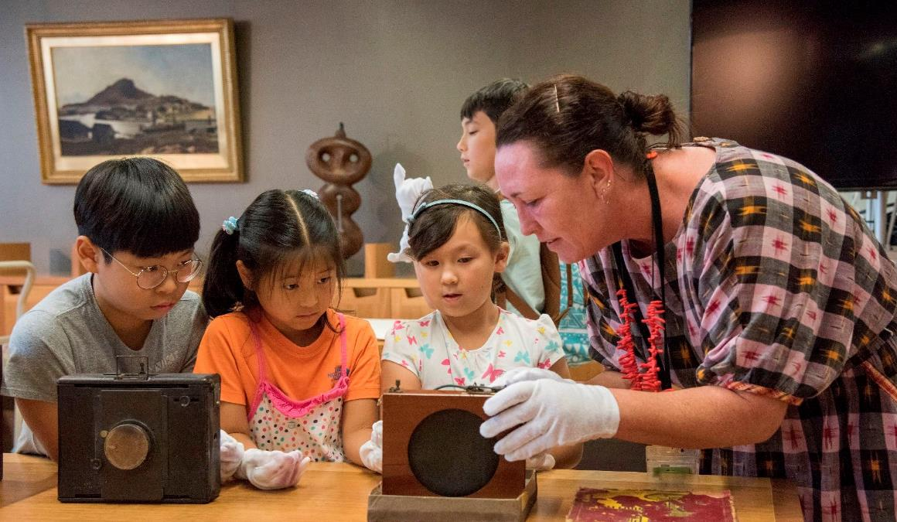
Founded in 1896, State Library of Queensland is the leading reference and research library in Queensland.
State Library is responsible for collecting and preserving a comprehensive collection of Queensland’s cultural and documentary heritage, providing free access to information for all Queenslanders, and for the advancement of public libraries across the state.
Our purpose

Slide 7
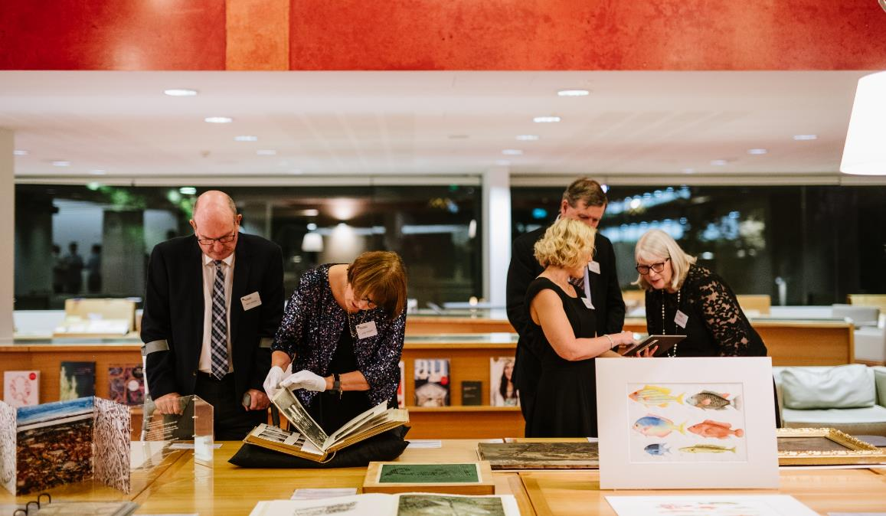
Inspiring possibilities through knowledge, stories and creativity
Our vision

Slide 8
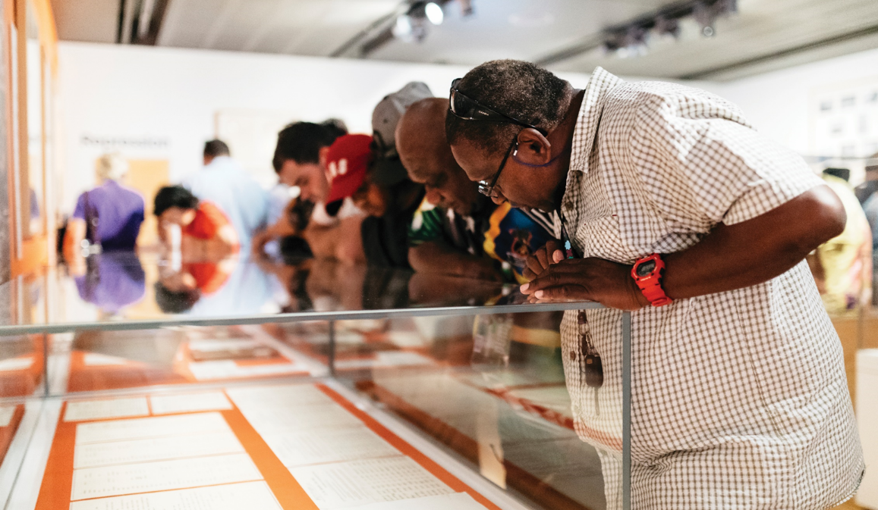
Trusted Content
Collect, preserve and provide access to trusted content
Number of additions to the collection
Use of content
Objective 1

Slide 9
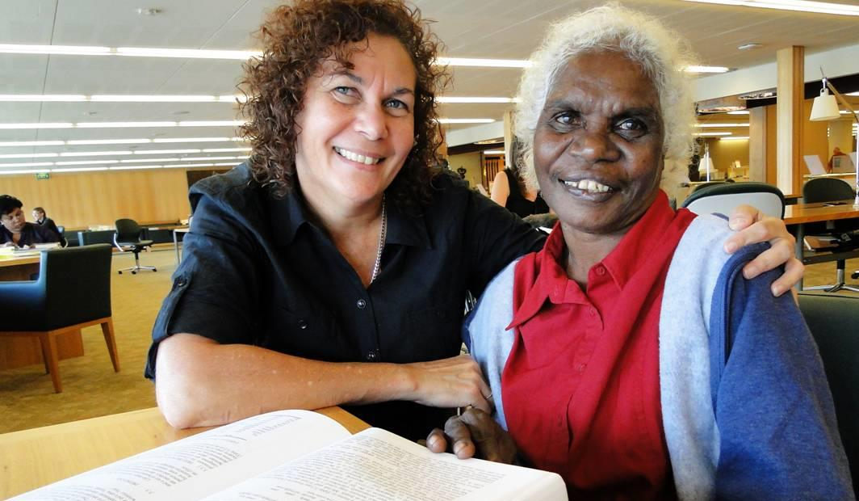
Seek diverse stories
Encourage and collaborate on research to deepen knowledge
Engage with people as seekers and creators
Preserve the collection for future generations
Intentionally collect a trusted record of Queensland
Our strategies to achieve
Trusted content

Slide 10
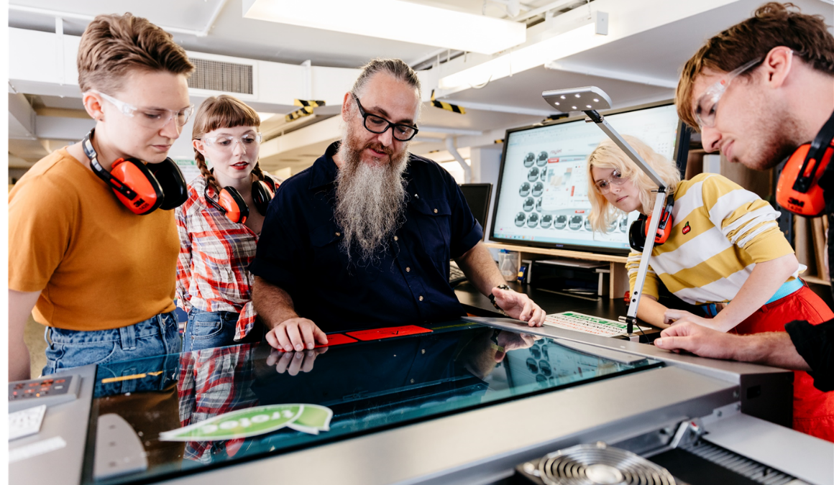
Shared experiences
Grow our audiences through rewarding experiences
Visits onsite & online
Number of new members
Visits to public libraries
Objective 2

Slide 11
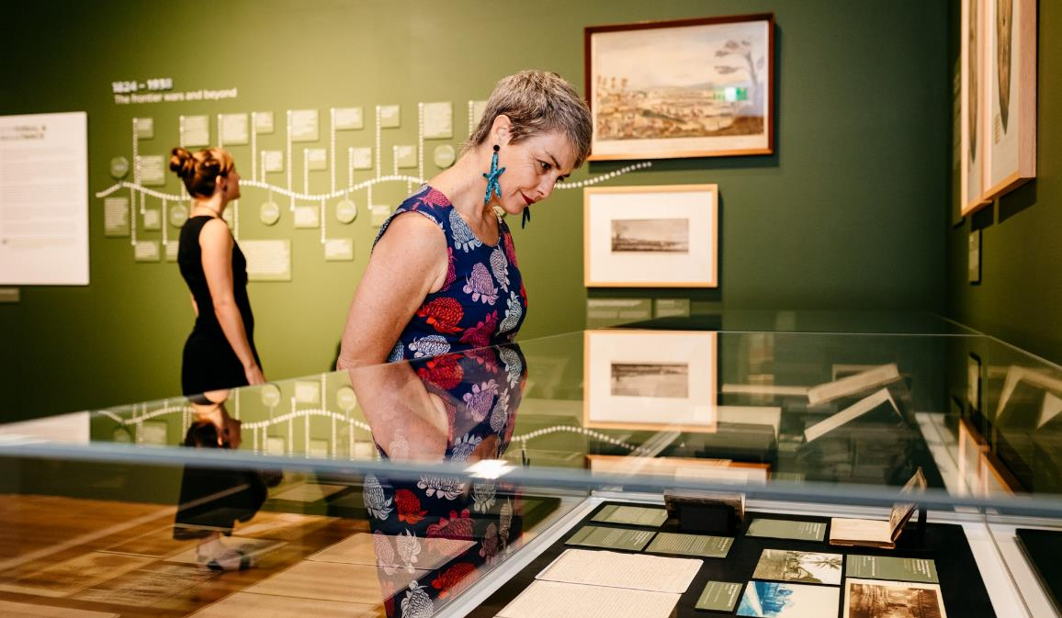
Improve access so it’s easier to find and use information
Focus on interactions — where clients can create and participate
Scale services to reach new audiences
Seek opportunities to promote literacy in all its forms
Advocate for public libraries and partner with local government to enable a thriving network of public libraries and IKCs
Our strategies to achieve
Shared experiences

Slide 12
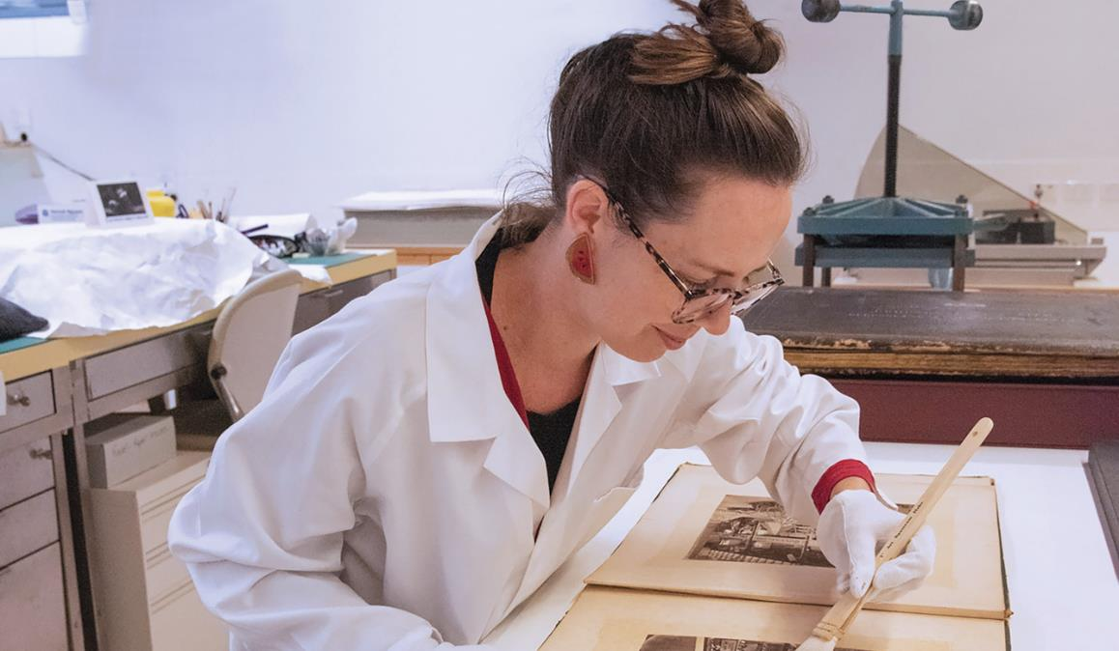
Future-focused people and processes
Enable continuous improvement and innovation
Customer satisfaction
Average cost per visit
Objective 3

Slide 13
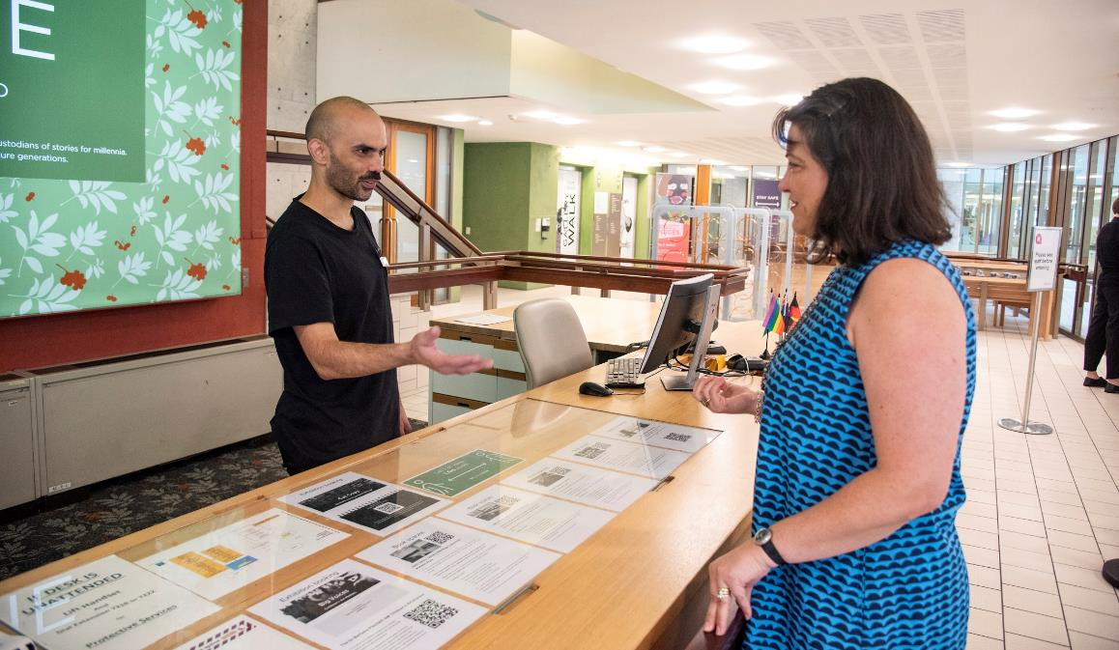
A culturally diverse workforce, with different skillsets, experiences and thinking styles
Share, understand, and challenge our own and others’ work so we continue to transform
Evaluate our services and share compelling stories of impact
Attract investment and partnerships
Our strategies to achieve
Future-focused people and processes

Slide 14
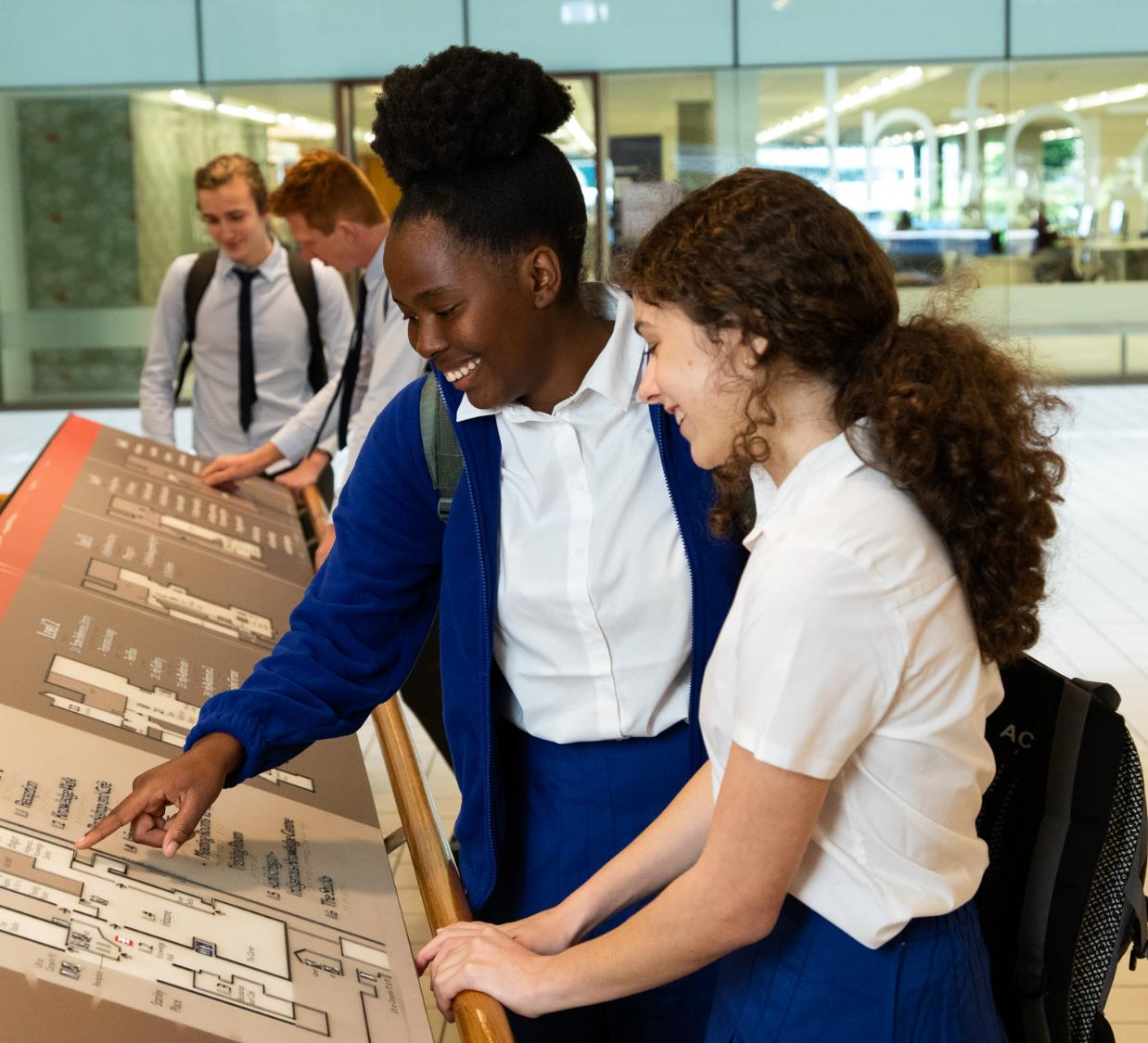
Key initiatives

Slide 15
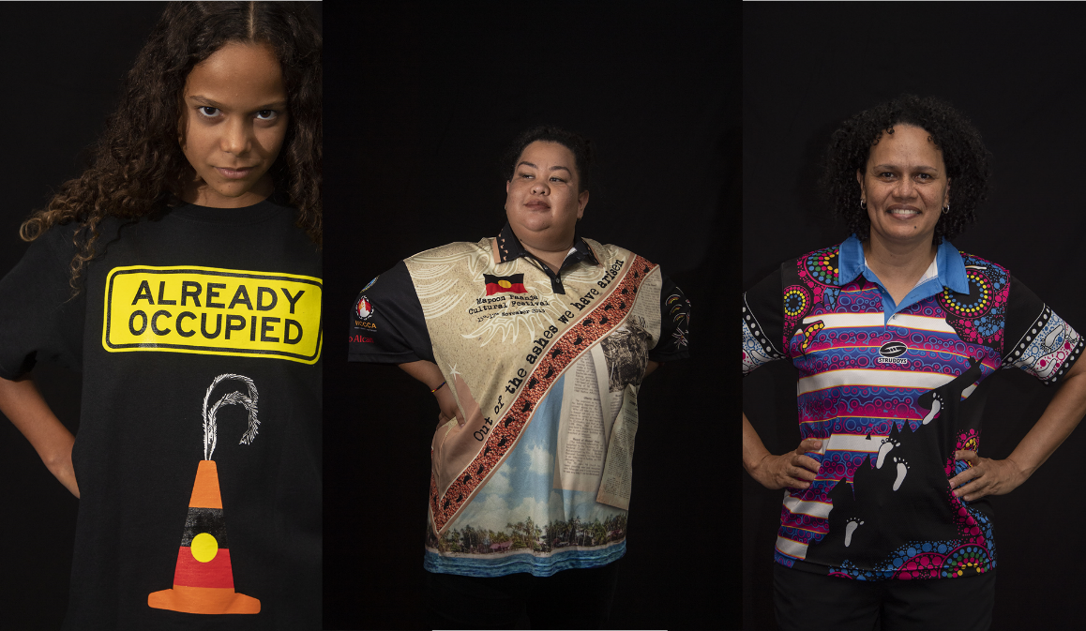
Truth-telling
An opportunity for Aboriginal and Torres Strait Islander peoples to record evidence about past actions and share their culture, heritage and history with the broader community.

Slide 16
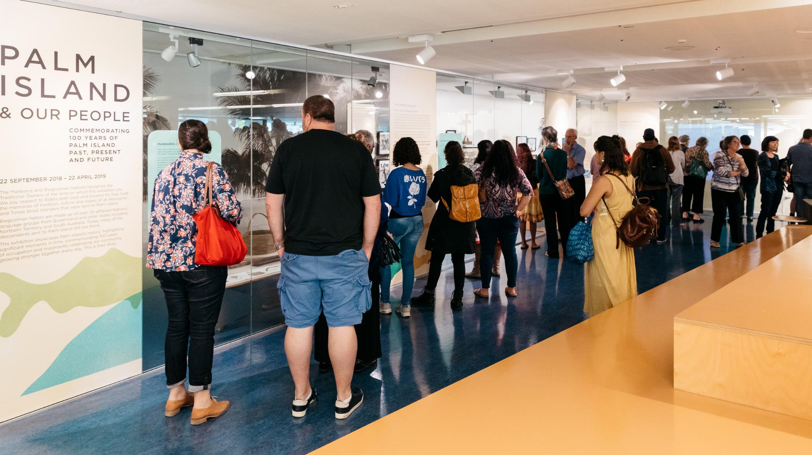

Slide 17
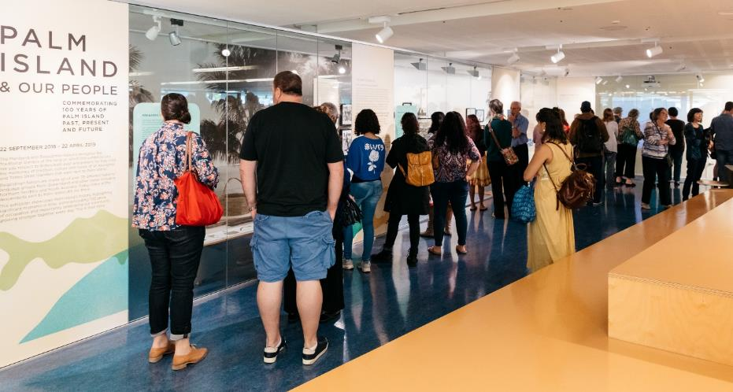
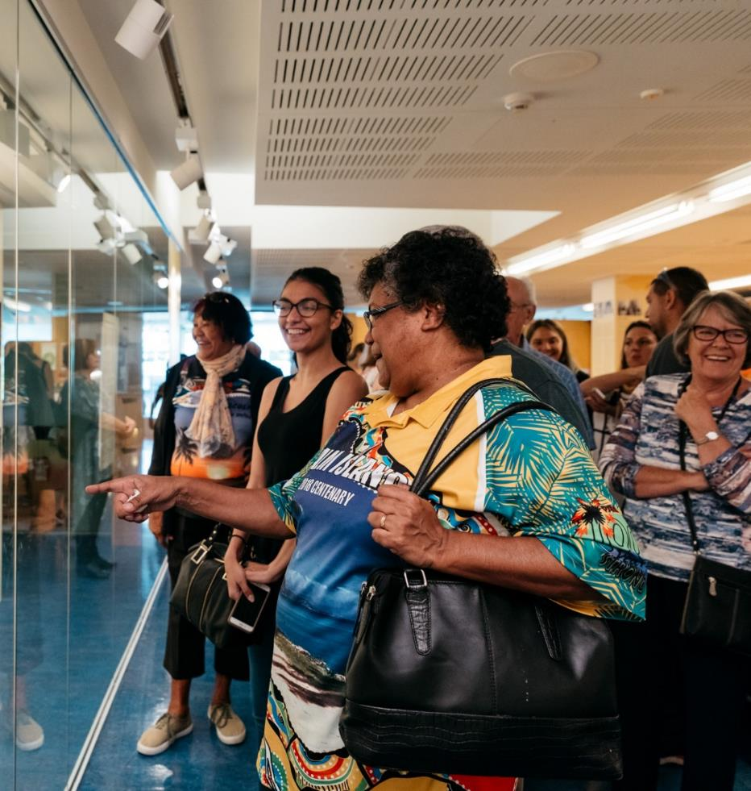
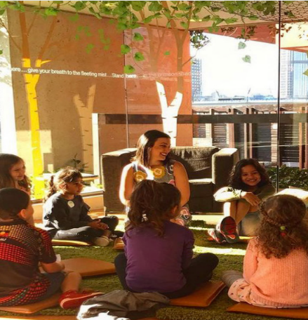
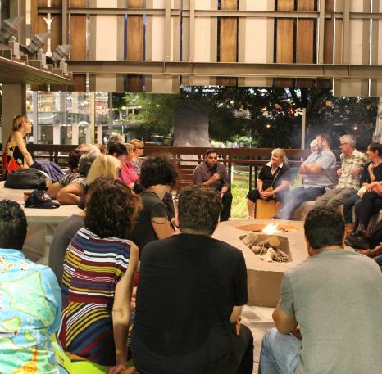
Kuril dhagun

Slide 18
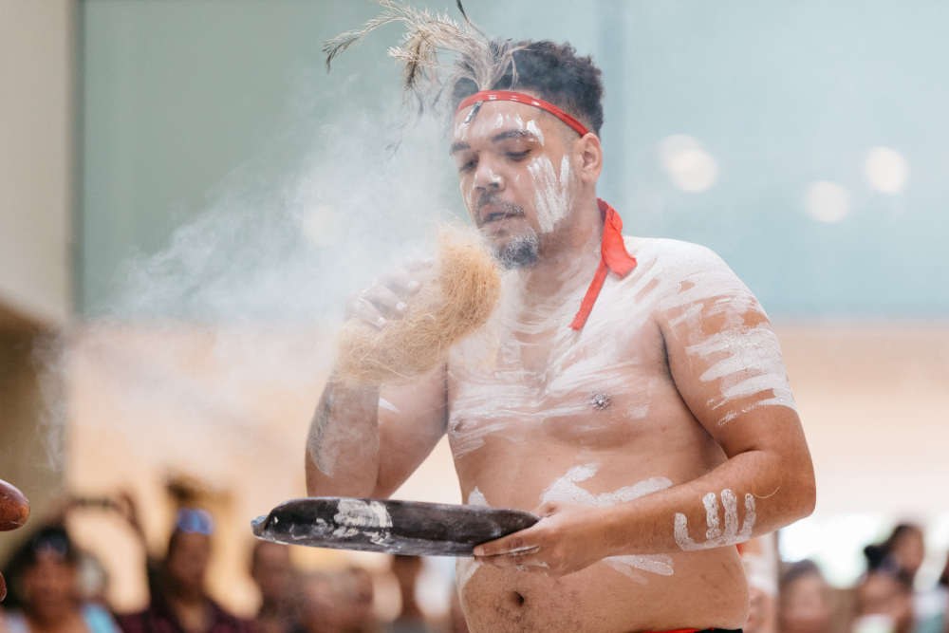
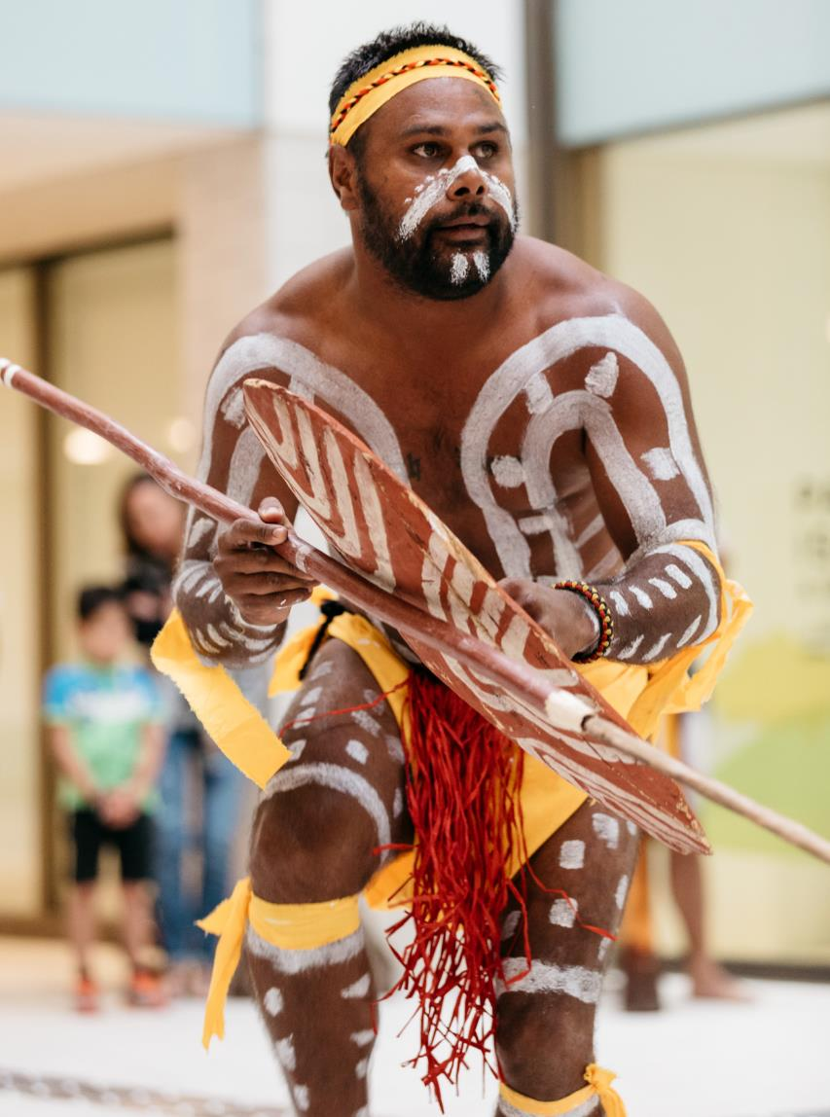
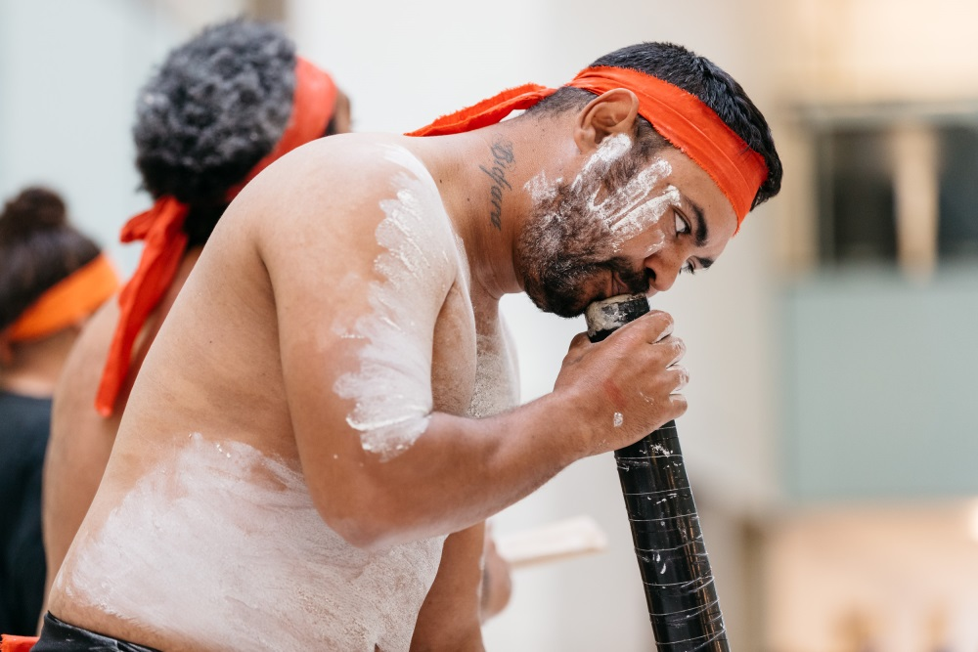
Bwgcolman dancers from Palm Island

Slide 19
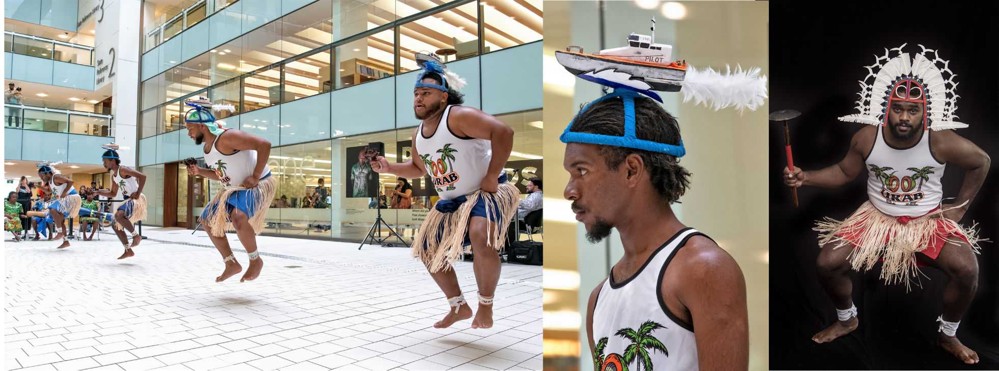
Urab dancers, from the Torres Strait

Slide 20
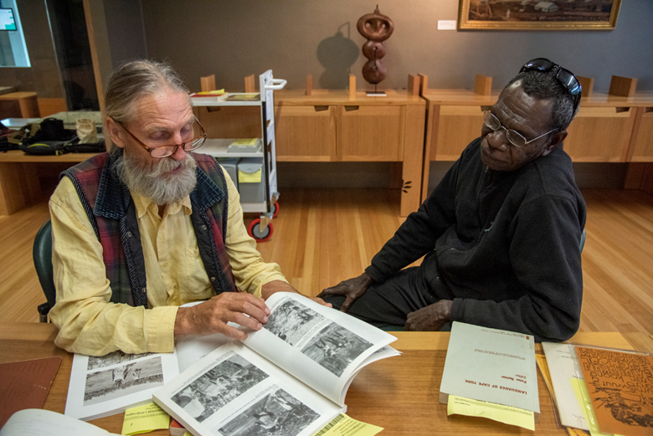
Indigenous languages program
Actively supporting communities in the revival, documentation and preservation of traditional languages

Slide 21
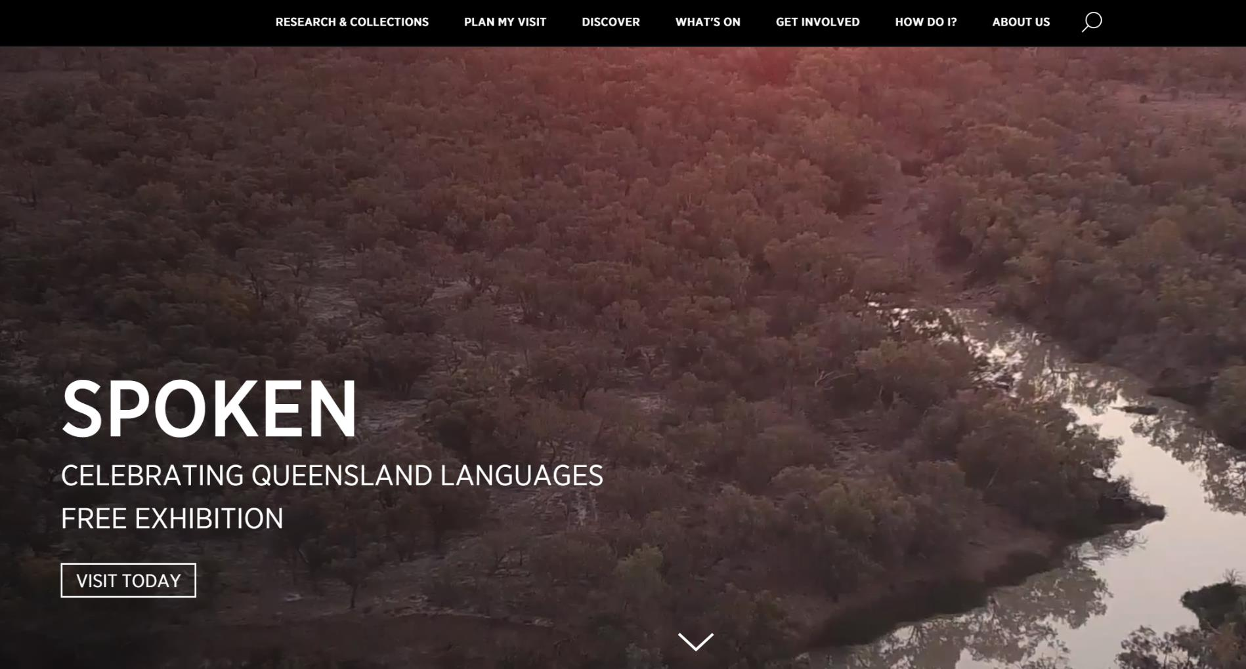
Notes:
International Year of Indigenous Languages – 2019
It was an opportunity to showcase the language revitalization work that we had been doing for over a decade – documenting, preserving and making accessible language
The Exhibition opened on 20 November 2019 – William Barton one of Australia's leading didgeridoo players and composers performed at the opening event

Slide 22
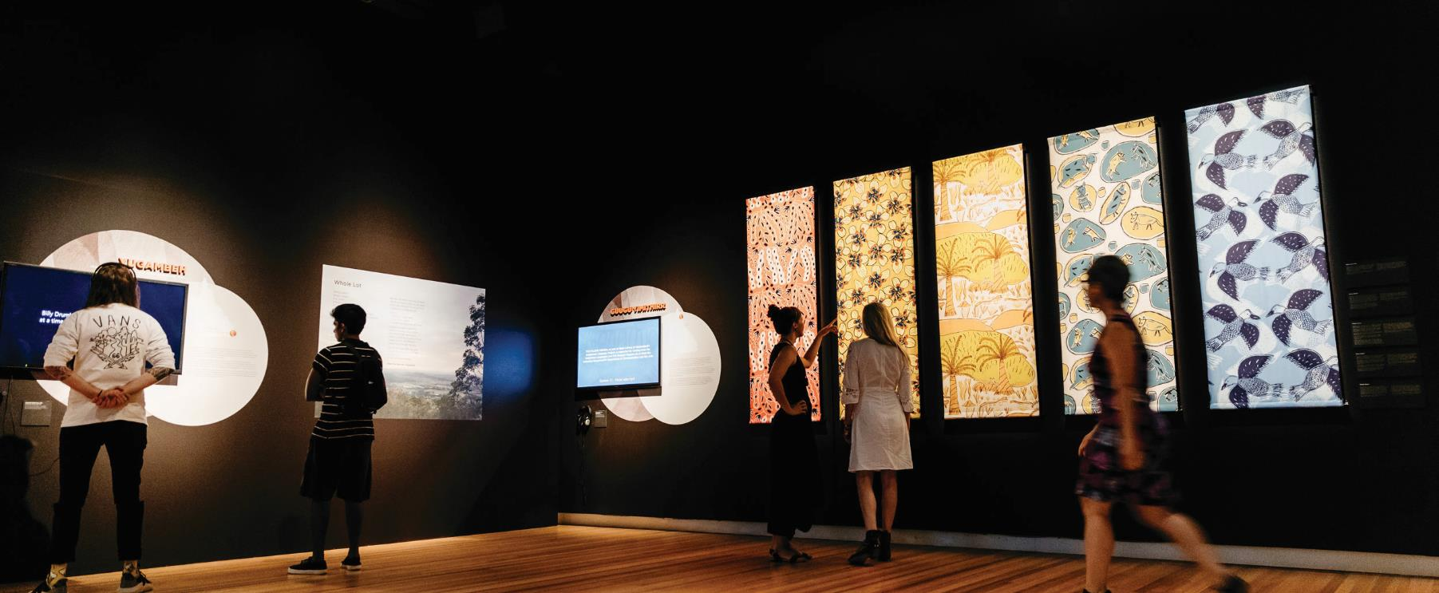
Spoken: celebrating Queensland’s languages – slq gallery

Slide 23
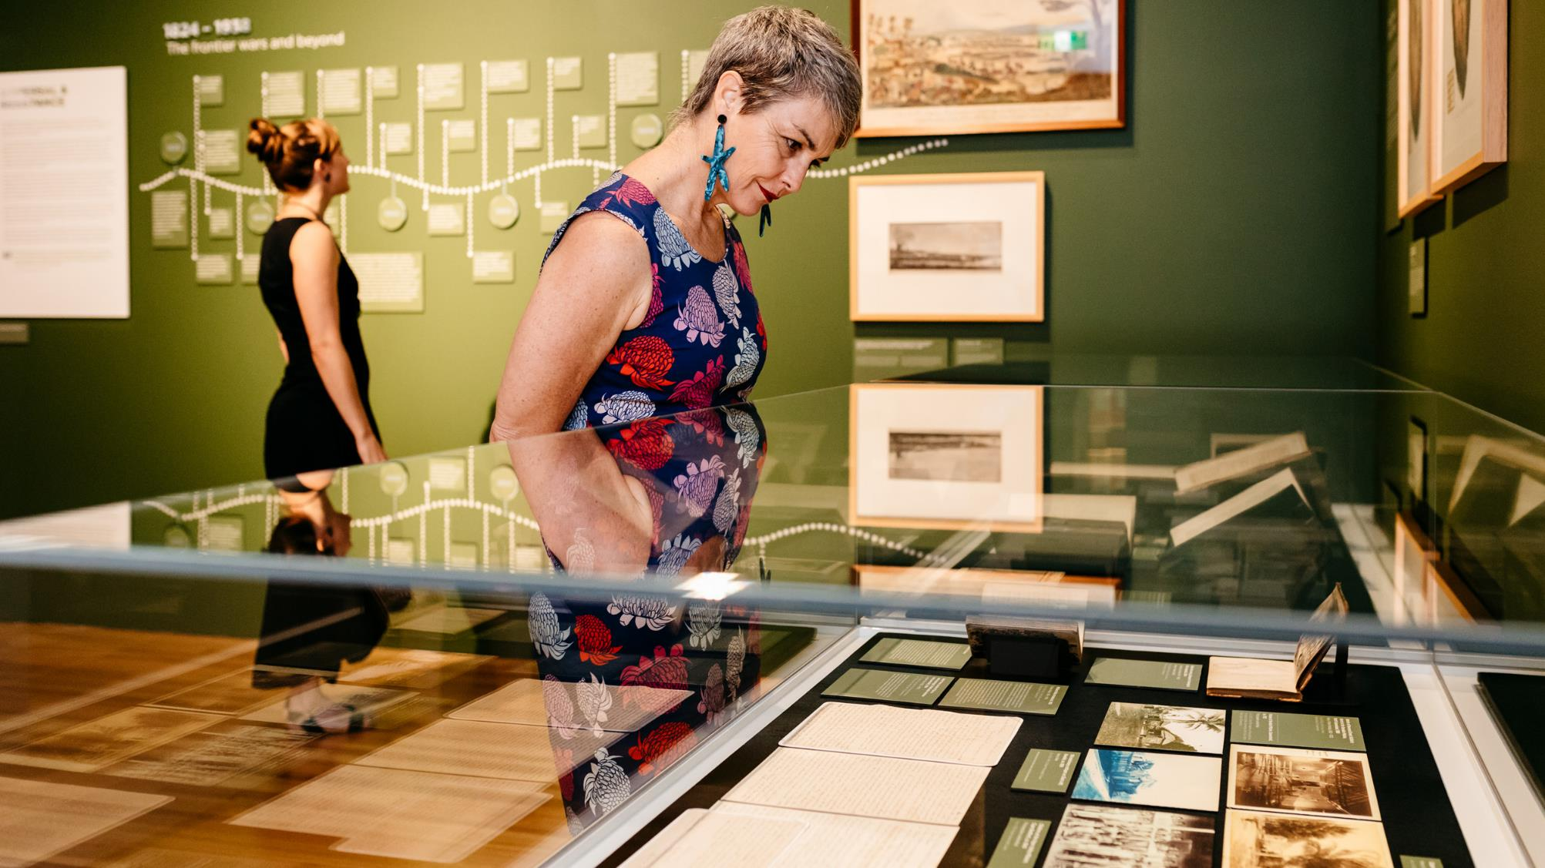
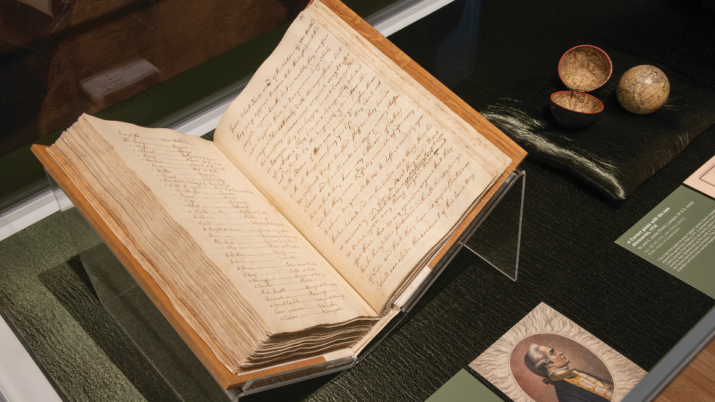

Slide 24
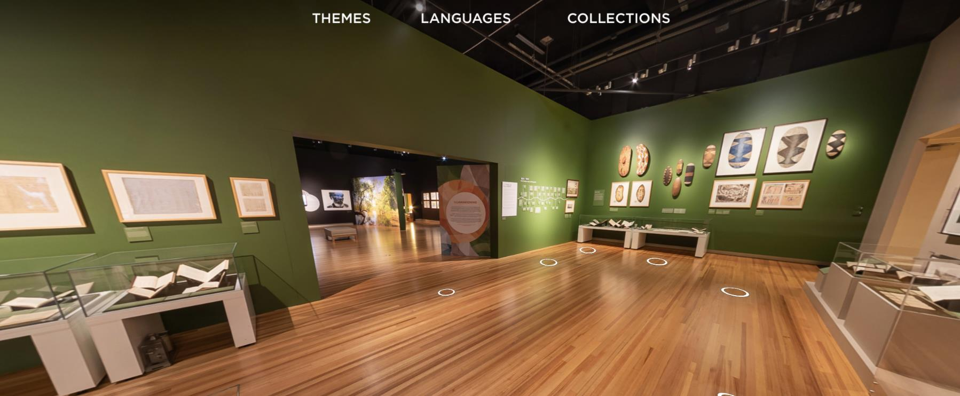
Spoken: celebrating Queensland languages – virtual experience

Slide 25
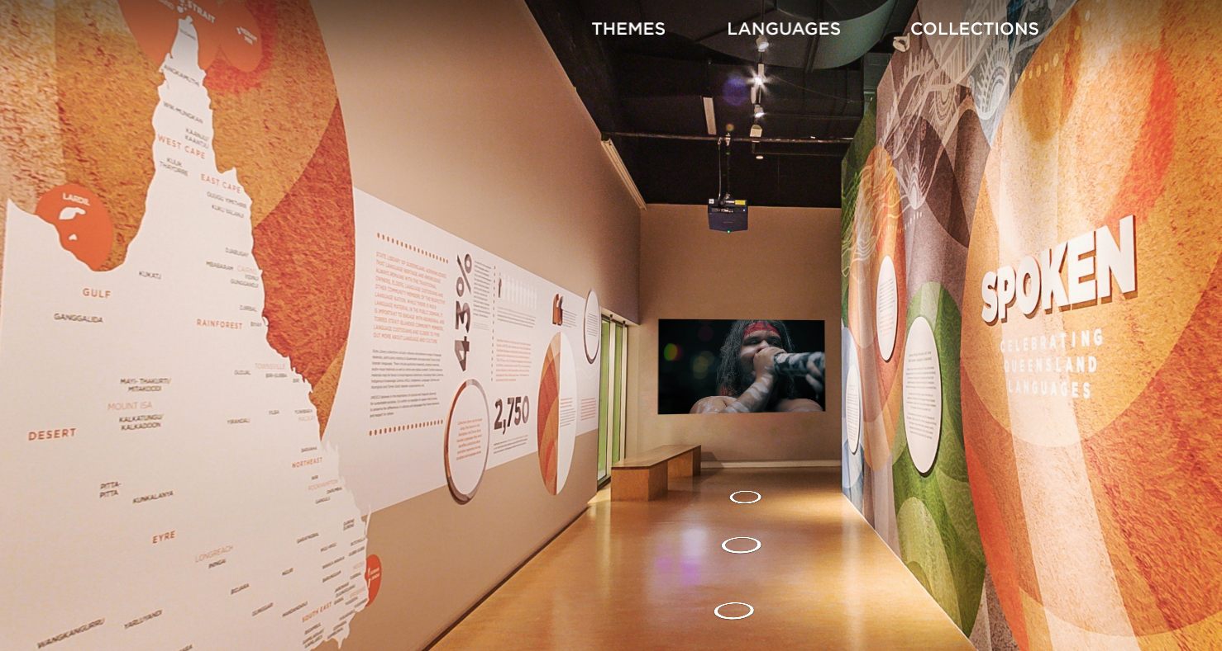

Slide 26
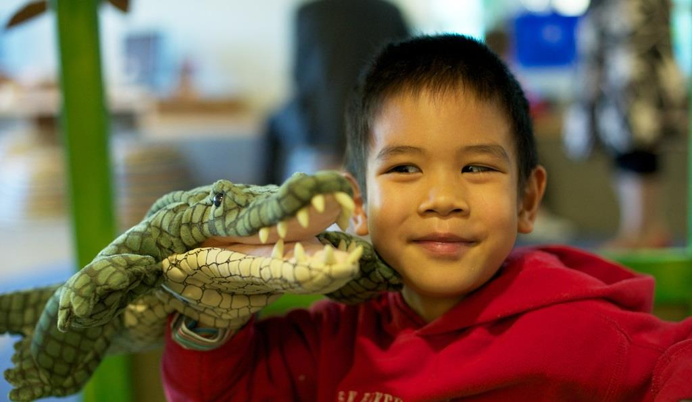
Literacy
First 5 Forever is an initiative of the Queensland Government, coordinated by State Library of Queensland and delivered in partnership with local government.
Since launching in 2015 there have been more than 4 million attendances at First 5 Forever activities in public libraries and Indigenous Knowledge Centres across Queensland.

Slide 27
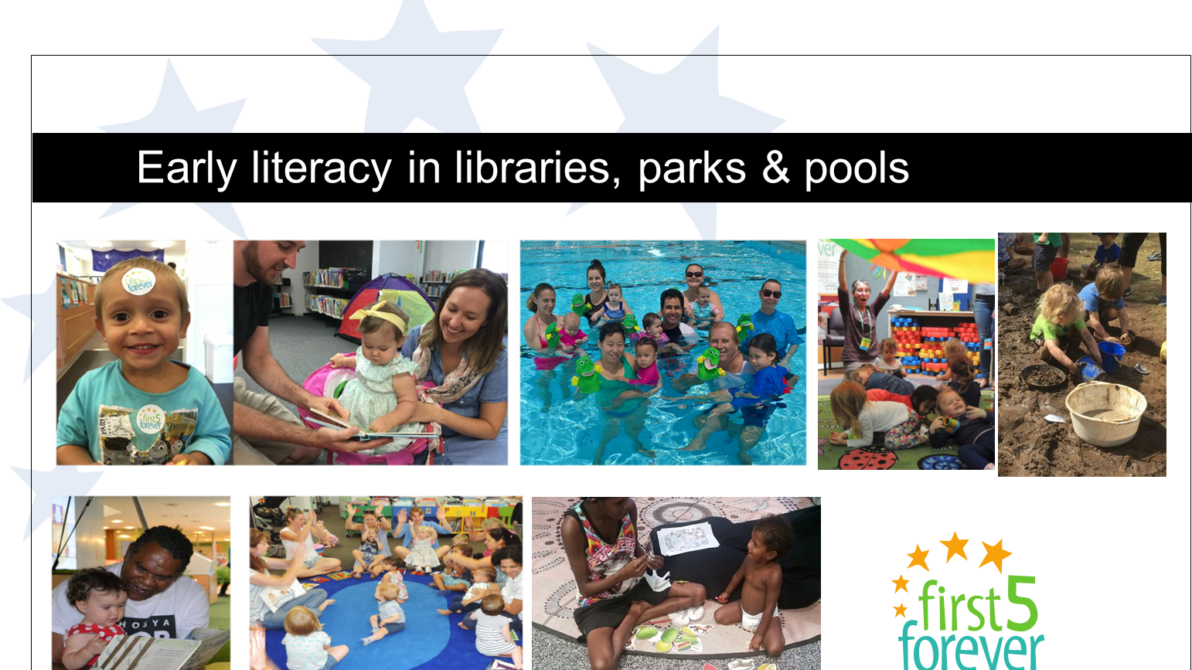

Slide 28
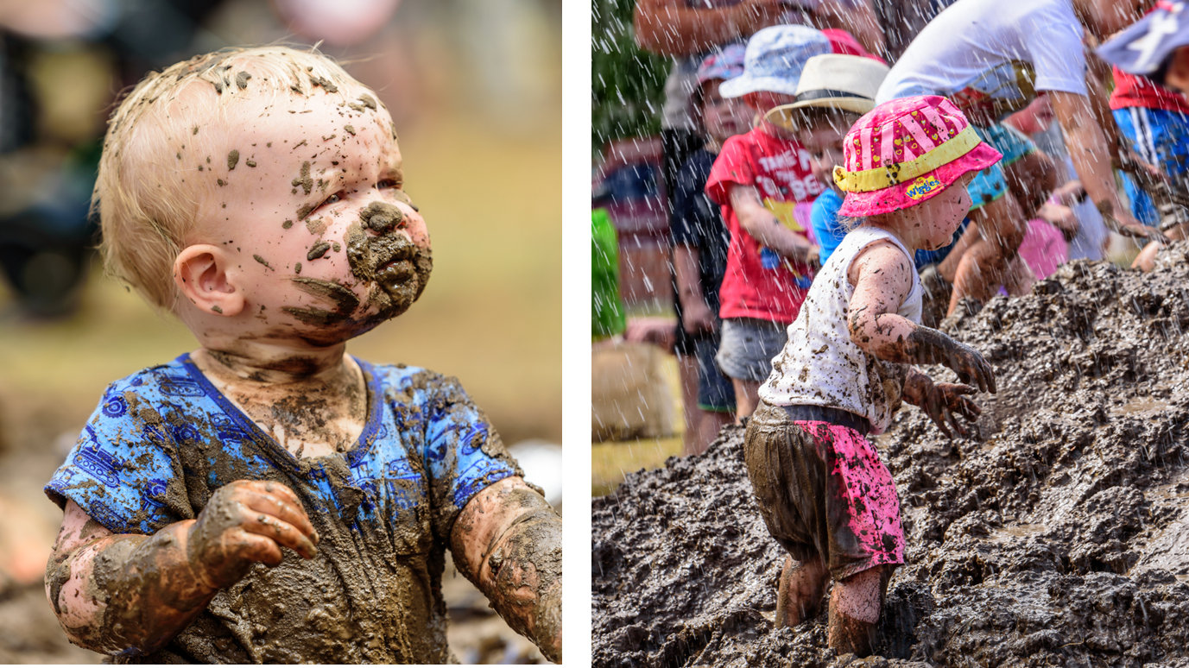

Slide 29
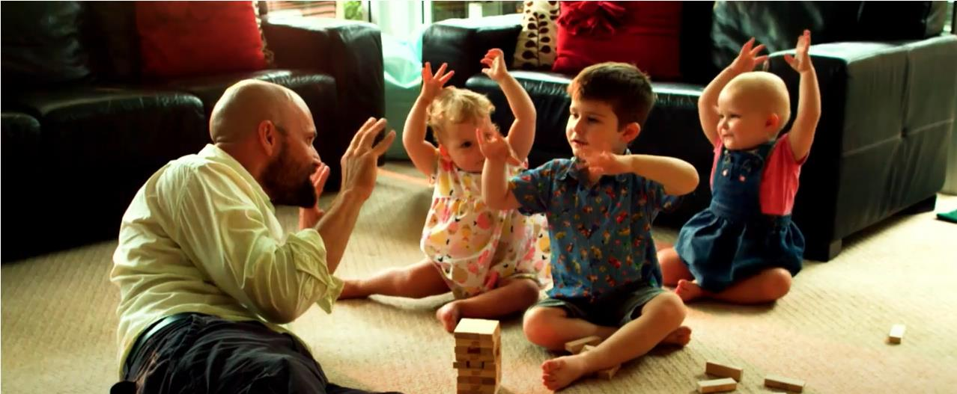
Little moments, big impact

Slide 30
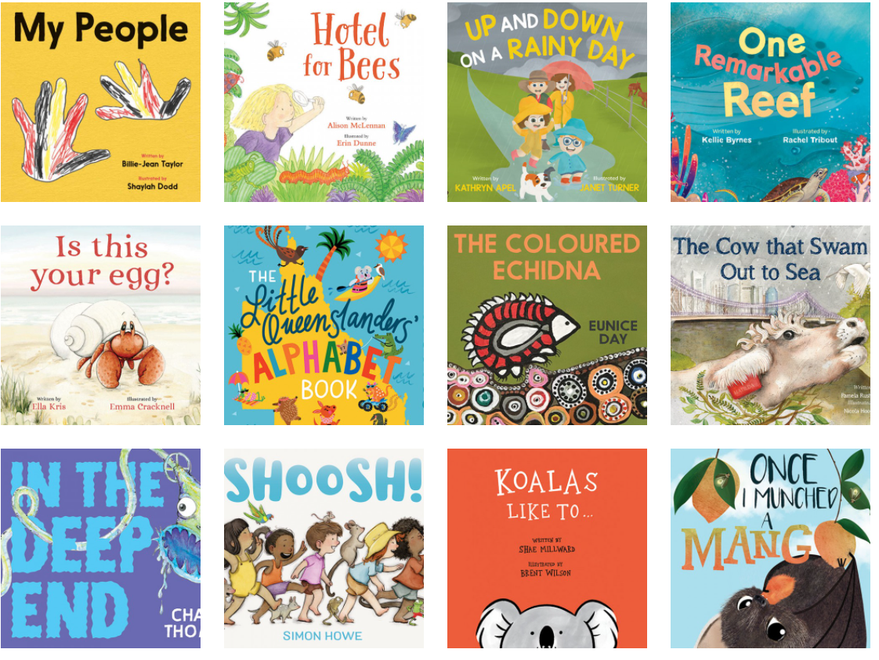
Stories for little Queenslanders
https://www.slq.qld.gov.au/first5forever/books

Slide 31

Learning from home
When schools closed in March 2020 (due to COVID-19) we aggregated our web presence of collection resources, online tools, supporting the Australian curriculum.
It was developed to support students, parents and teachers to inspire, challenge and engage.

Slide 32


Slide 33



Slide 34



Slide 35



Digital inclusion

Slide 36

Thank you!
Vicki McDonald
State Librarian and Chief Executive Officer
State Library of Queensland
vicki.mcdonald@slq.qld.gov.au
Twitter: coffeemiss
www.slq.qld.gov.au

