Slide 1

Leave no one behind:
A shared future for public libraries
Vicki McDonald AM FALIA
State Librarian and CEO, State Library of Queensland
President-elect, International Federation of Library Associations and Institutions

Slide 2

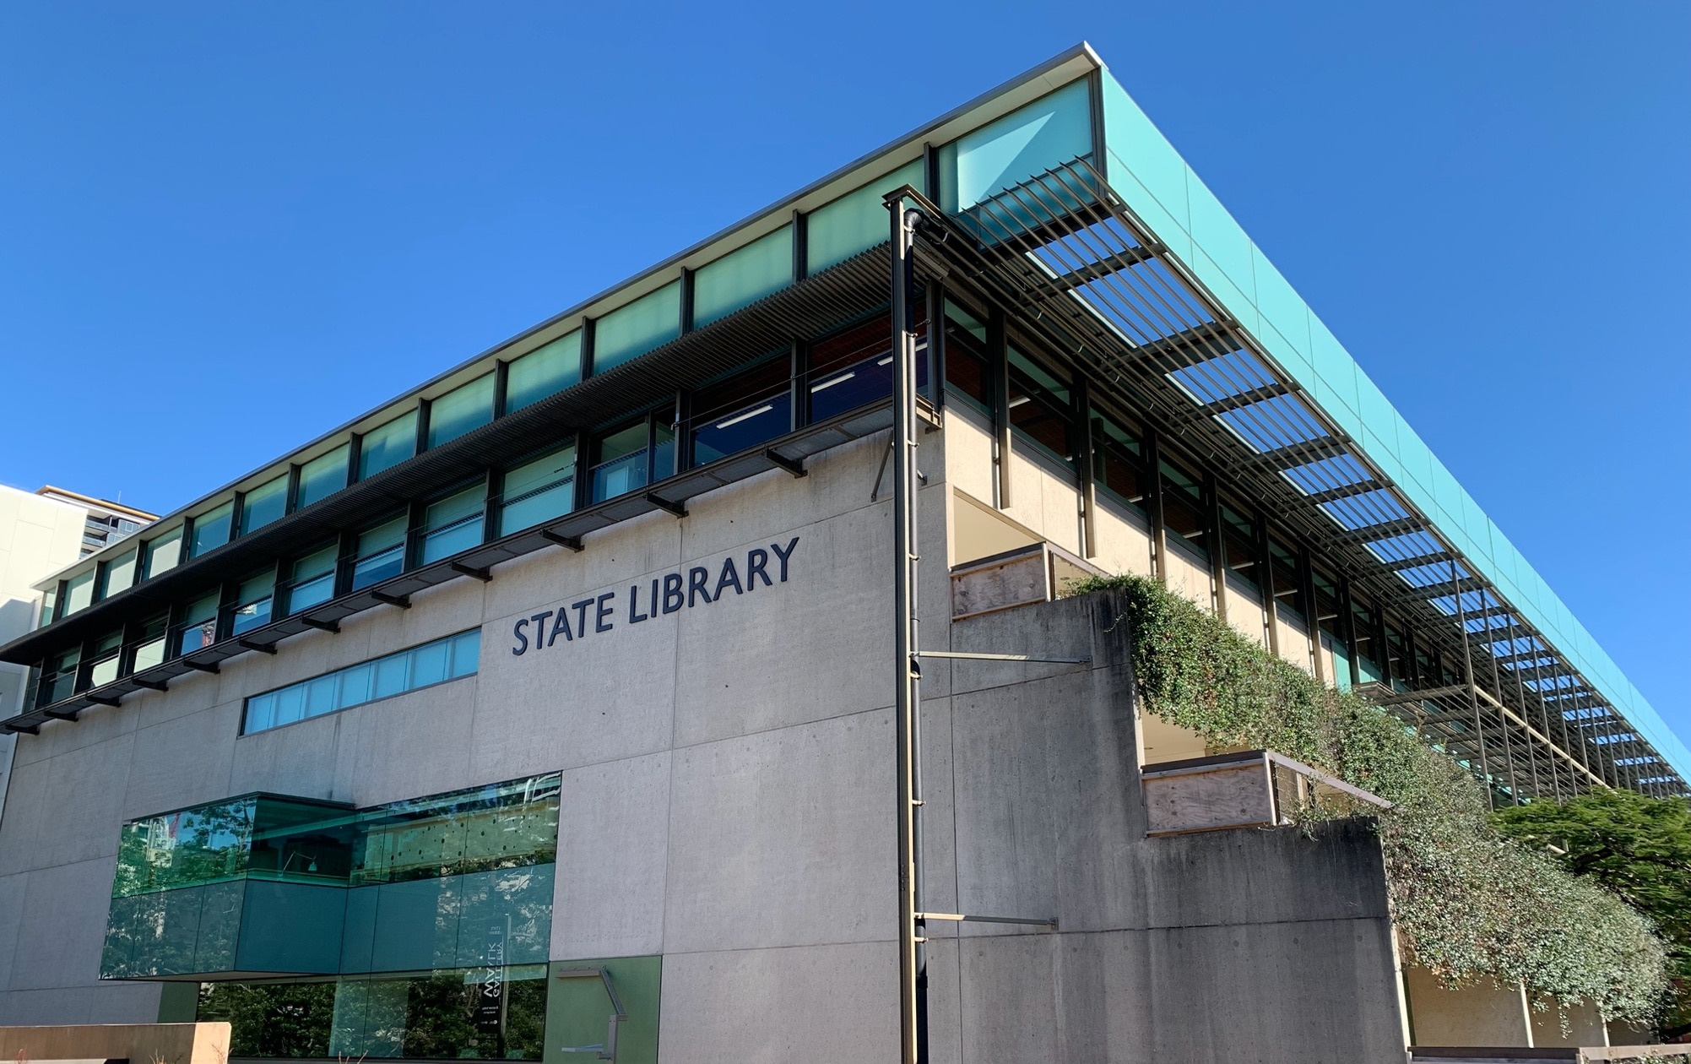

Slide 3


Slide 4


Slide 5


Slide 6

United Nations
2030 Agenda for Sustainable Development
Universal values
Human Rights approach
Leave no one behind
Gender equality and Women’s empowerment

Slide 7
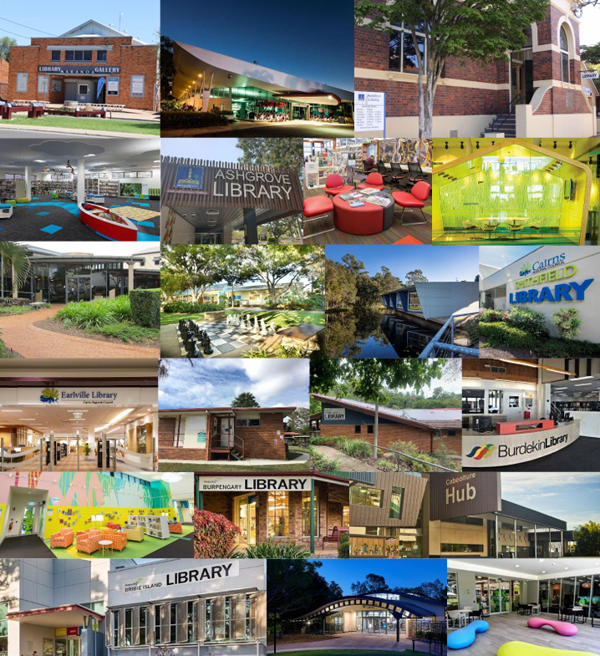
Public library network
More than 320 public libraries across Queensland
Queensland Government, through State Library of Queensland,
in partnership with 75 local governments

Slide 8
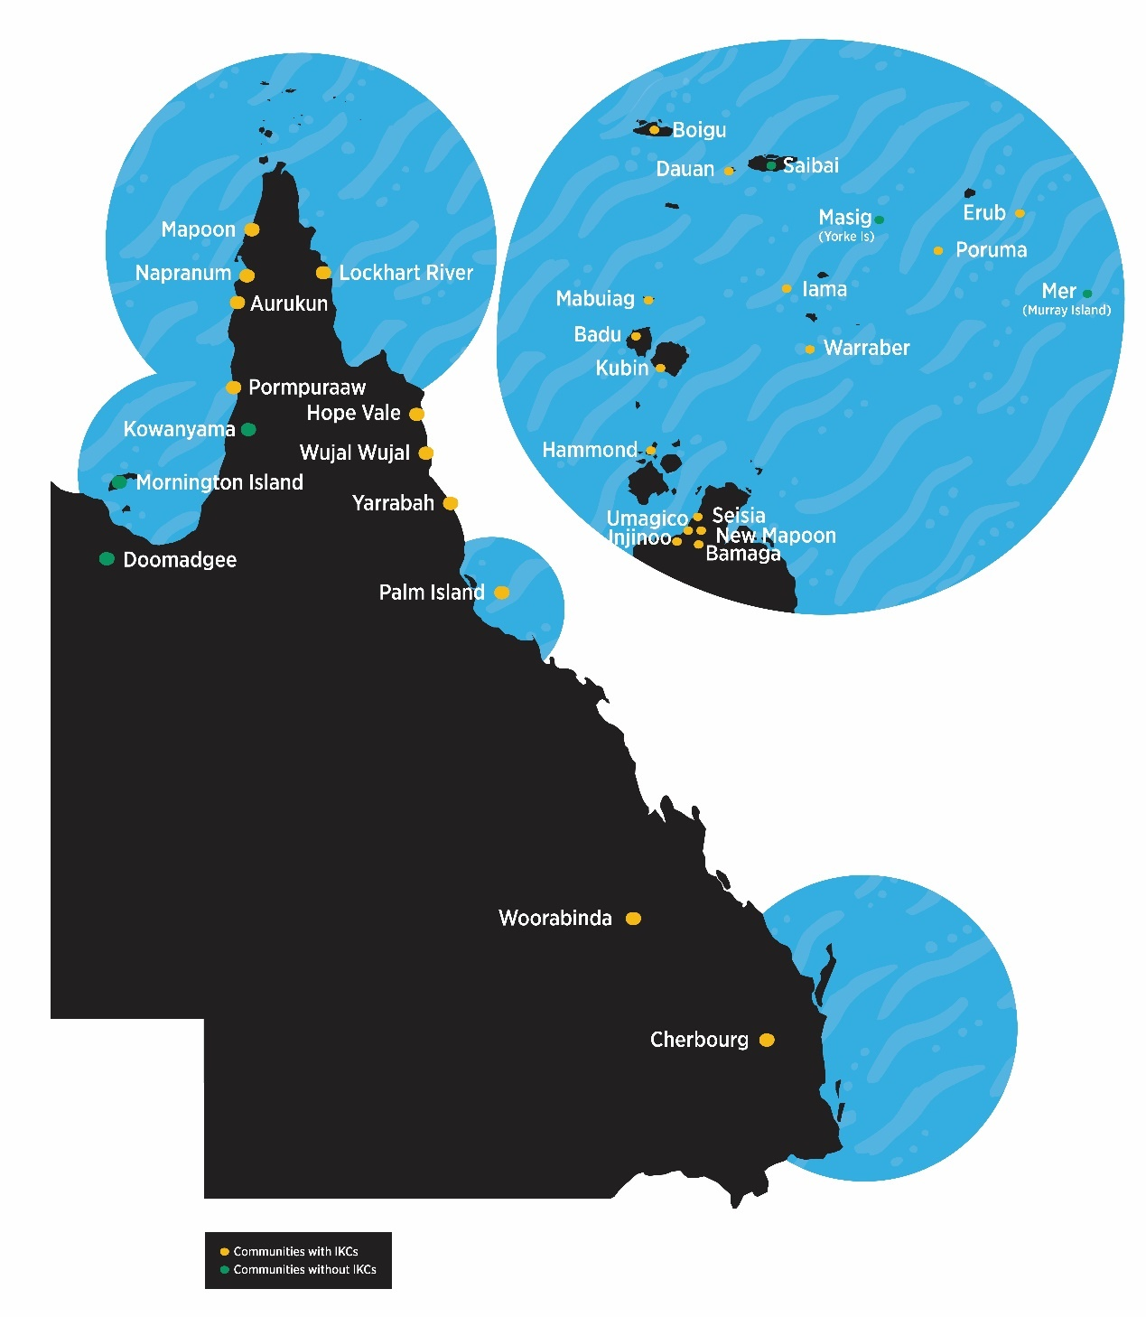
Public library network
26 Indigenous Knowledge Centres
12 Aboriginal and/or Torres Strait Islander Councils

Slide 9
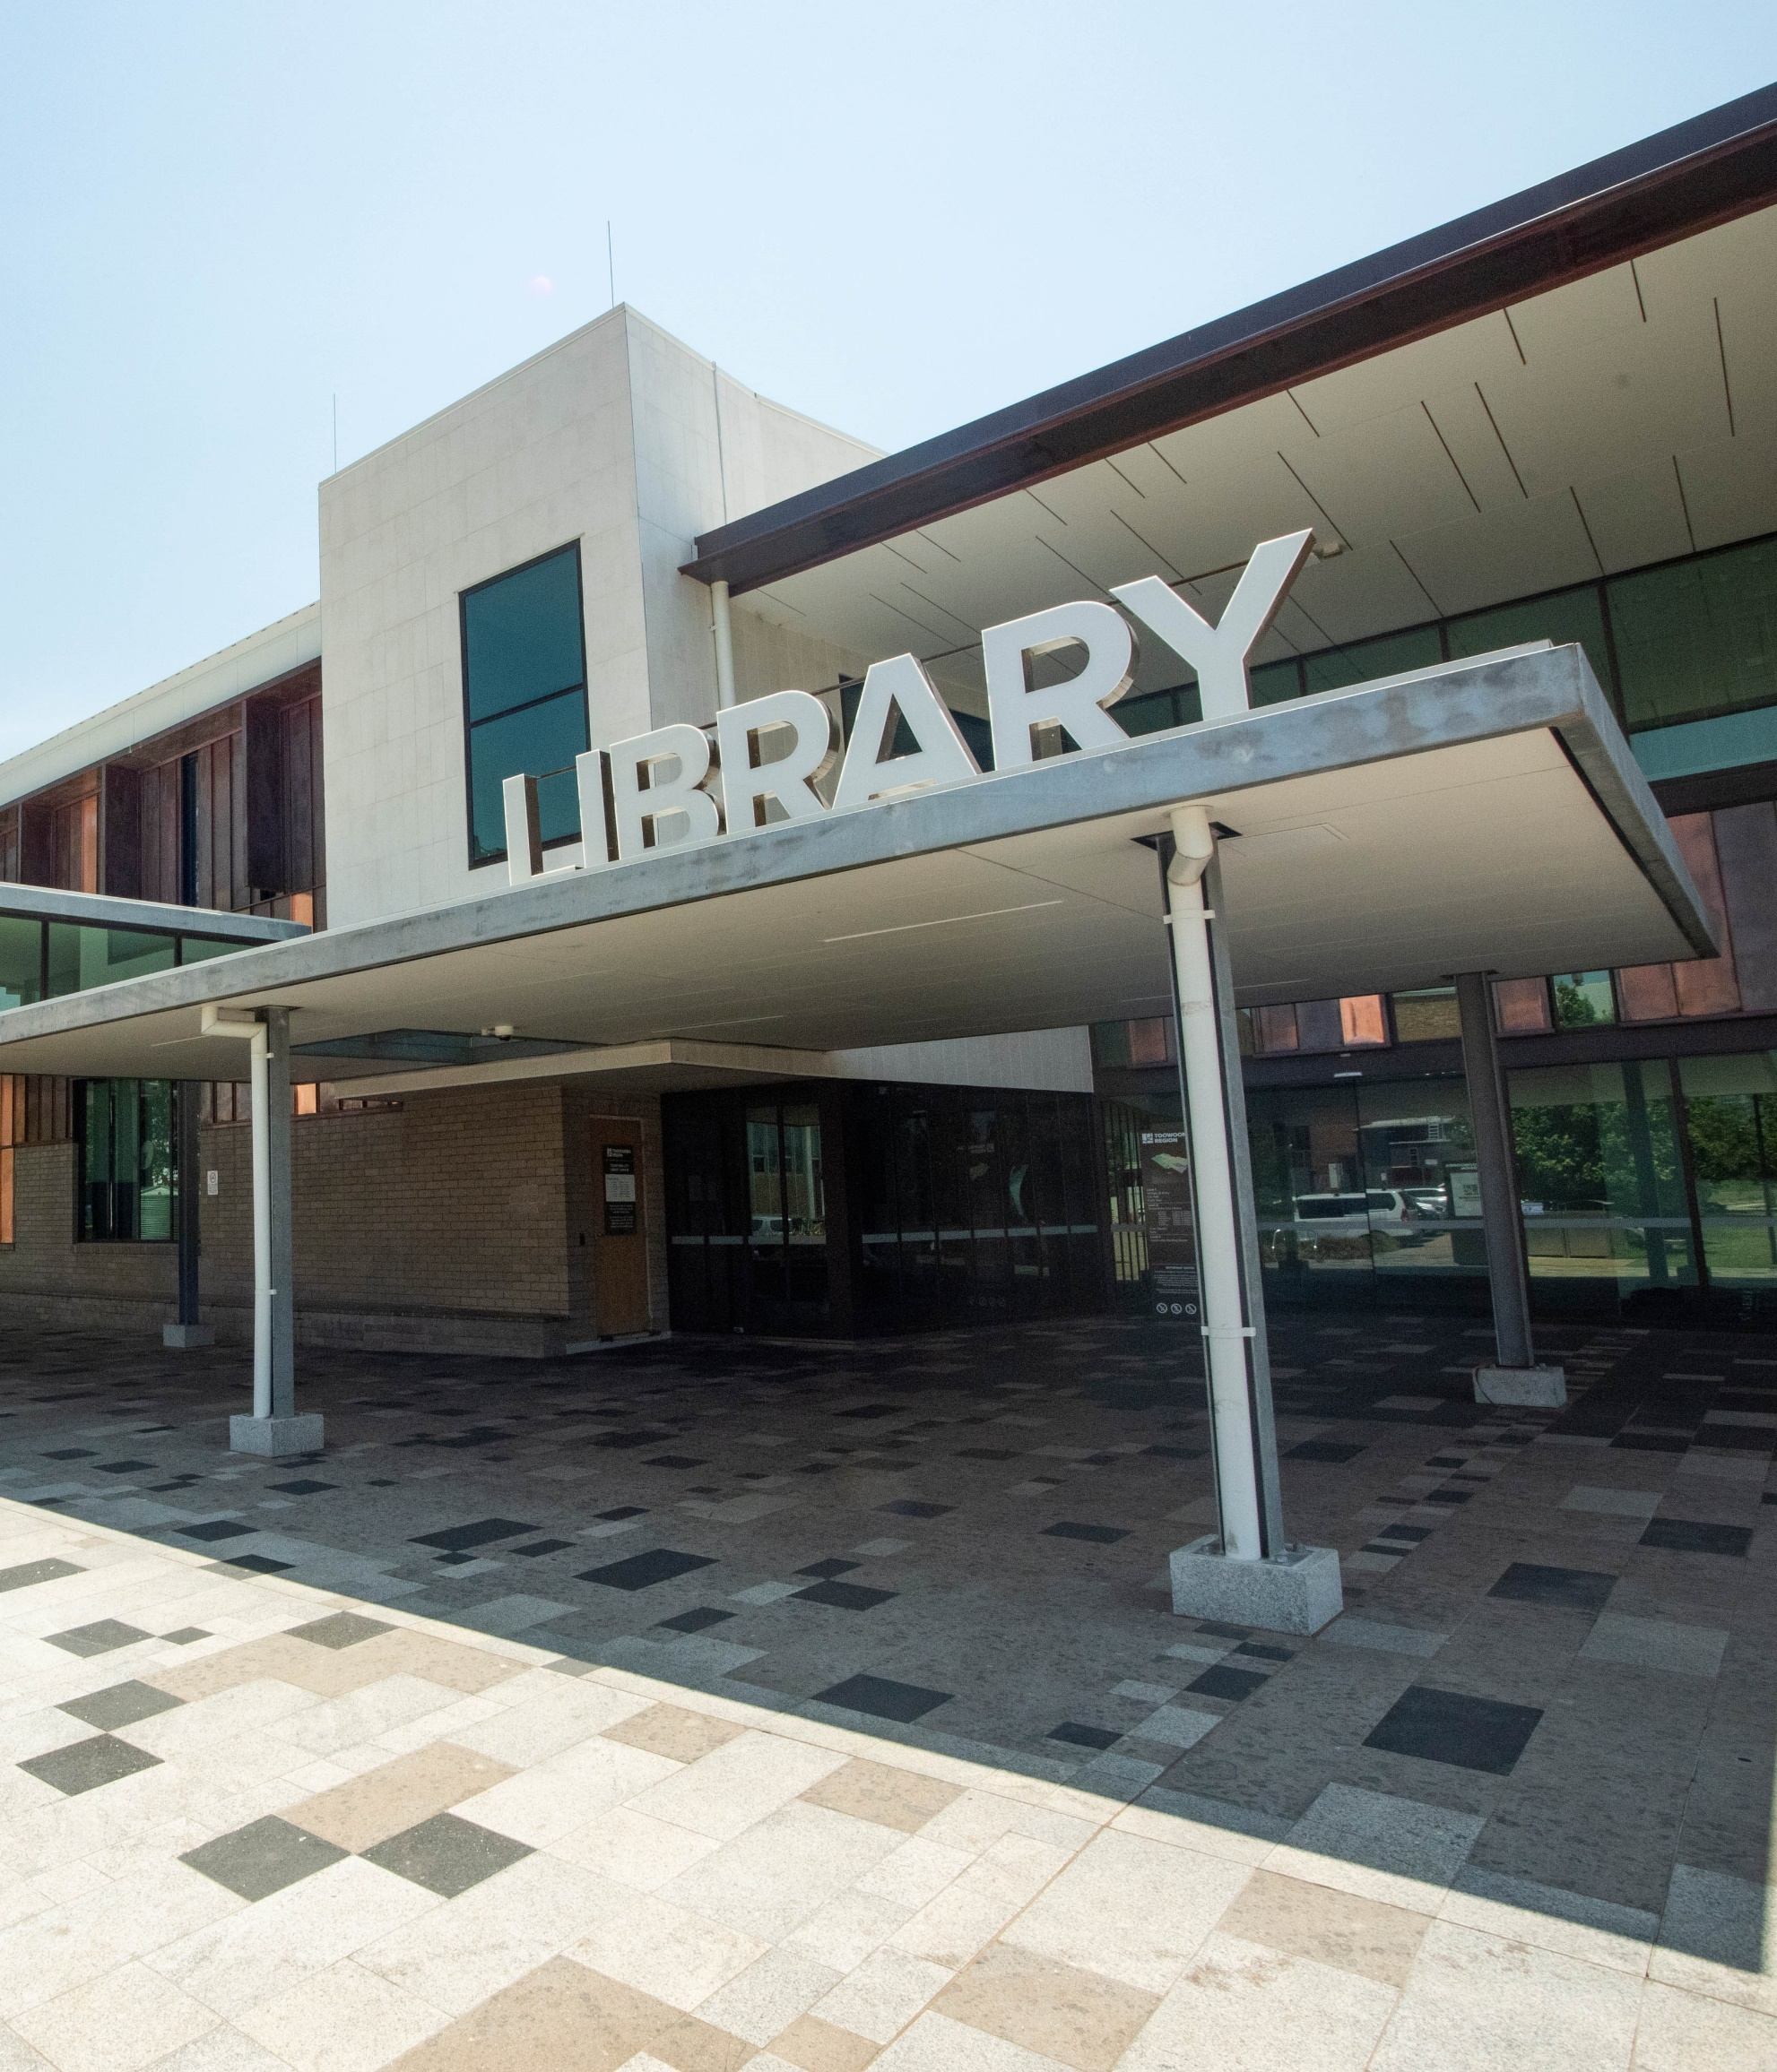
Public library partnership
$300M combined annual investment from state and local governments
Queensland Government annual investment
$26.3M Public Library Funding
$5M First 5 Forever

Slide 10
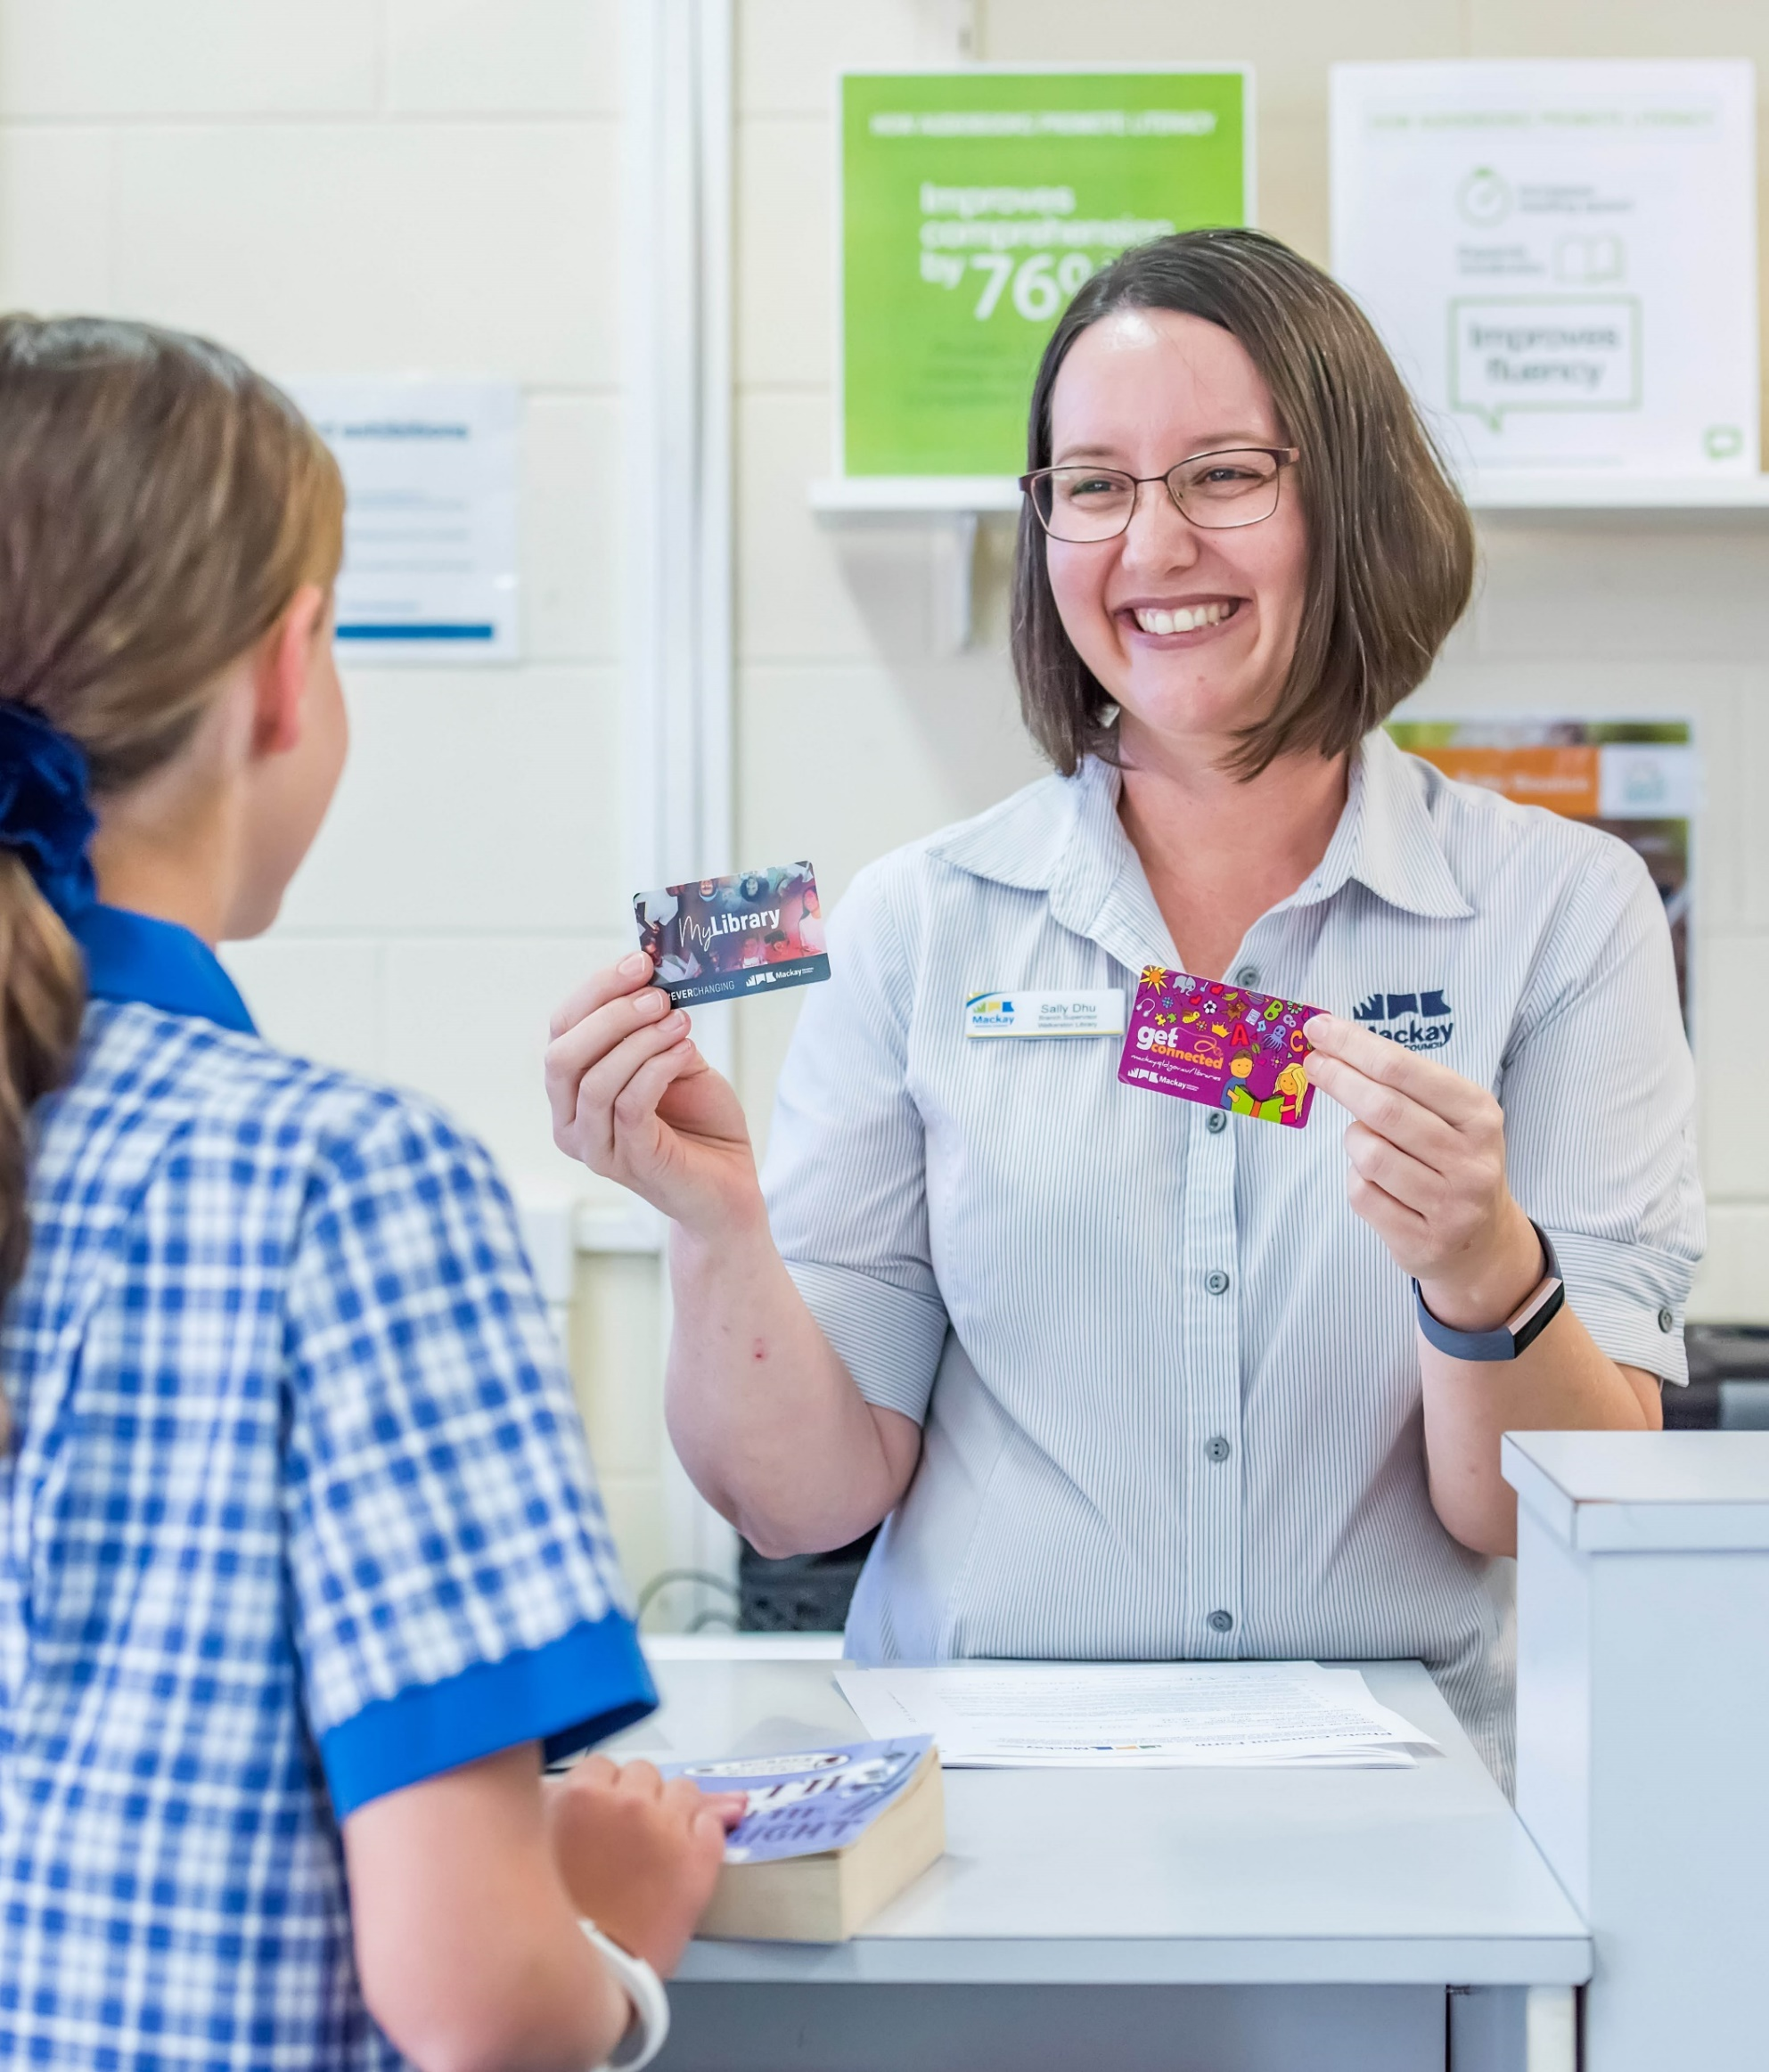
Public library reach
5.4M population of Queensland
40% library members
320+ public libraries serving communities as small as 200
234 McDonald’s restaurants in Queensland

Slide 11
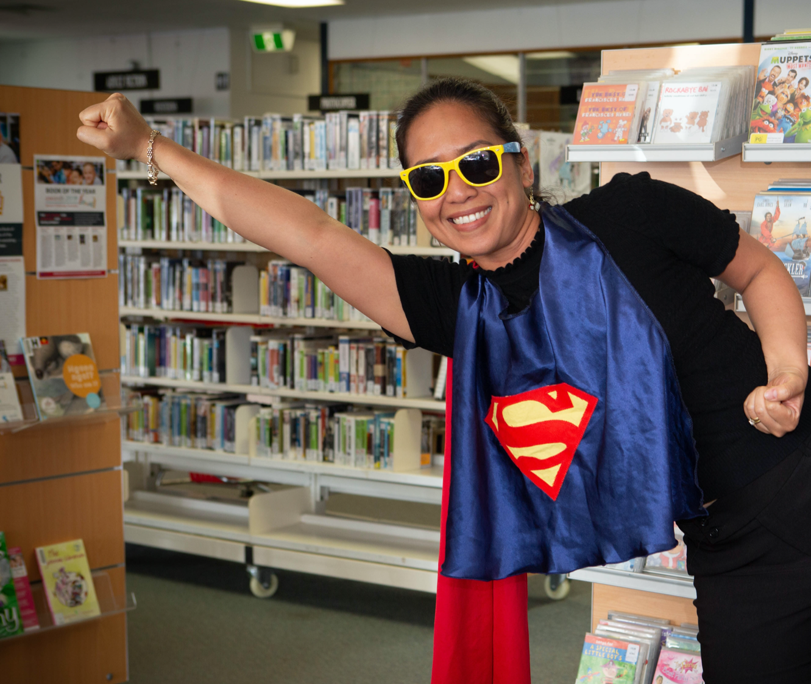
Public library expertise
1587 Full-time equivalent staff positions across Queensland
Valued for knowledge and skills
Respected by communities
Dedicated to local outcomes

Slide 12
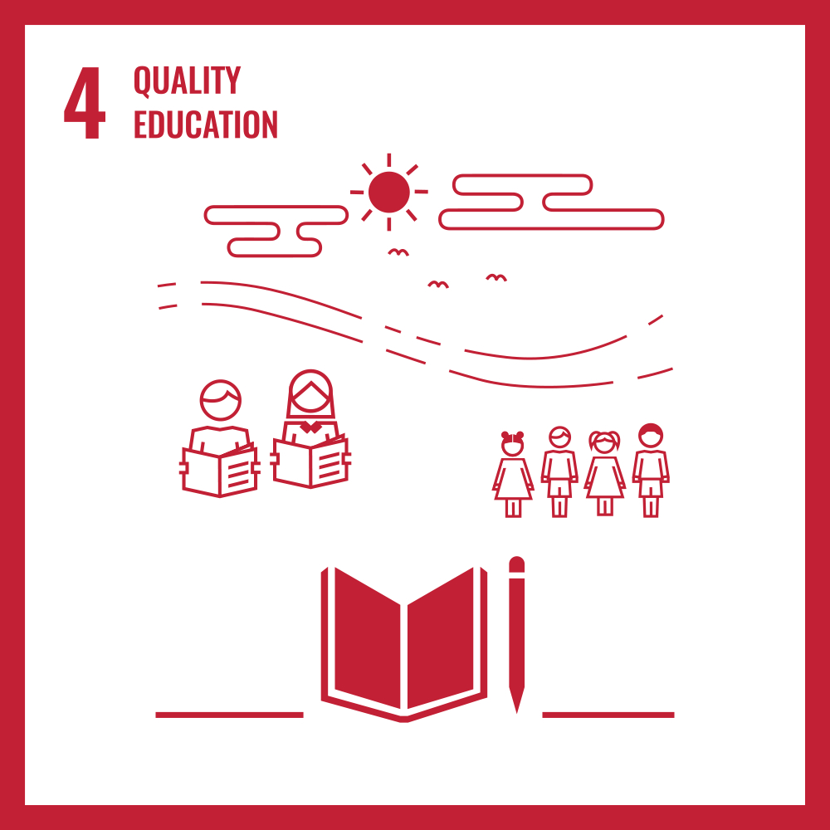
Goal 4
Quality education
Ensure inclusive and equitable quality education and promote lifelong learning opportunities for all

Slide 13

Target 4.2
By 2030, ensure that all girls and boys have access to quality early childhood development, care and pre-primary education so that they are ready for primary education
Indicator 4.2.1
Proportion of children aged 24–59 months who are developmentally on track in health, learning and psychosocial well-being, by sex
Indicator 4.2.2
Participation rate in organized learning (one year before the official primary entry age), by sex

Slide 14
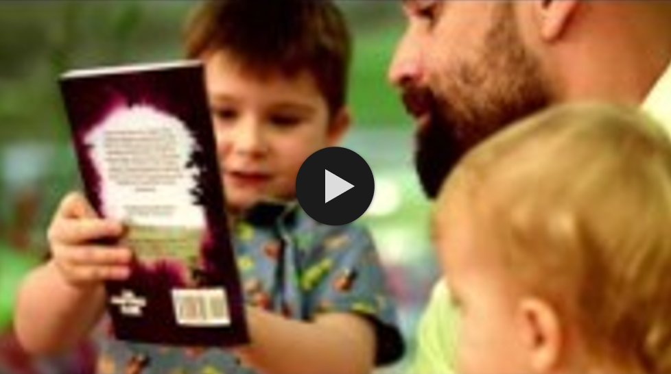
Notes:
Watch the First 5 Forever video - https://youtu.be/ubx4IJoNVVI

Slide 15

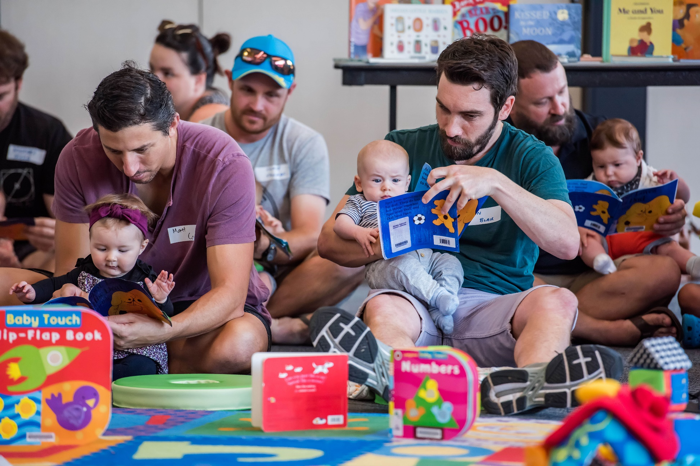
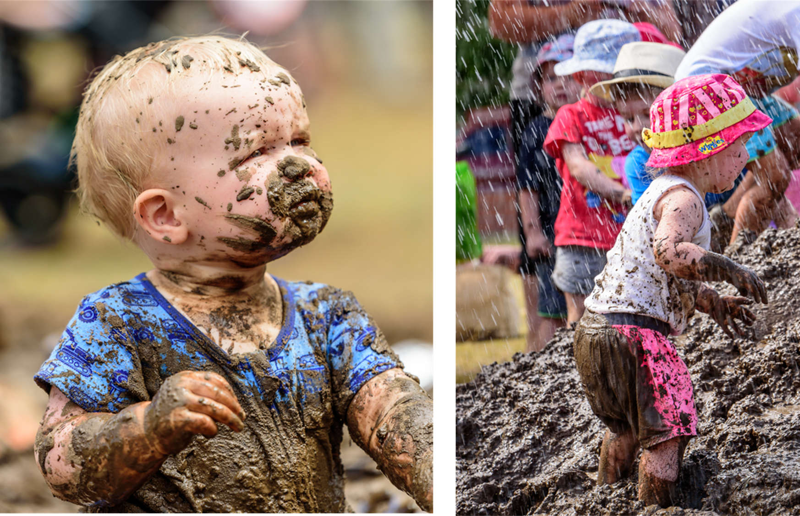
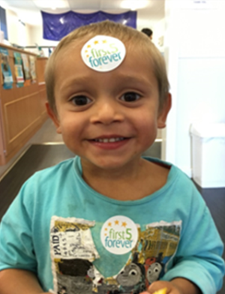
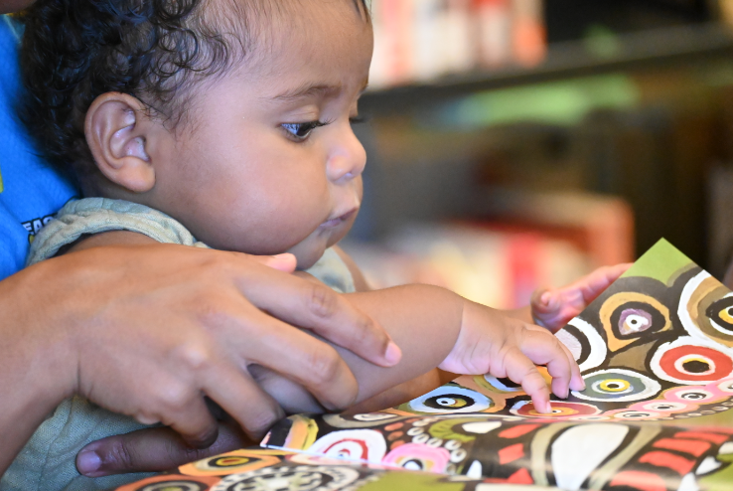


Slide 16
Target 4.4
By 2030, substantially increase the number of youth and adults who have relevant skills, including technical and vocational skills, for employment, decent jobs and entrepreneurship
Indicator 4.4.1
Proportion of youth and adults with information and communications technology (ICT) skills, by type of skill

Slide 17
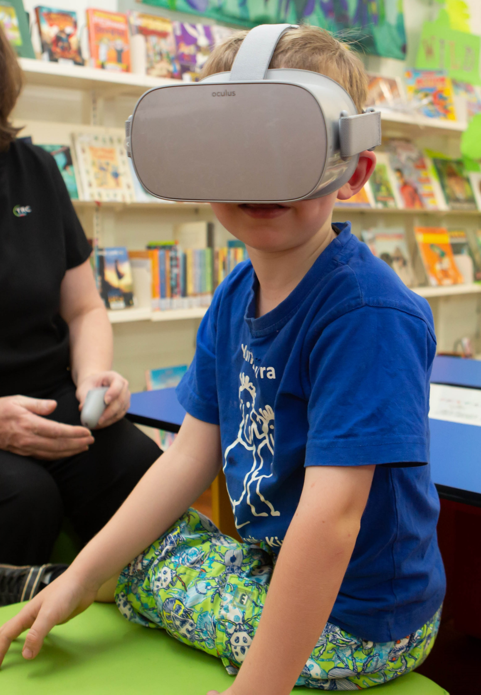



Slide 18
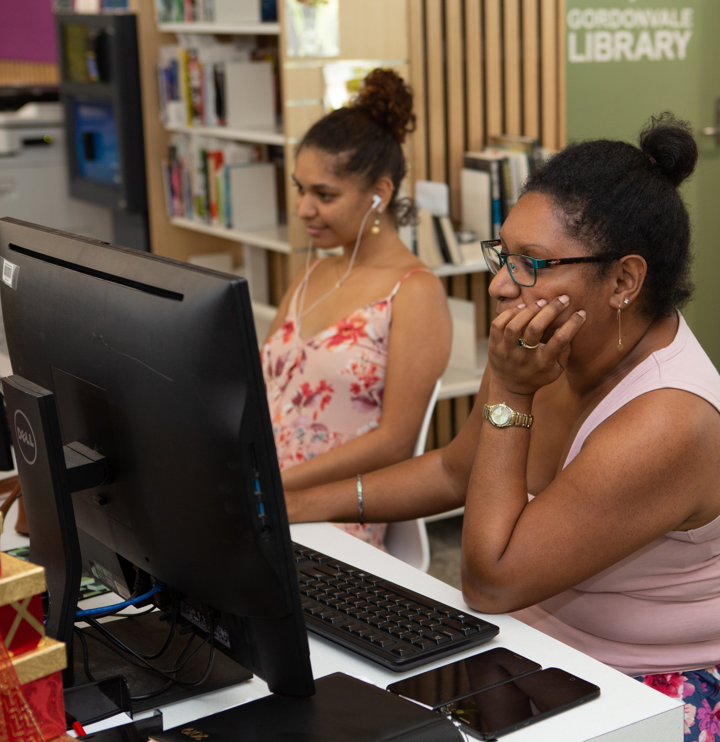


Slide 19
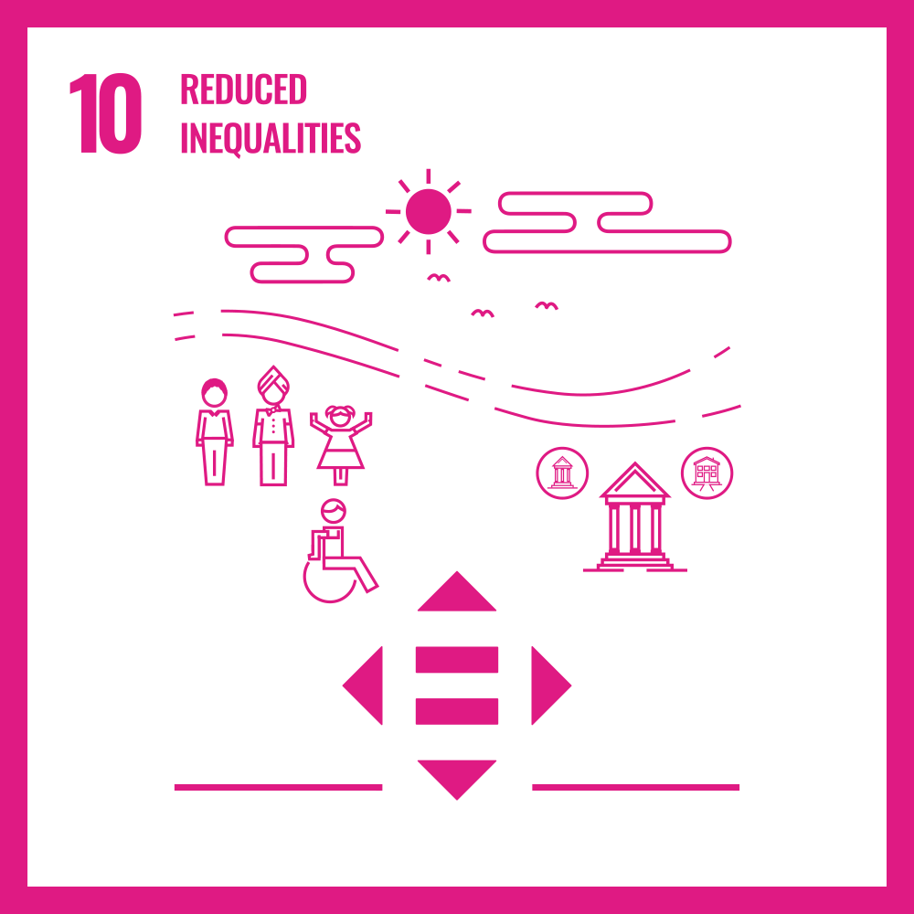
Goal 10
Reduced inequalities
Reduce inequality within and among countries and populations by extending access to technologies and knowledge to disadvantages segments of society.

Slide 20
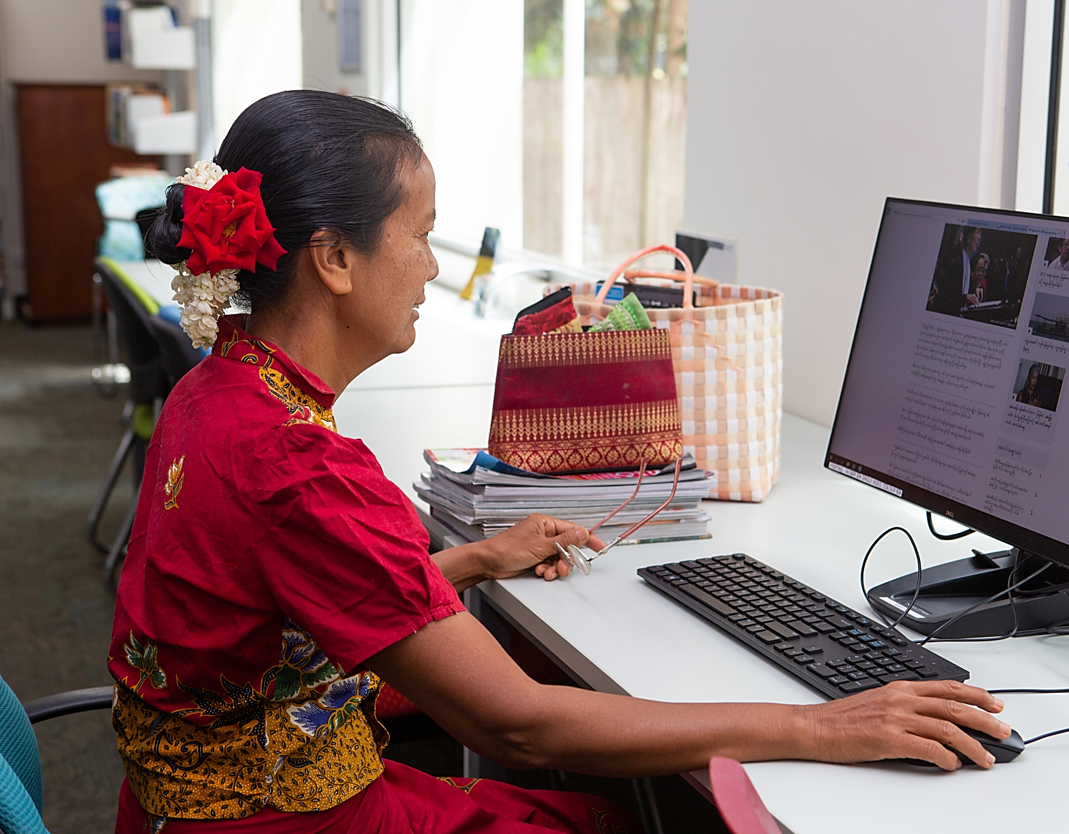
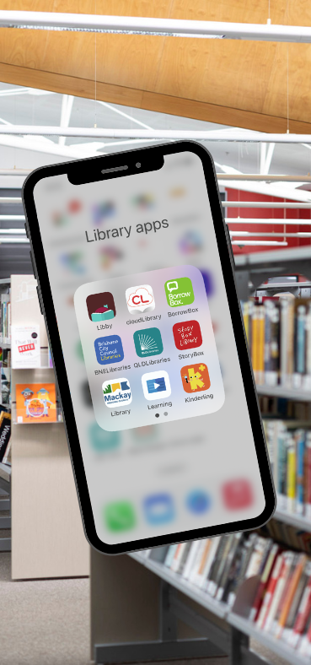

Slide 21




Slide 22
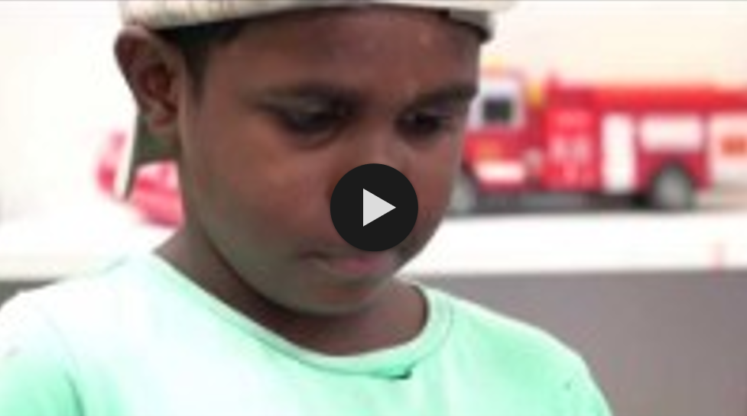
Notes:
Watch Deadly Digital Communities video - https://youtu.be/KH5wqQXhdbk

Slide 23

10-year roadmap for public libraries
Positions Queensland public libraries as key community and cultural hubs now and into the future
responds to current data, research, evaluations and policies
celebrates the reach and investment in public libraries
commits to shared values and ways of working
invites others to partner with public libraries
identifies targets, milestones, and actions to drive locally relevant outcomes and grow the collective impact of the network
positions Queensland public libraries – nationally and internationally

Slide 24
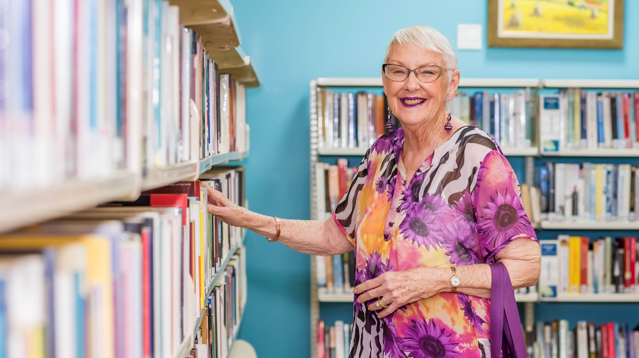
Love
your library research
2022

Slide 25
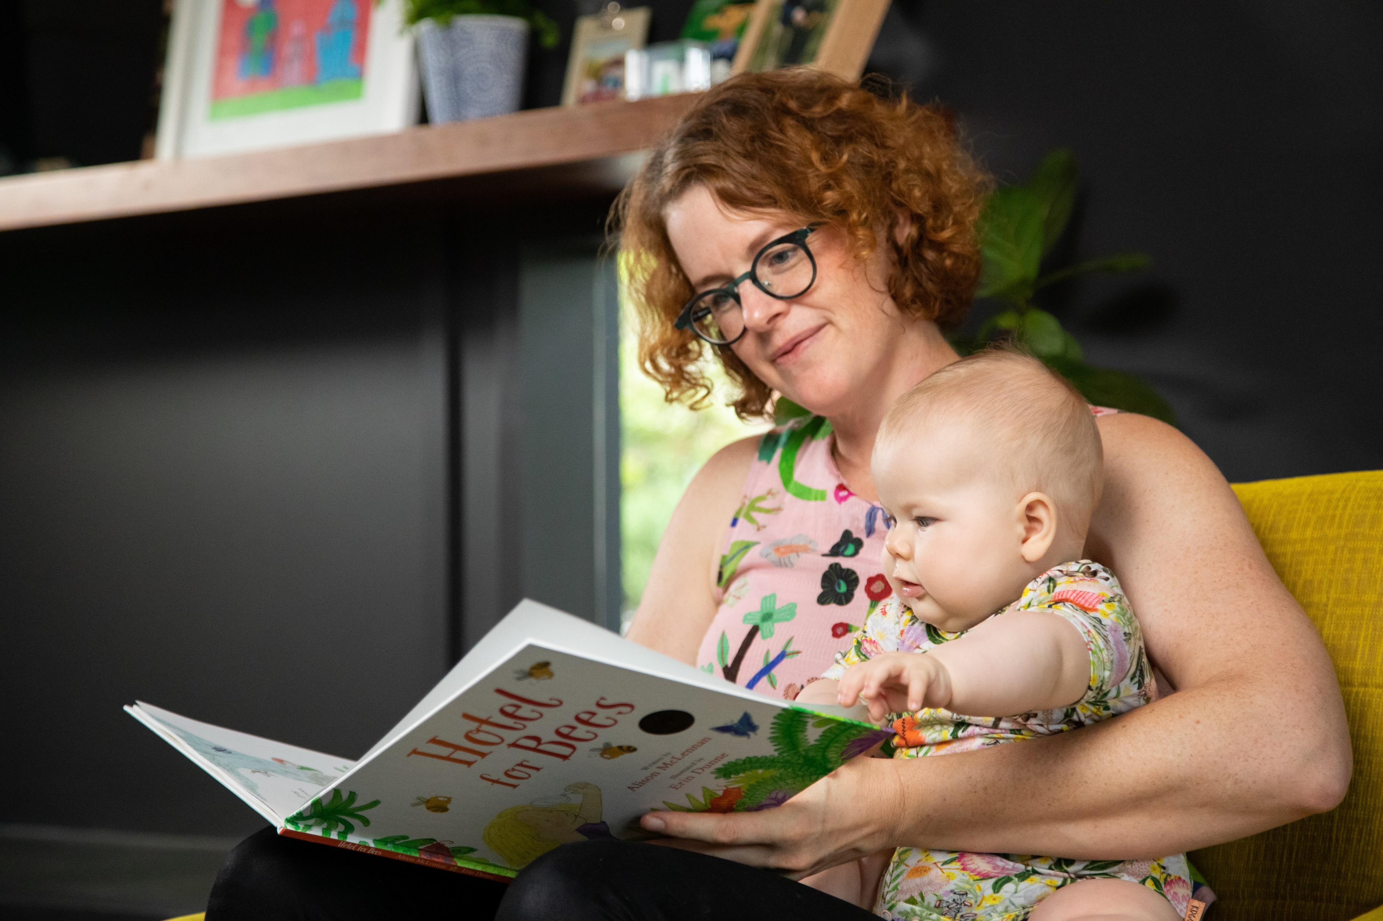
First 5 Forever evaluation report 2019–2022

Slide 26
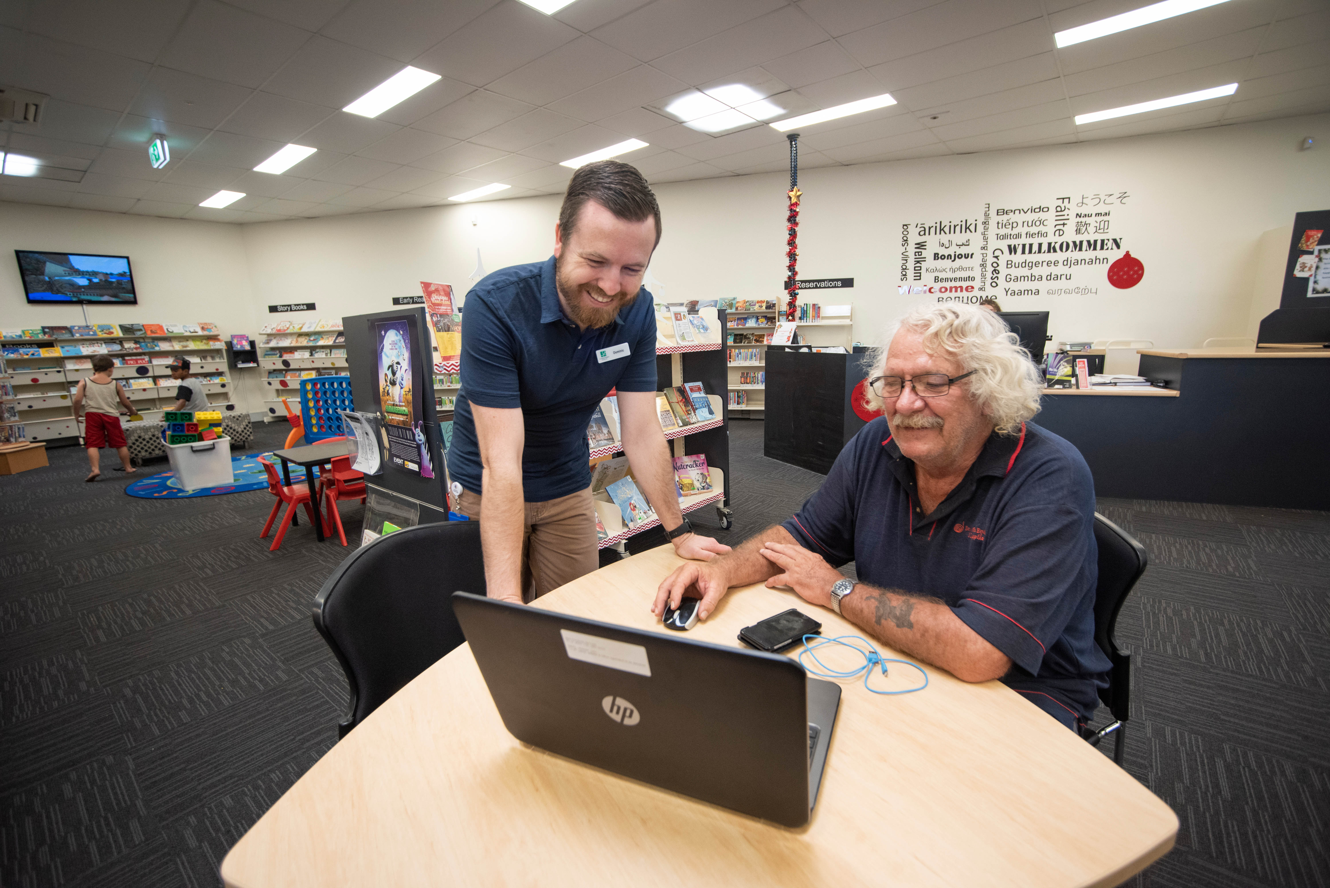
Digital inclusion programs evaluation
2016–2022

Slide 27
Provocation questions
What is the vision for your community in the next 10 years?
What role can libraries play in contributing to a better future for your community?
Notes:
TBC
QR code for SLIDO

Slide 28

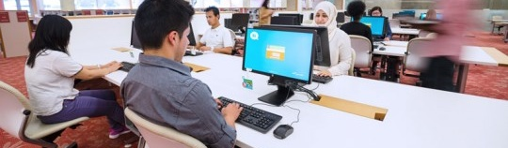

Today one of our Infozone regular visitors stopped by the Welcome Desk to share his excitement with Liam about his new job.
He talked about being able to pay his bills and even eat at a buffet, and thanks the library for its services that allowed him time and computer access to submit applications.
Notes:
Temp pics added – will follow up with Marketing for better pic

Slide 29


