Slide 1
BRINGING IT ALL TOGETHER vicki mcdonald AM FALIA
ALIA INFORMATION ONLINE
18 MAY 2023

Slide 3
A man* is known by the company he keeps
AESOP
*In this case a woman

Slide 4
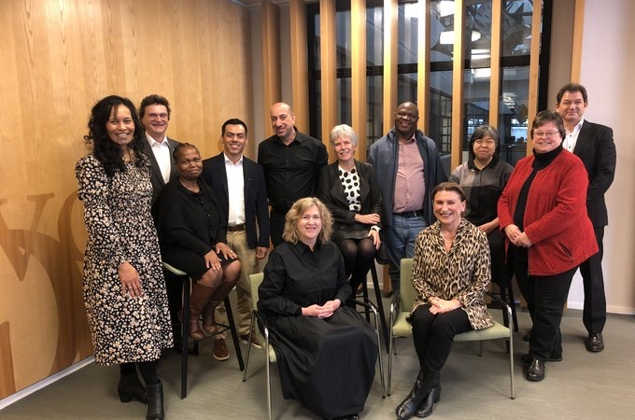
Back row: Te Paea Paringtatai, Halo Locher, Nthabiseng Kotsokoane, Jonathan Hernandez Perez, Ayub Khan, Kirsten Boelt, Mandla Ntombela, Yasuyo Inoue, Helen Mandl, Jaap Naber.
Front row: Vicki McDonald, Barbara Lison
Notes:
Back row : Te Paea, Halo Locher, Nthabi, Jonathan Hernandez, Ayub, Kirsten, Mandla, Yasuyo, Helen Mandl, Jaap
Front row: Vicki McDonald, Barbara Lison
https://www.ifla.org/units/governing-board/committee/

Slide 5
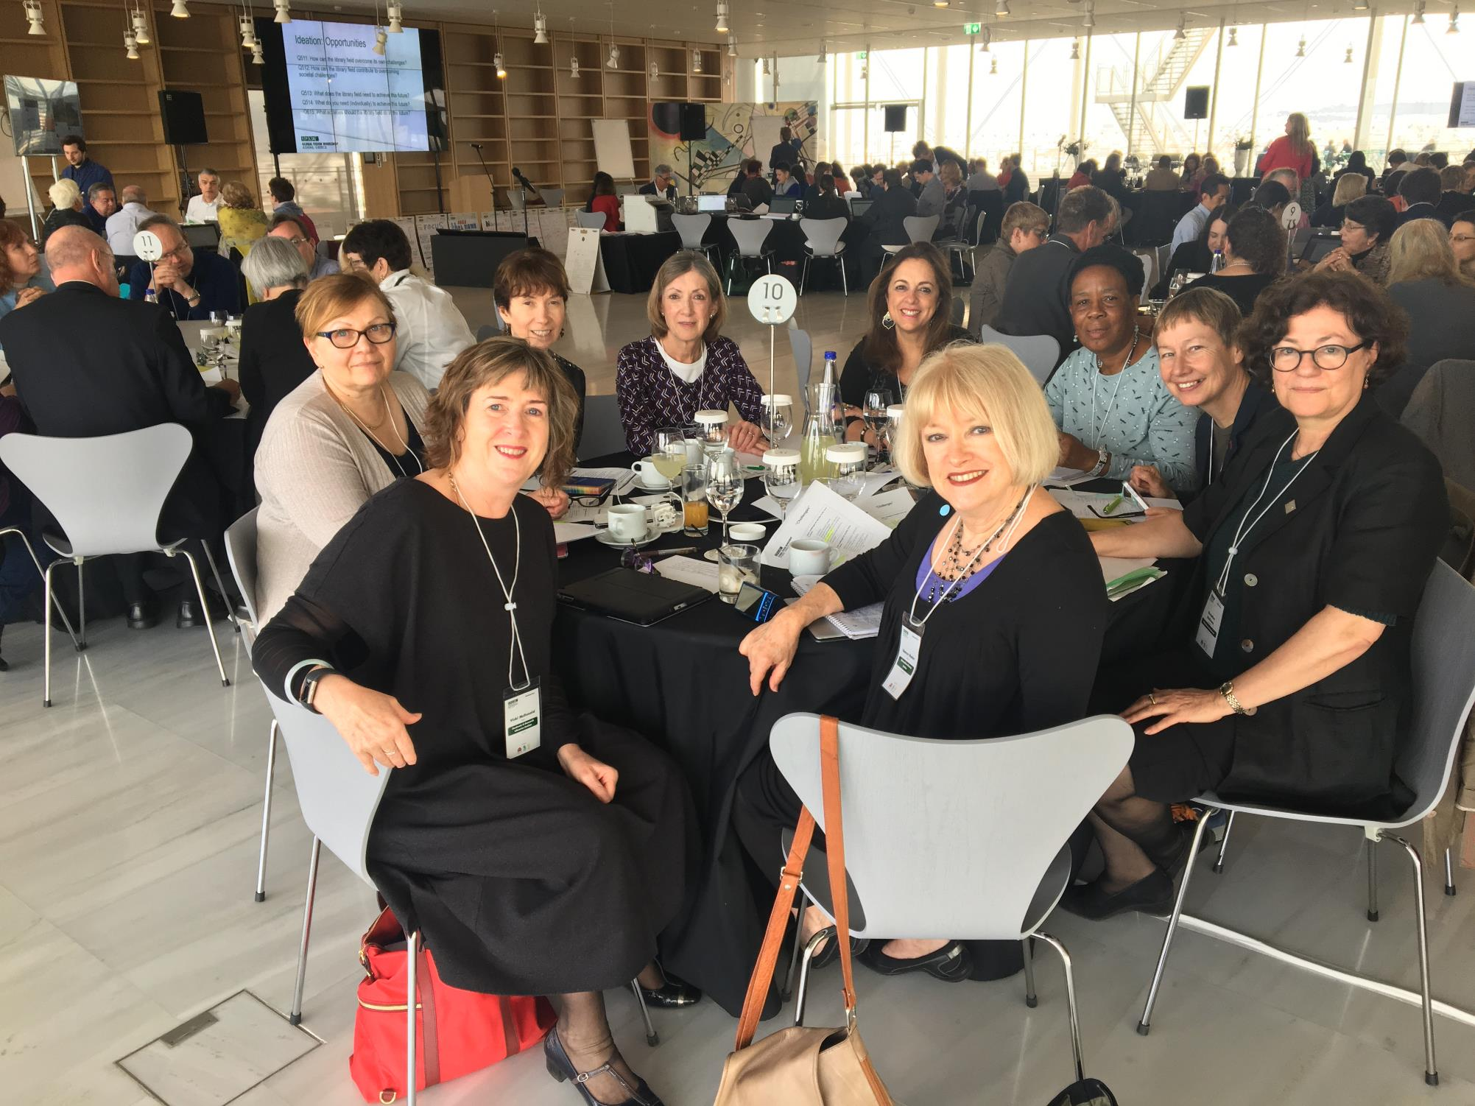
IFLA Global Vision Workshop – Athens, Greece – April 2017
Notes:
IFLA Global Vision Workshop April 2017

Slide 6
The endorsement of the principles of freedom of access to information, ideas and works of imagination and freedom of expression embodied in Article 19 of the Universal Declaration of Human Rights
The belief that people, communities and organisations need universal and equitable access to information, ideas and works of imagination for their social, educational, cultural, democratic and economic well-being
The conviction that delivery of high quality library and information services helps guarantee that access
The commitment to enable all Members of the Federation to engage in, and benefit from, its activities without regard to citizenship, disability, ethnic origin, gender, geographical location, language, political philosophy, race or religion
VALUES
Notes:
IFLA core values

Slide 7
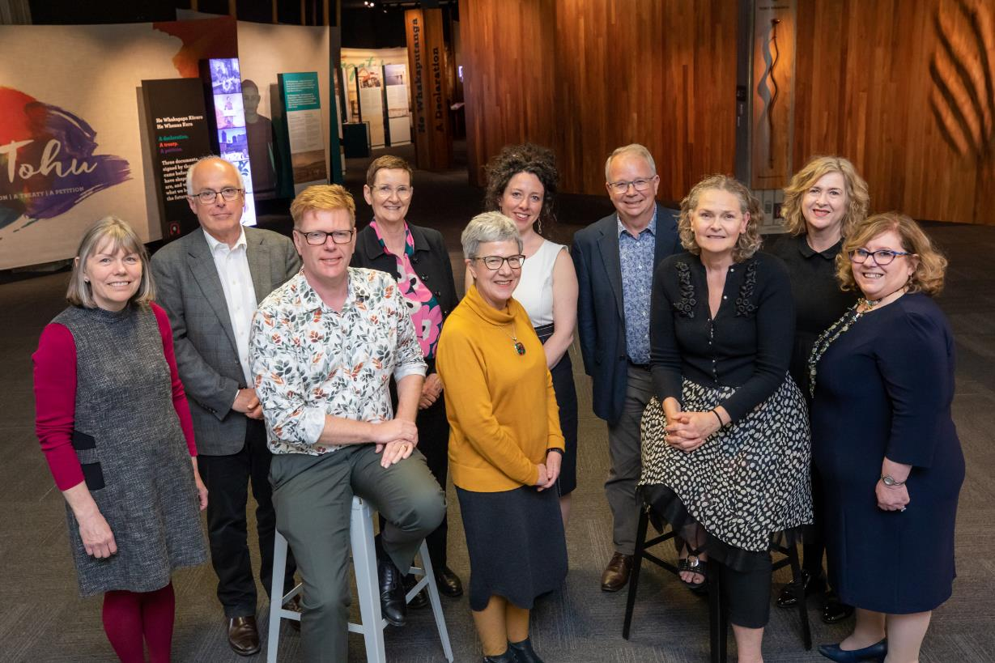
Sue McKerracher (TAS), John Vallance (NSW), Patrick Gregory (NT), Catherine Clark (WA), Marie-Louise Ayres (NLA), Barbara Lemon (NSLA), Geoff Strempel (SA), Rachel Esson (NLNZ), Vicki McDonald (QLD), Vanessa Little (ACT)
Notes:
NSLA Board: Sue McKerracher, John Vallance, Patrick Gregory, Catherine Clark, Marie-Louise Ayres, Barbara Lemon, Geoff Strempel, Rachel Esson, Vicki McDonald, Vanessa Little

Slide 8
Our collections are connected, rich and sustainable
Libraries are at the heart of the cultural life of Australia and Aotearoa New Zealand
Our workforce is skilled and diverse
Libraries are trusted and valued
Notes:
https://www.nsla.org.au/about-nsla/strategic-plan/

Slide 9
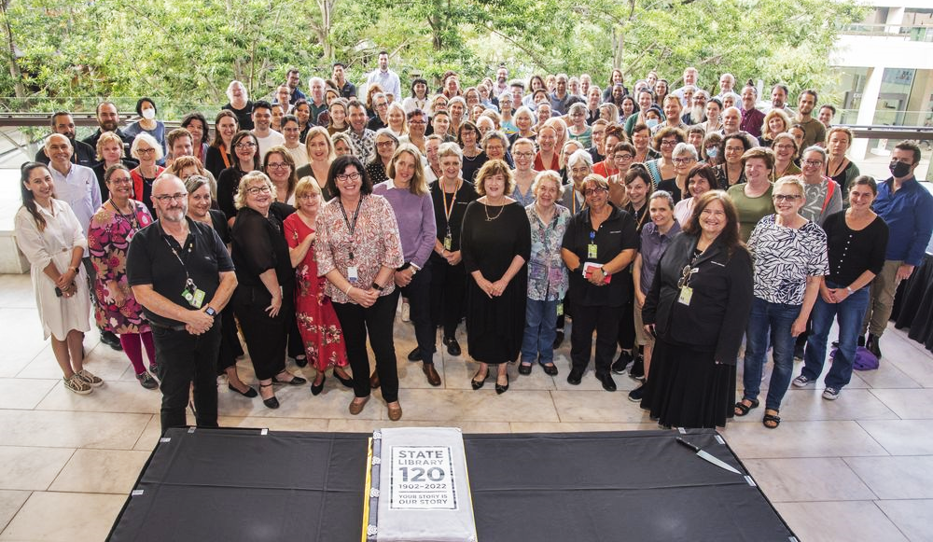
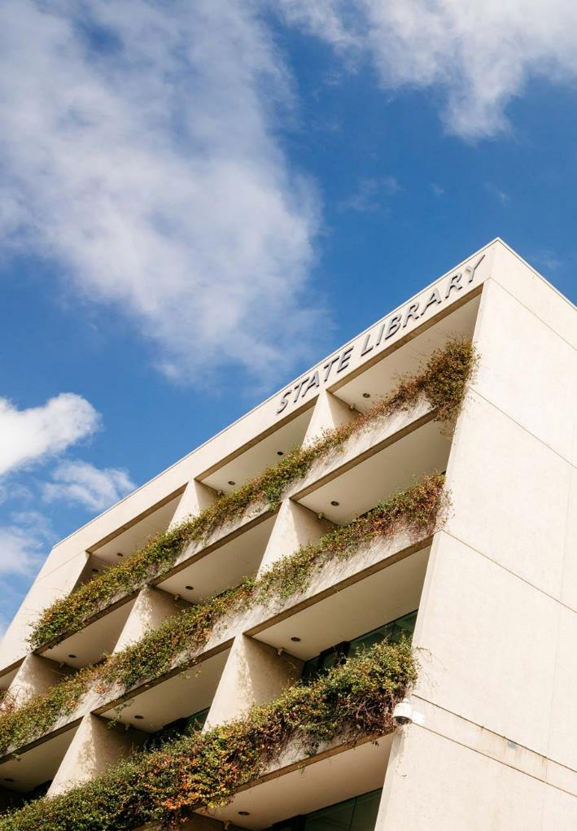
STATE LIBRARY OF QUEENSLAND
State Library of Queensland staff celebrating 120-year anniversary, 2022. State Library of Queensland, Josef Ruckli.
Notes:
https://www.slq.qld.gov.au/

Slide 10
OUR VISION
A library of influence, inspiring and connecting people through knowledge, storytelling and creativity
Notes:
https://www.slq.qld.gov.au/about/corporate-information/plans

Slide 11
OUR ENDURING VALUES
Strategic Plans 2017-2022
Strategic Plan 2023-27
We provide free and equitable access
We seek diverse voices
We share We belong to the community
Access is free and equitable. We serve people everywhere in Queensland, onsite and online
Diversity is celebrated. We seek and share the diverse stories of Queenslanders
First Nations people and their knowledge, strength and resilience are centred. We are committed to res pectful processes of truth-telling
Our workplace is safe and purposeful. We respect the expertise of our people
Notes:
https://www.slq.qld.gov.au/about/corporate-information/plans

Slide 12
Be clear about your purpose
Be clear about your role
Be clear about whom your serve
Be driven by your values
Be authentic
PURPOSEFUL LEADERSHIP
Foreign Minister Julie Bishop and the Governor-General Her Excellency the Honourable Quentin Bryce AC CVO, Department of Foreign Affairs and Trade, 10 December 2013.
Notes:
HBR article → https://hbr.org/2022/04/5-principles-of-purposeful-leadership

Slide 13
Future communities Preparing people, customers and communities for the future
Future libraries Creating inclusive and accessible digital libraries and services
Our sustainable future
Building sustainable workplaces, workforces and services
SHAPING THE FUTURE
Notes:
CONFERENCE THEME AND SUB THEMES

Slide 14
FUTURE COMMUNITIES
PREPARING PEOPLE, CUSTOMERS AND COMMUNITIES FOR THE FUTURE

Slide 15
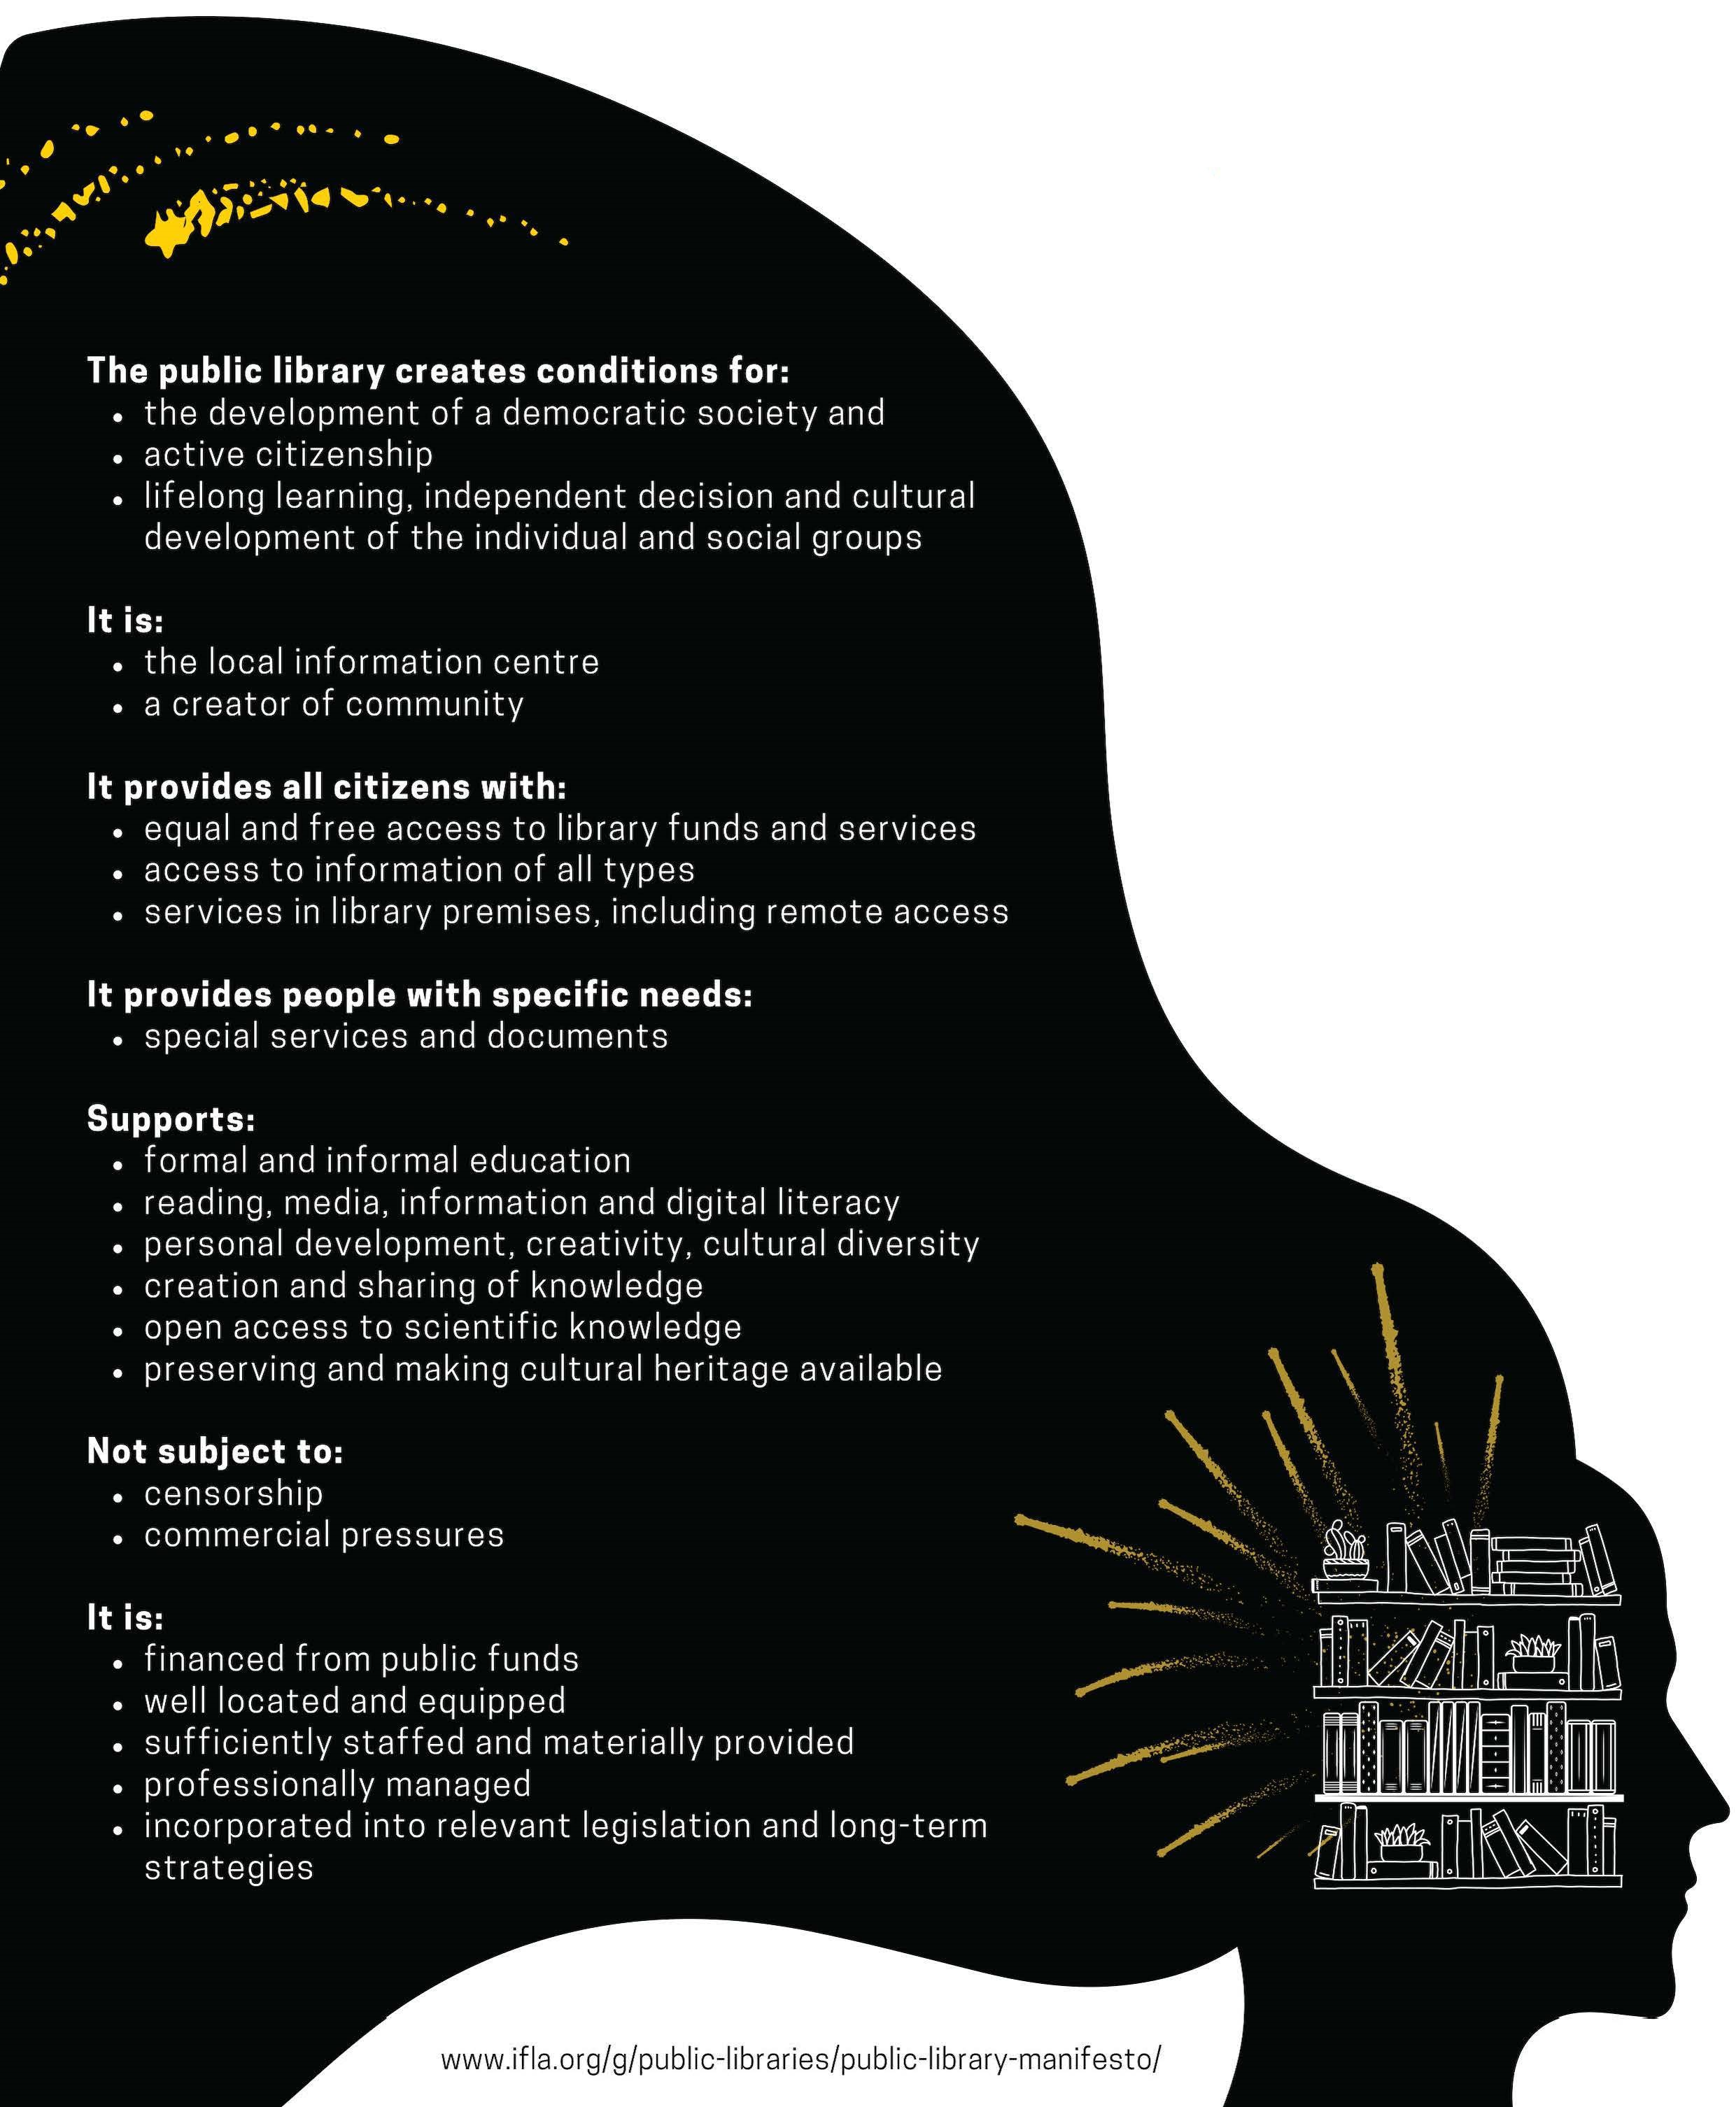
Notes:
https://www.ifla.org/public-library-manifesto/

Slide 16
Notes:
https://sdgs.un.org/goals

Slide 17
United Nations​
2030 Agenda For Sustainable
Development ​
​
Universal Values​
​
Human Rights approach​
Leave No One Behind​
Gender equality and women’s empowerment
Notes:
https://sdgs.un.org/goals

Slide 18
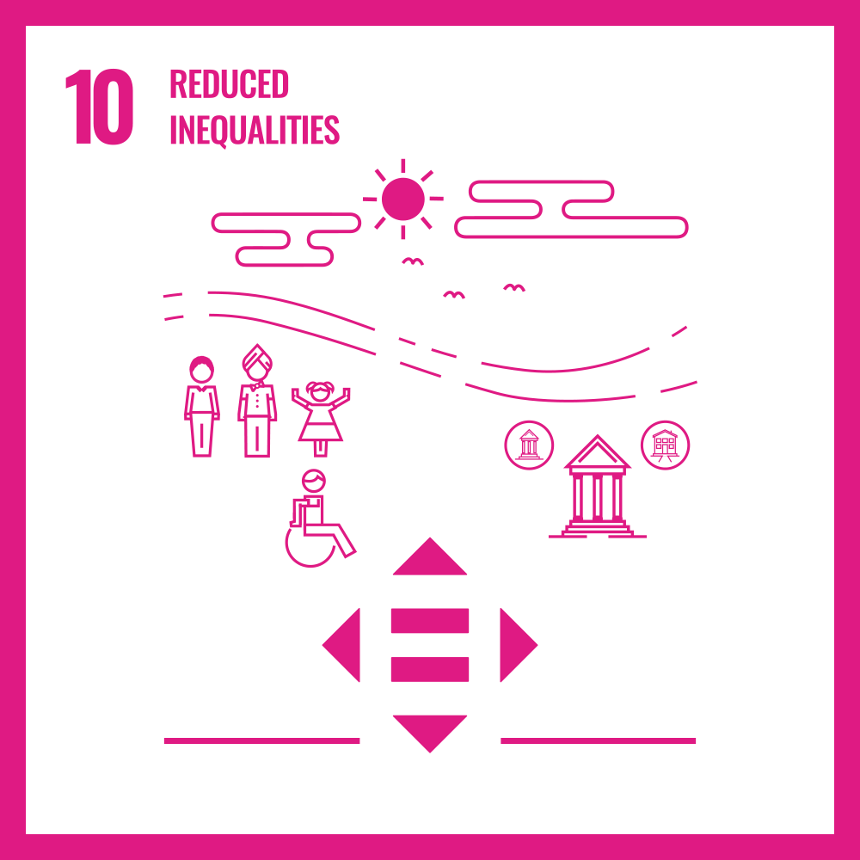
GOAL 10​
​
Reduced inequalities​
​
Reduce inequality within and among countries and populations by extending access to technologies and knowledge to disadvantaged segments of society.​
Notes:
https://sdgs.un.org/goals/goal10

Slide 19
Measuring Australia’s Digital Divide
Access
Affordability
Digital ability
AUSTRALIAN DIGITAL INCLUSION INDEX
Australian Digital Inclusion cover image: 2021.
Notes:
https://www.digitalinclusionindex.org.au/

Slide 20
National access score
69.4 in 2020 | 70 in 2021
Groups who have not improved
Mobile-only users (43.4 )
Over 75 years of age (53.5)
Did not complete secondary school (57.0)
Rent from a public housing authority (57.2)
Lowest income quintile (57.7)
Notes:
https://www.digitalinclusionindex.org.au/digital-inclusion-the-australian-context-in-2021/

Slide 21
National statistics
Divide between regional and metropolitan is marked
Australians who live alone are less included than families with children
Digital inclusion increases with education, employment and income
28% of Australians are excluded or highly excluded
14% of Australians cannot afford reliable connectivity
9.6% are mobile only users
Notes:
https://www.digitalinclusionindex.org.au/digital-inclusion-the-australian-context-in-2021/

Slide 22
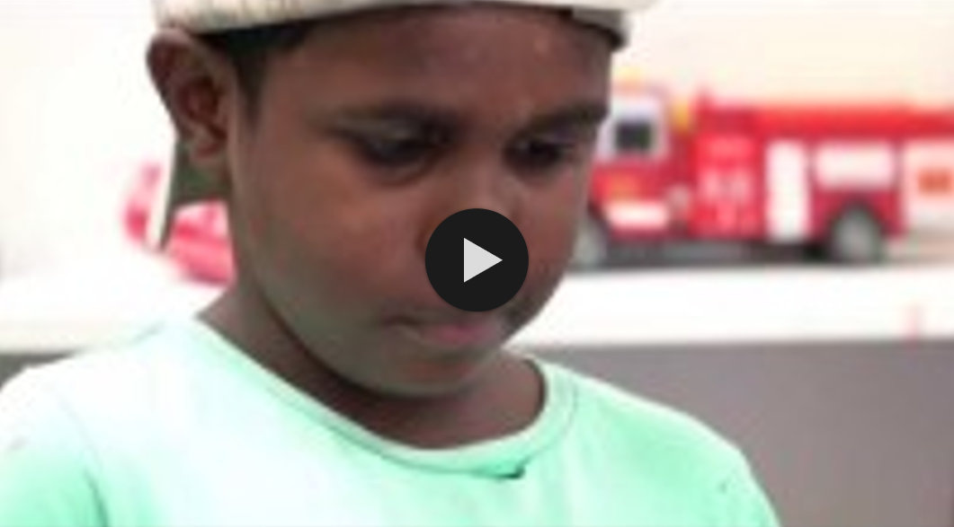
Watch the video → https://www.youtube.com/watch?v=KH5wqQXhdbk&t=195s
Deadly Digital Communities – Regina James, Coordinator Bwgcolman Indigenous Knowledge Centre, Palm Island
Notes:
https://www.youtube.com/watch?v=KH5wqQXhdbk&t=195s
Deadly Digital Communities – Regina James, Coordinator Bwgcolman Indigenous Knowledge Centre, Palm Island

Slide 23
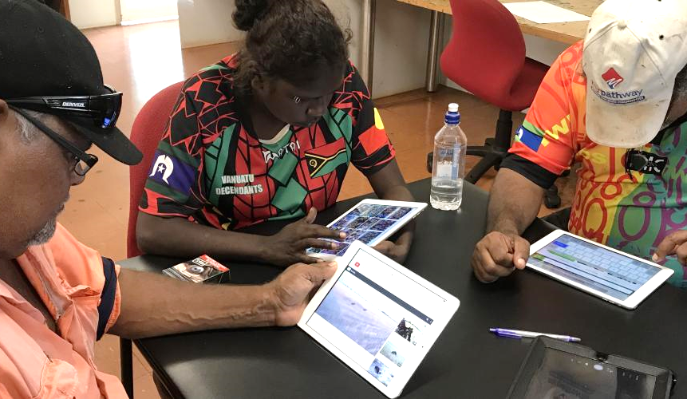
Establishing new Indigenous Knowledge Centres in remote and discrete communities, and improving the viability of existing centres
Employing Regional Digital Development Officers, operating from local libraries, to help identify opportunities for regional communities to realise their digital potential
Co-designing and delivering the next Deadly Digital Communities program, working closely with Elders and First Nations communities
Deadly Threads, Brian Cassey, 2021.
Hope Vale Aboriginal Shire Council.
Notes:
https://www.chde.qld.gov.au/digitaleconomy/action-plan

Slide 24
FUTURE LIBRARIES
CREATING INCLUSIVE AND ACCESSIBLE DIGITAL LIBRARIES AND SERVICES

Slide 25
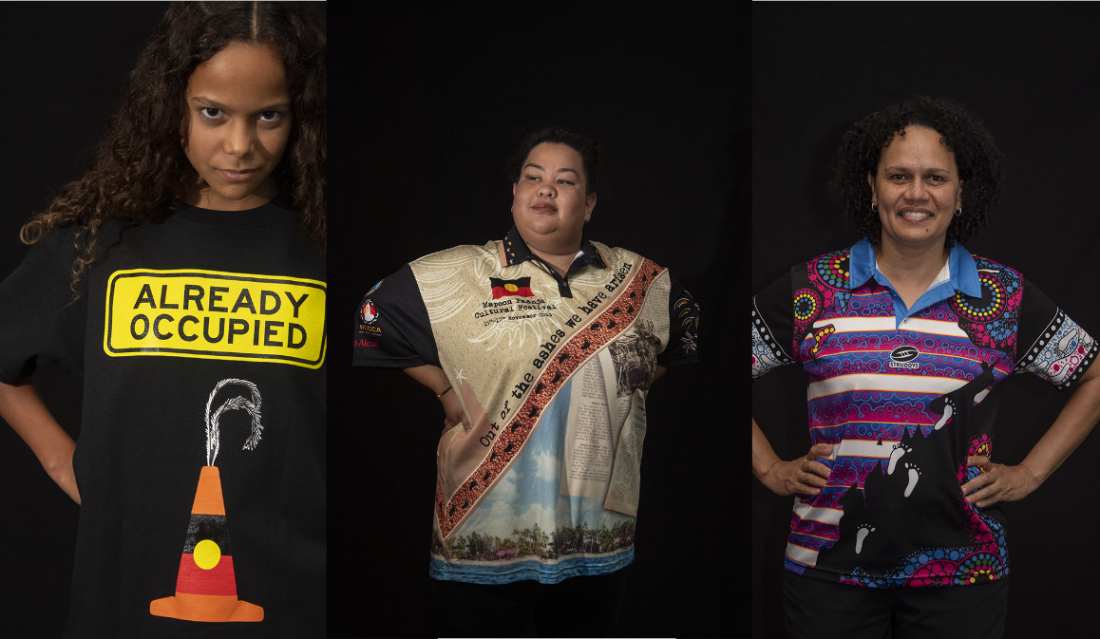
TRUTH-TELLING
An opportunity for Aboriginal and Torres Strait Islander peoples to record evidence about past actions and share their culture, heritage and history with the broader community.
Deadly Threads exhibition at State Library of Queensland, Brian Cassey, 2021.

Slide 26
My father says language tells us not just who we are but where we are.
Language and names are markers of identity.
Reviving Indigenous languages is in itself a response to a history of oppression and denial. It can be liberating and assertive but like all identity it is a construction.
Stan Grant
The Guardian, 31 August 2016
Notes:
https://www.theguardian.com/culture/commentisfree/2016/aug/31/if-language-tells-us-who-we-are-then-who-am-i

Slide 27
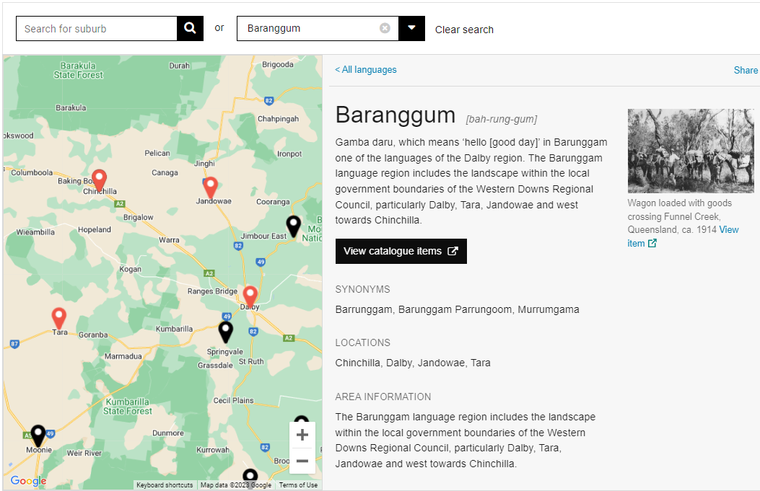
Indigenous languages map of Queensland
Notes:
https://www.slq.qld.gov.au/discover/first-nations-cultures/aboriginal-and-torres-strait-islander-languages

Slide 28
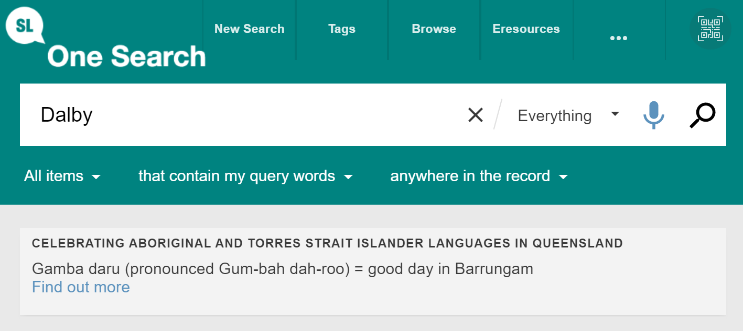
Notes:
https://onesearch.slq.qld.gov.au/discovery/search?vid=61SLQ_INST:SLQ

Slide 29
Explore the virtual tour→
https://www.slq.qld.gov.au/virtual-tours/spoken
Spoken: Celebrating Queensland Languages

Slide 30
Content Description Principles
Words matter. Language is powerful. It conveys meaning, framing, and sets intentions.
Frick, Rachel L., and Merrilee Proffitt. 2022. Reimagine Descriptive Workflows. OCLC Research. https://doi.org/10.25333/wd4b-bs51
Notes:
Rachel Merrick slides

Slide 31
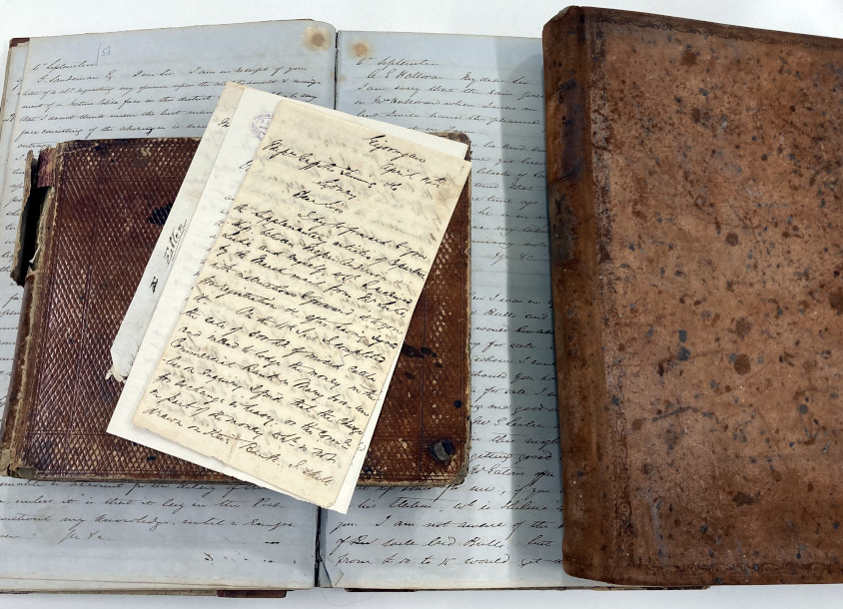
Gigoomgan
Station records
(OM68-13)
Home to the Kabi Kabi [Gubbi Gubbi] people, prior to its establishment. Journals record the use of Aboriginal labour and clashes with local tribes over livestock.
Notes:
Rachel Merrick slide
Image: Working photo of physical Station ledger (1858-1863), Station diary (1854-1858), Station diary (1859-1868) - OM68-13/6-8 Gigoomgan Station records, John Oxley Library, State Library of Queensland - https://collections.slq.qld.gov.au/guide/om68-13/details#ITOM68-13-1-6

Slide 32
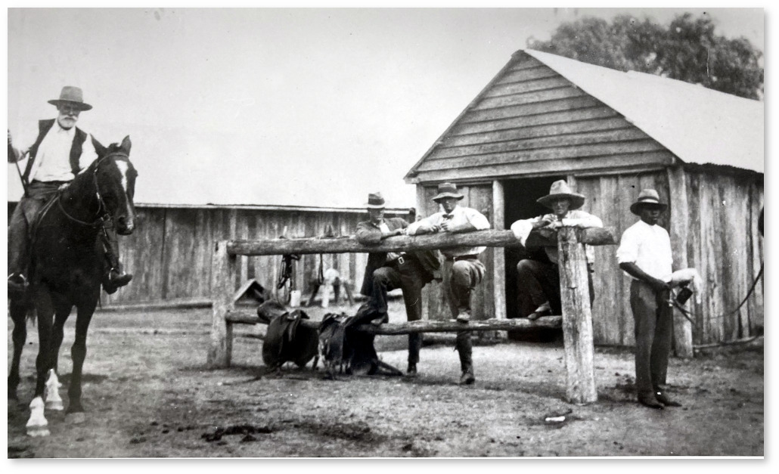
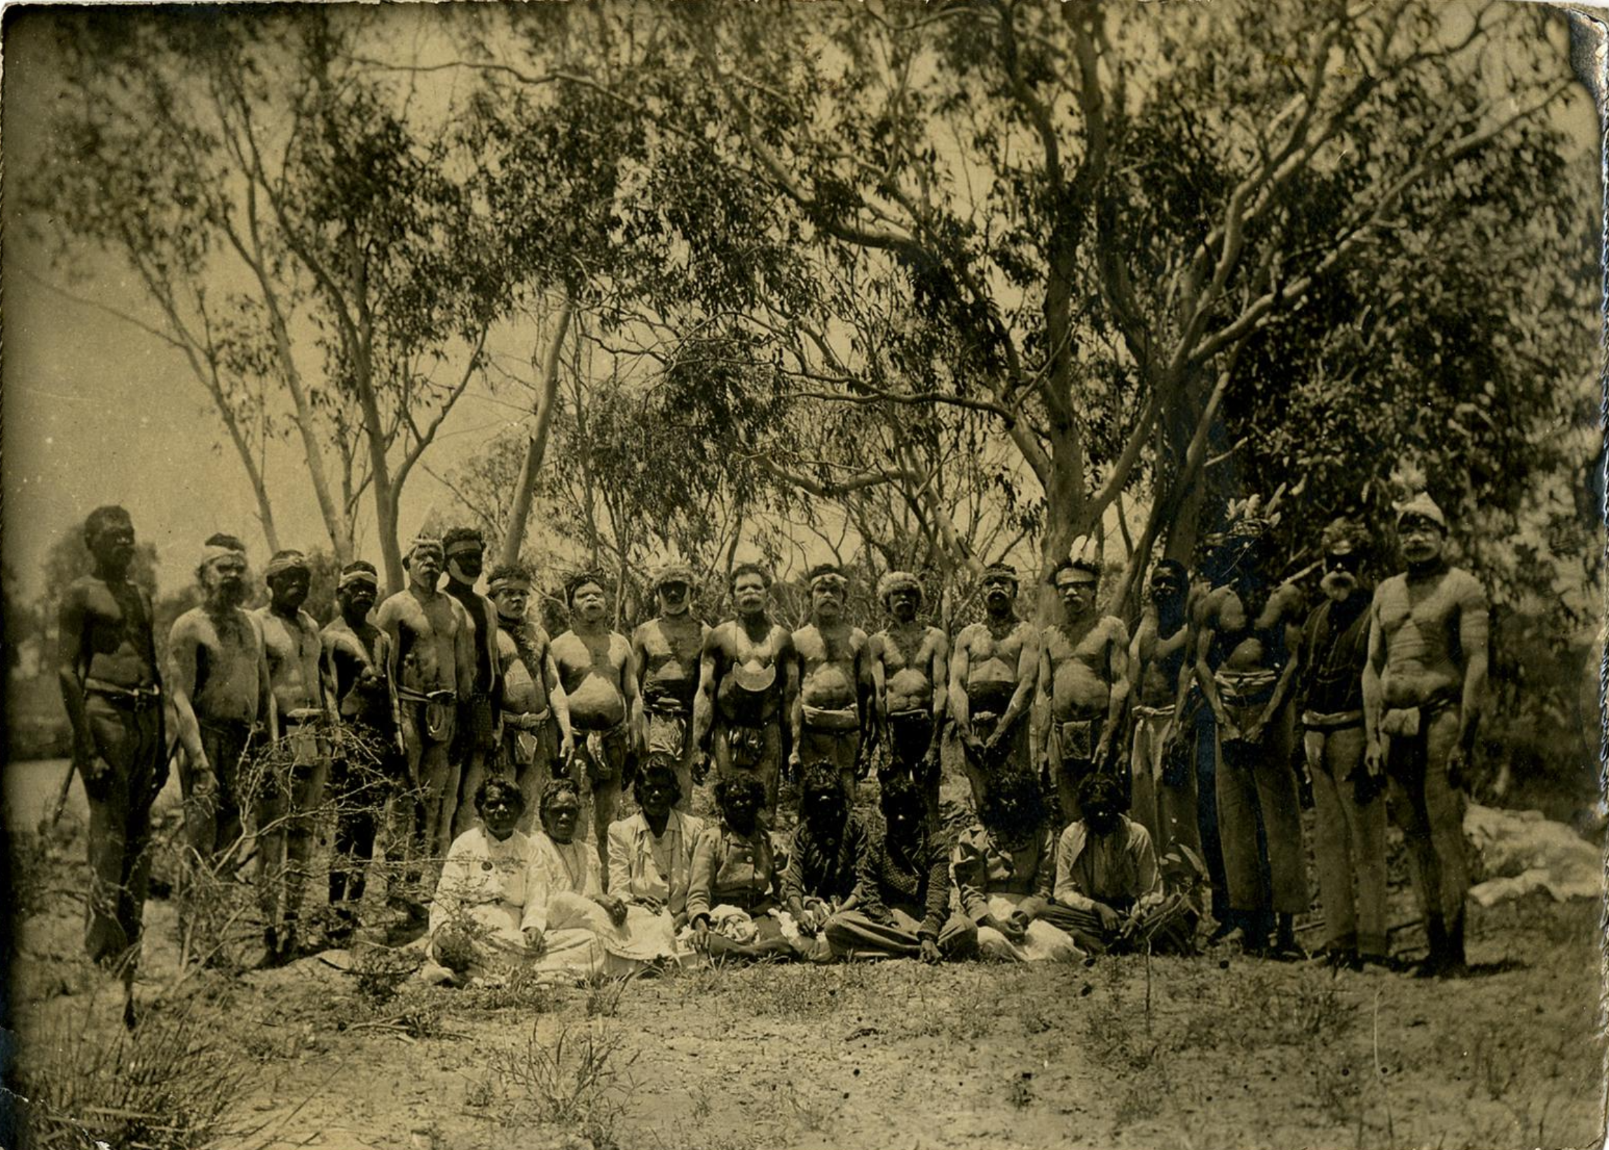
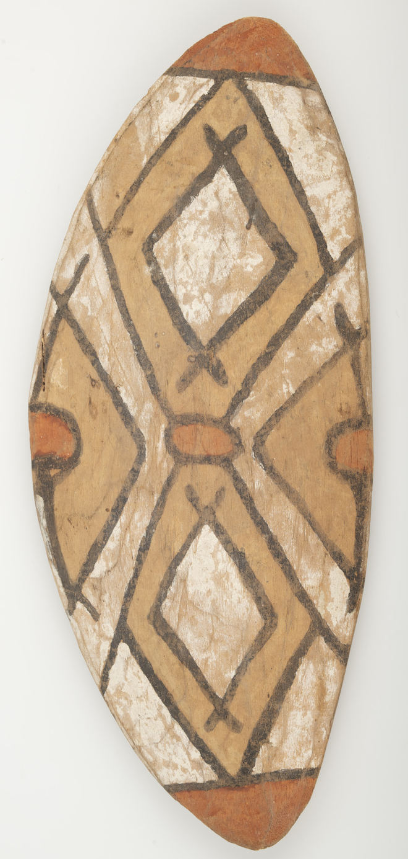
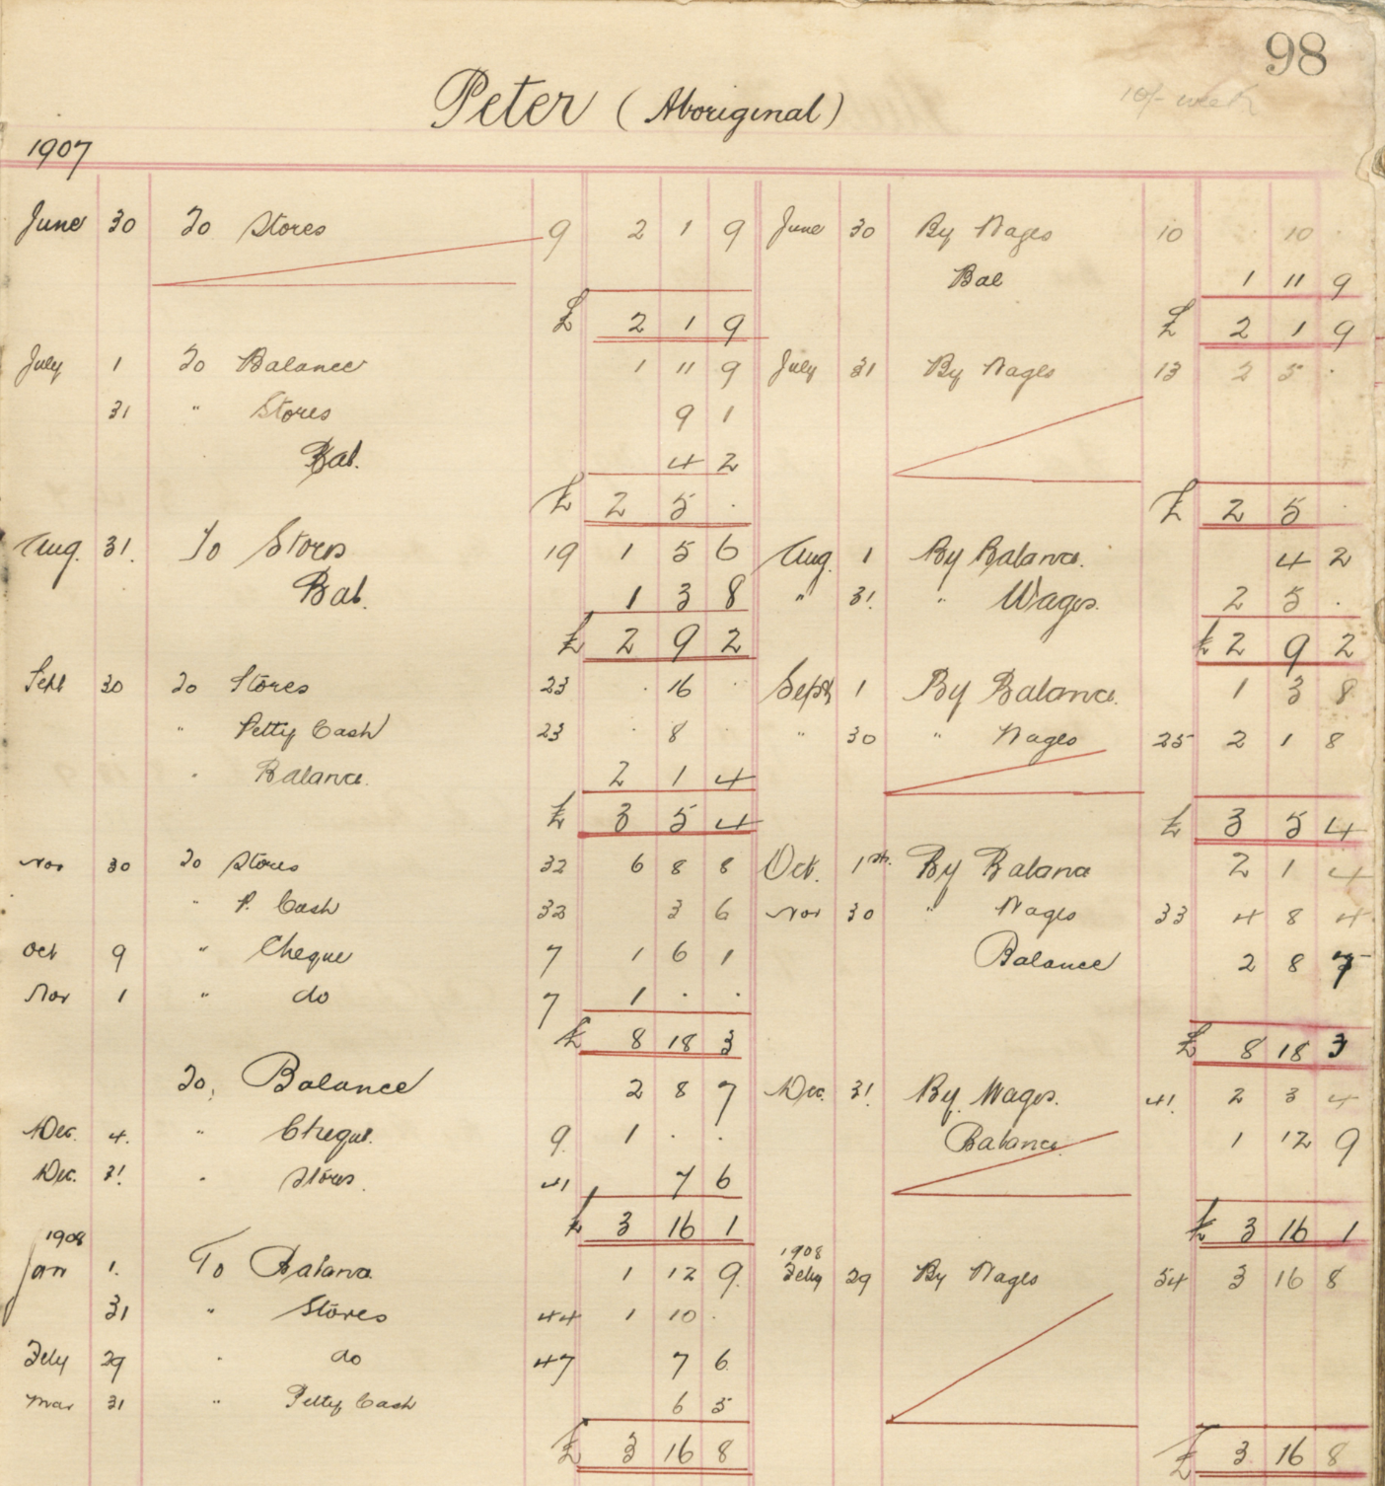
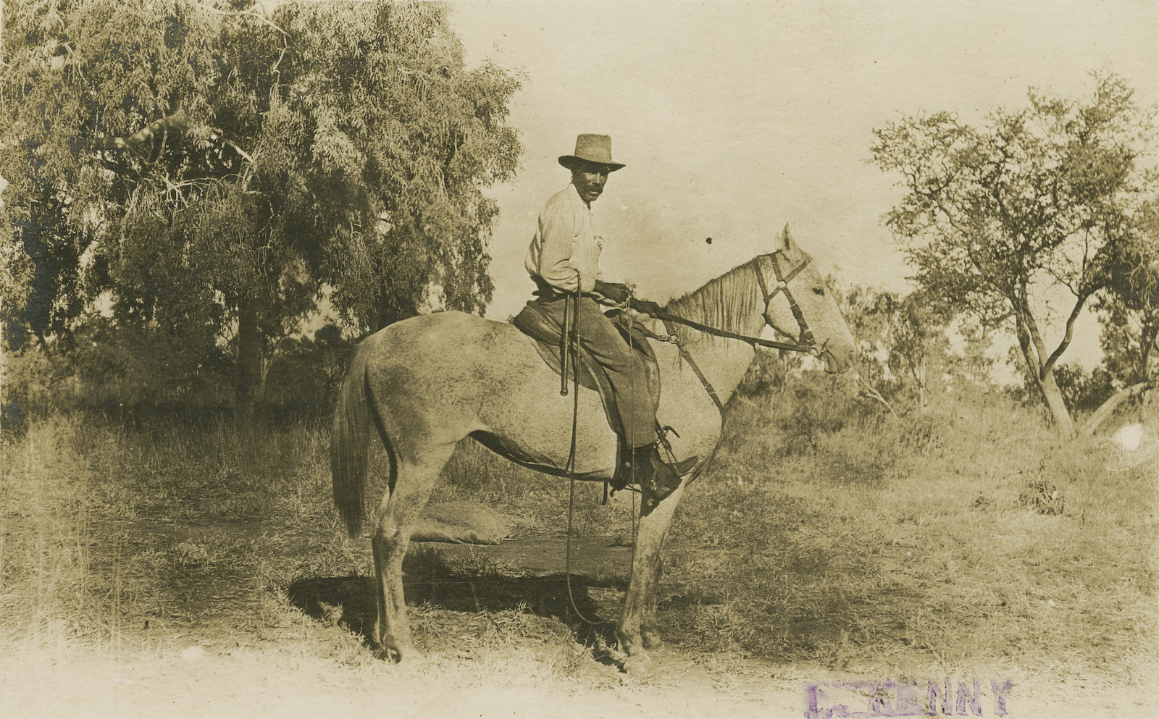
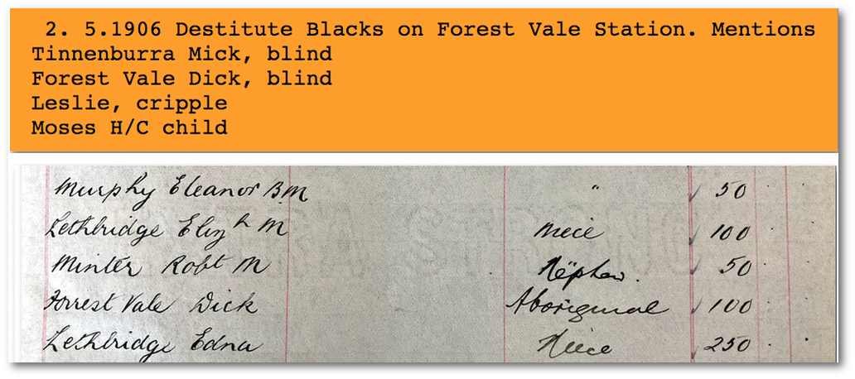
...by adjusting our perspective by only a few degrees, we see a vastly different world through the same window.
Pascoe, Bruce. 2014. Dark Emu: Black Seeds: Agriculture or Accident?. Broome, Western Australia: Magabala Books.
Notes:
Rachel Merrick slide
Image 1: Working photo of physical copy print - Stockmen on Camboon Station in the 1920s, copy print collection, Negative number 12502, John Oxley Library, State Library of Queensland
Image 2: Dalleburra and Munggoobra people (1908) - TR 1867/142, Christison Family papers and Lammermoor Station records, John Oxley Library, State Library of Queensland - https://collections.slq.qld.gov.au/guide/tr1867/details#ITTR1867-3-142
Image 3: Page 98[153], Accounts ledger (1907-1914) – 29426/3, Beechal Station Records, John Oxley Library, State Library of Queensland - https://collections.slq.qld.gov.au/guide/29426/details#IT29426-1-3
Image 4: Jacob Chermside, (c1891-1954) - TR 1867/400, Christison Family papers and Lammermoor Station records, John Oxley Library, State Library of Queensland - https://collections.slq.qld.gov.au/guide/tr1867/details#ITTR1867-4-400
Image 5: Aboriginal Australian man on horseback on Kamilaroi Station around 1915 - 33463/6, Kamilaroi Station photograph album, John Oxley Library, State Library of Queensland - https://onesearch.slq.qld.gov.au/permalink/61SLQ_INST/1dejkfd/alma99184206164902061
Image 6: Page 35[89], Station ledger (1886-1902) - R 404/2, Umbercollie Station records, John Oxley Library, State Library of Queensland - https://collections.slq.qld.gov.au/guide/R404/details#ITR404-1-2
Image 7: Ko-Bro, also known as Barney (c1858-1911) - TR 1867/391, Christison Family papers and Lammermoor Station records, John Oxley Library, State Library of Queensland - https://collections.slq.qld.gov.au/guide/tr1867/details#ITTR1867-4-391
Image 8: Shield (1863-1899) - TR 1867/379, Christison Family papers and Lammermoor Station records, John Oxley Library, State Library of Queensland - https://collections.slq.qld.gov.au/guide/tr1867/details#ITTR1867-17-379
Image 9: Booloodea Timullinya, also known as Wyma (c1850-1926) - TR 1867/389, Christison Family papers and Lammermoor Station records, John Oxley Library, State Library of Queensland - https://collections.slq.qld.gov.au/guide/tr1867/details#ITTR1867-4-389
Image 10: Top: Screenshot of entry in Mitchell Police Letter Book 1889-1921, Queensland State Archives - http://www.cifhs.com/qldrecords/qldmitchell.html ;
Bottom: Working photo of physical Probate ledger (1919-1920) - OM84-16/90, Lethbridge Family Papers; Forest Vale Station; Mitchell Downs Station, John Oxley Library, State Library of Queensland - https://collections.slq.qld.gov.au/guide/om84-16/details#ITOM84-16-7-90

Slide 33
Librarians must … reflect on their own internal biases ... deconstruct language and decolonize the systems that perpetuate the continued marginalization of others.
To remain neutral about these systems is the very opposite of what it means to be a librarian in the twenty-first century.
Vaughan, Crystal. “The Language of Cataloguing: Deconstructing and Decolonizing Systems of Organization in Libraries."
Dalhousie Journal of Interdisciplinary Management, vol. 14, Spring 2018. https://ojs.library.dal.ca/djim/article/view/7853/7247.
Notes:
Rachel Merrick slide

Slide 34
Listen to the podcast →
https://www.slq.qld.gov.au/discover/podcasts/dangerouswomen
Dangerous Women Podcast
Notes:
https://www.slq.qld.gov.au/discover/podcasts/dangerouswomen

Slide 35
OUR SUSTAINABLE FUTURE
BUILDING SUSTAINABLE WORKPLACES, WORKFORCES AND SERVICES

Slide 36
GOAL 16
​
Peace, justice and strong institutions
​
Promote peaceful and inclusive societies for sustainable development, provide access to justice for all and build effective, accountable and inclusive institutions at all level.​
Notes:
https://sdgs.un.org/goals/goal16

Slide 37
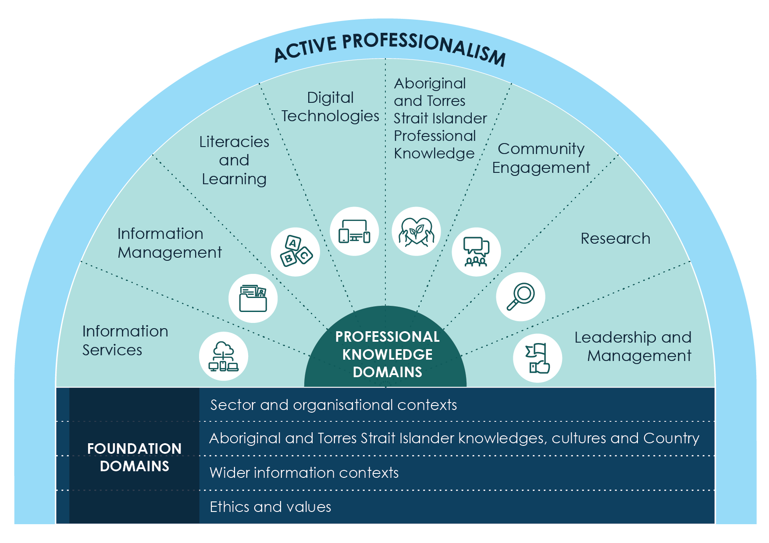
Notes:
https://professionalpathways.alia.org.au/

Slide 38
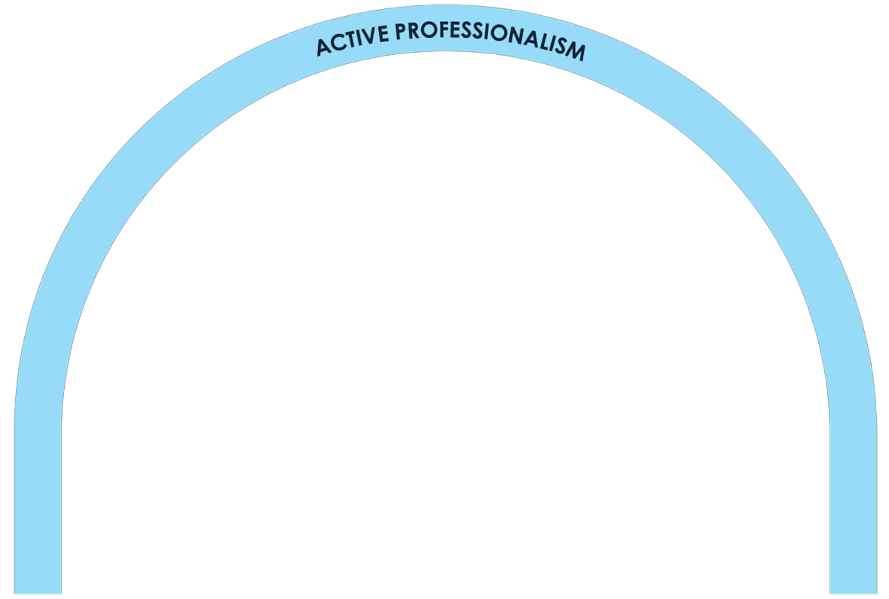
Notes:
https://professionalpathways.alia.org.au/

Slide 39
Vision Libraries are at the heart of the cultural life of Australia and Aotearoa New Zealand
Strategic priority First Nations Strengthen respectful and responsive relationships between libraries, First Nations library professionals, and tangata whenua
Collaborative projects and initiatives Joint policies and training arising from the NSLA Culturally Safe Libraries Program
Annual Indigenous cultural capability audits to track change in NSLA libraries
Evolving approach to respectful collection management in partnership with First Nations subject matter experts
Notes:
https://www.nsla.org.au/about-nsla/strategic-plan/

Slide 40
Great libraries build great communities
R. David Lankes
11 March 2012
Notes:
Blog:
Beyond the Bullet Points: Bad Libraries Build Collections, Good Libraries Build Services, Great Libraries Build Communities – R. David Lankes

Slide 41
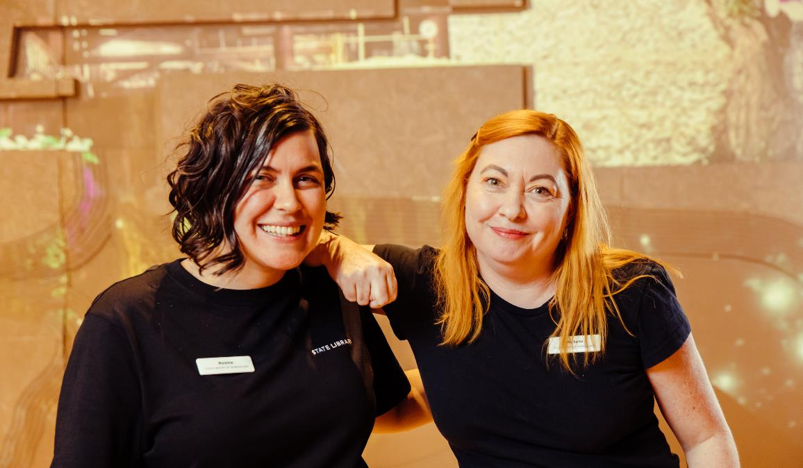
Fastest-growing, highest-demand emerging skills sets
Artificial intelligence / machine Learning
Cloud computing
Product management
Social media
How Skills Are Disrupting Work, Burning Glass Institute, December 2022
FUTURE FOCUSED PEOPLE
State Library of Queensland staff, Josef Ruckli, 2022.
Notes:
https://www.burningglassinstitute.org/research/how-skills-are-disrupting-work

Slide 42
What you want your successors to say in forty years is they made good decisions
National Library of Australia staff
Custodians and midwives: The Library of the Future, 2021
Notes:
https://cybernetics.anu.edu.au/assets/Custodians_and_Midwives_FINAL_web.pdf
Quote from 5.2 A Final Word, page 113
Just like all work that the NLA does, this report reflects a particular moment in time, always situated within the knowledge that past decisions and knowledge inform what we do now, and that what NLA employees and their audiences will do/want/need in the future is both critical and unknown. Our goal has been to inform you of what is on your horizon in terms of tech capabilities that have the potential to transform collections and Library practices as fundamentally as indexing did in the nineteenth century, and as the internet and search did in the last forty years, and to empower you to make the best-informed decisions you can now for your future audiences. As many NLA staff said in interviews, what you want your successors to say in forty years is “they made good decisions in 2021.”

Slide 43
Adapting to climate change
Leaner, cleaner and greener
The escalating health imperative
Geopolitical shifts
Diving into digital
Increasingly autonomous
Unlocking the human dimension
CSIRO GLOBAL MEGATRENDS
Our Future World cover image, Sea Cliff Bridge, NSW Coast Near Wollongong, shutterstock.com.
Notes:
https://www.csiro.au/en/research/technology-space/data/Our-Future-World

Slide 44
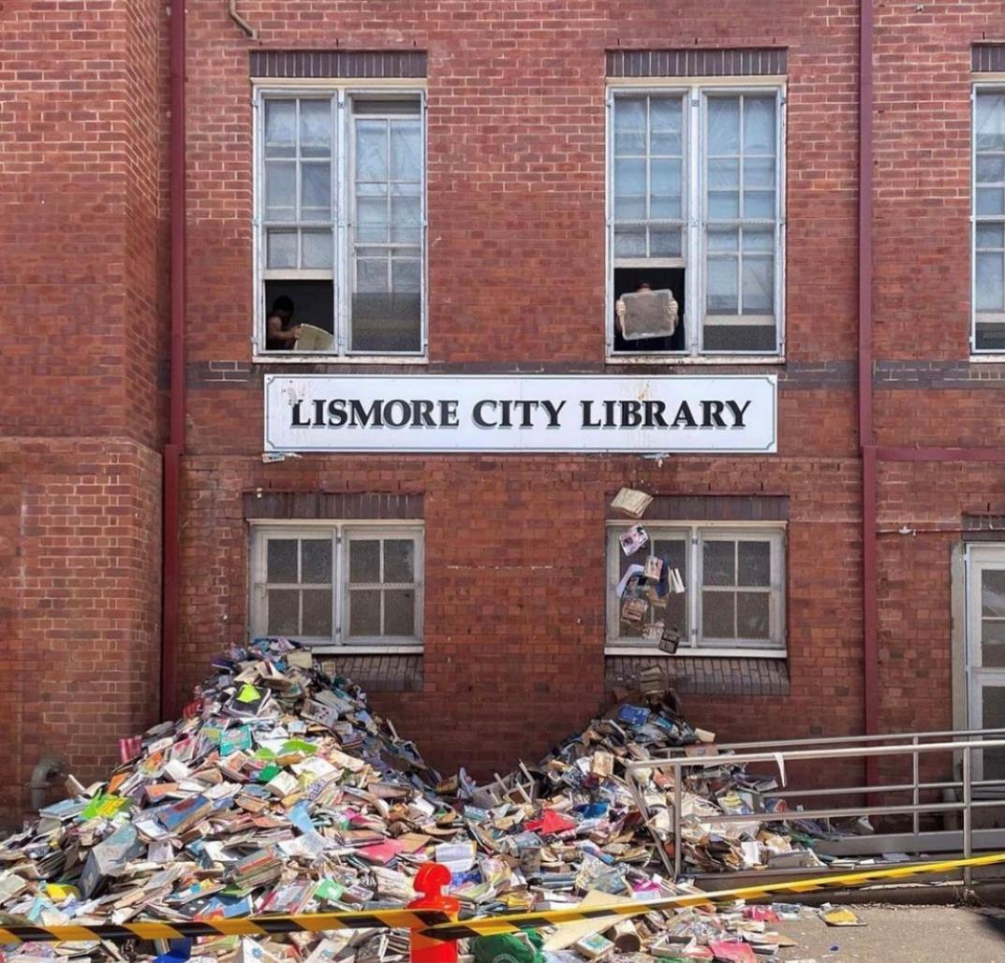
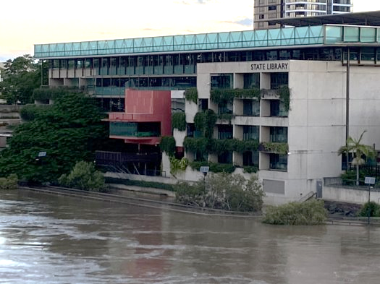
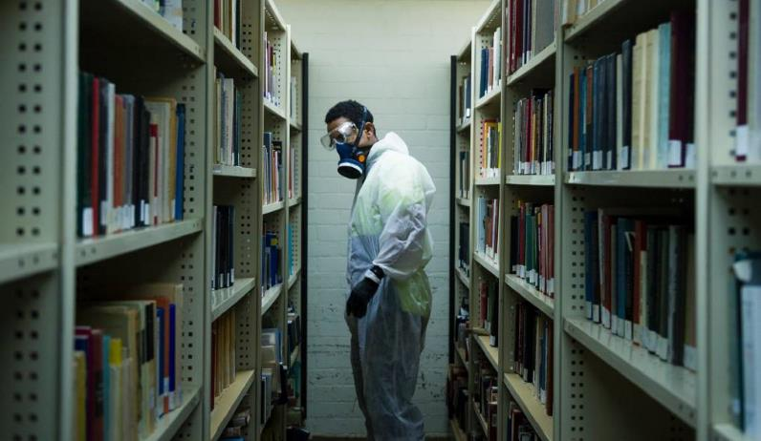
Lismore City Library, Anita Bellman, 2022. State Library of Queensland, 2022. Chifley Library Australian National University, Dion Georgopoulos, 2018.
Notes:
ADAPTING TO CLIMATE CHANGE
2022 FLOOD – LISMORE CITY LIBRARY (cleanup)
2022 FLOOD – STATE LIBRARY OF QUEENSLAND
2018 FLOOD – CHIFLEY LIBRARY AUSTRALIAN NATIONAL UNIVERSITY (cleanup)

Slide 45
A call to workers of all sectors to unite
Rebecca Giblin and Cory Doctorow
Chokepoint Capitalism, 2022
Notes:
https://www.penguinrandomhouse.com/books/710957/chokepoint-capitalism-by-cory-doctorow-and-rebecca-giblin/

Slide 46
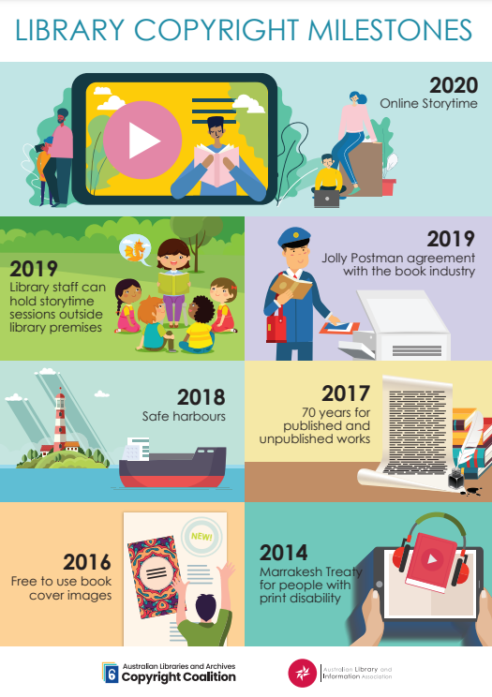
Notes:
https://www.alia.org.au/Web/Web/About-Us/Advocacy/Advocacy-campaigns.aspx?hkey=2836a587-a715-4488-8a33-693af0936961

Slide 47
THANK YOU! vicki mcdonald AM FALIA
ALIA INFORMATION ONLINE
18 MAY 2023

