Slide 1
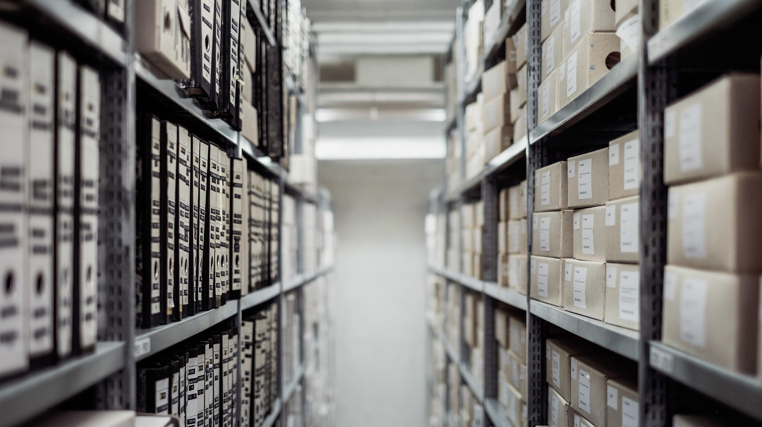
Who needs an archival management system anyway?
New approaches to the description and discovery of archival collections.
Carreen Dunbar and Margaret Warren
State Library of Queensland

Slide 2
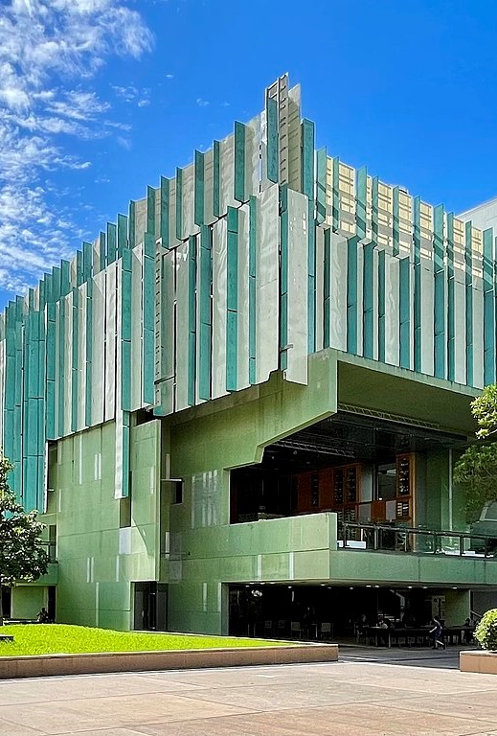
A library not an archive
State Library is not an archive, but we do hold archival collections that reflect the diversity of Queensland’s story from the past to the present.
Exterior of the State Library of Queensland, 2021
Kgbo, CC BY-SA 4.0 <https://creativecommons.org/licenses/by-sa/4.0>, via Wikimedia Commons
https://commons.wikimedia.org/wiki/File:Exterior_of_the_State_Library_of_Queensland,_2021.jpg

Slide 3
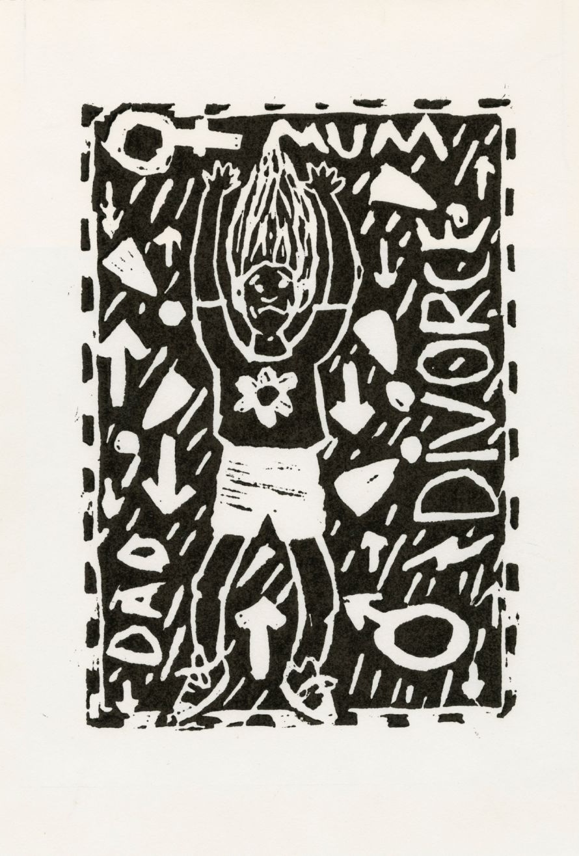
Archival collections
Approx. 10,000 archival collections
Business records, personal papers, photographic collections, film collections, audio/oral history collections, digital archives, born digital collections, personal archives
Approx. 600 collections with detailed finding aids
Children shouldn't be made to choose when their parents are getting divorced by Elizabeth McLellan
7116, Dr Barbara Piscitelli AM Children's Art Archive, John Oxley Library, State Library of Queensland.
http://hdl.handle.net/10462/deriv/260158

Slide 4
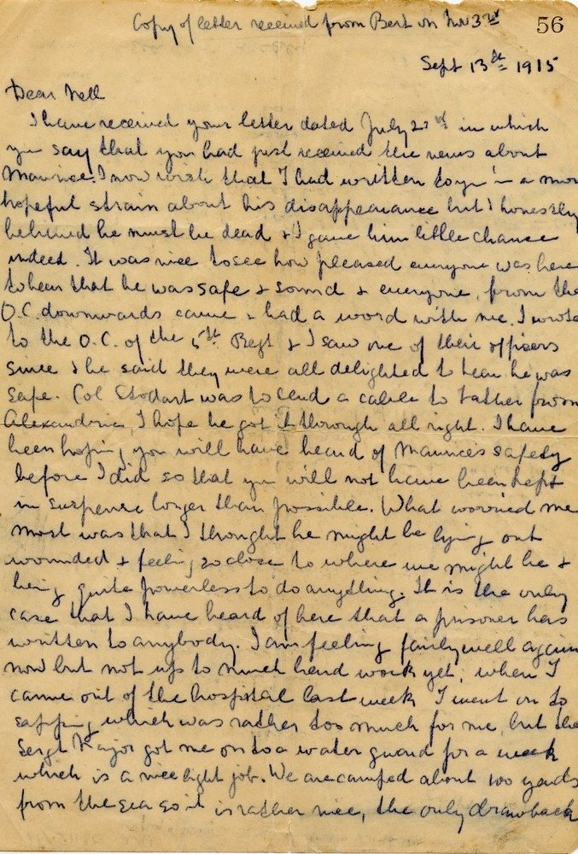
The problem
Complex and convoluted system
Not user friendly for clients or staff
Organizational changes
Cost considerations
Copy of a letter from Bert Delpratt to his sister Elinor White (Nell) regarding the news that Maurice George Delpratt was not dead but had been captured by the Turks.
28115, Maurice George Delpratt Correspondence, John Oxley Library, State Library of Queensland. http://hdl.handle.net/10462/eadarc/8217

Slide 5
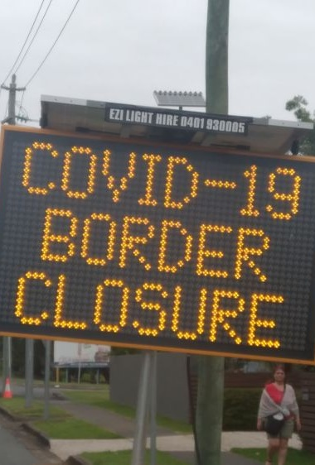
Developing a solution
Articulating business requirements
Challenging assumptions end-to-end
Border closure warning sign with the border closure in the background, Coolangatta, April 2020
32537, David W. Allen COVID-19 photographs and papers, John Oxley Library, State Library of Queensland
https://hdl.handle.net/10462/photosbd/0318585

Slide 6
Existing system - finding aid
Notes:
Since 2009 finding aids at the State Library had been created using a complex multi-step process. Collection level records were created in our library management system by our cataloguers and finding aids were created by archivists in Excel and through a scripted process, converted to EAD, added to our digital asset management system, Digitool, and presented via our catalogue, One Search. For many years, it was the best finding aid solution we could offer with the resources available to us. Unfortunately, it was not a very user-friendly experience.
For clients, the front-end screen managed to be somehow both cluttered but with too much white space. It involved lots and lots of scrolling in separate frames and had duplication of data at all levels. It was visually unappealing, navigation was very flat: there was a table of contents, but it was hard to know where you were at any given time. It was not device friendly and it looked nothing like the other descriptive records in our catalogue.

Slide 7
Existing workflow 15 step process Many opportunities for error
Notes:
For staff it was an extremely clunky and labour-intensive process that could take anywhere from 2 days to two weeks to make live. A 15-step process, handled many times by staff across four different teams, combined with the strictness of XML meant multiple opportunities for error – and a critical error at almost any point would cause the system to fail and need to be restarted.
Staff building the finding aids, whilst expert in archival and descriptive practices, are not necessarily experts in XML or EAD encoding and we could not afford the luxury of a single workflow that demanded the need for specialist resources or skills to create, use or modify records.
In addition to new system implementation of Rosetta, as noted earlier, another golden opportunity (and challenge) for workflow redesign was presented when an organisational re-alignment entirely changed where the description and arrangement of archival collections was undertaken. Previously the work of a specialist ‘archival’ team who had almost complete ownership of all tasks, the work was centralised, with responsibility for hierarchical description realigned into the traditional library technical services area where expertise in the cataloguing collection level data already lay.

Slide 8
Philosophical Considerations
A new approach to hierarchical description
A contemporary discovery experience
Complied with our principles for arrangement and description
Integrated experience regardless of format
Ease of use
Ease of access
Aerial views of dazzling white sand on Whitehaven Beach, Whitsunday Island, Great Barrier Reef, tropical North Queensland, 1985
7435 Ron and Ngaire Gale Collection, John Oxley Library, State Library of Queensland
http://hdl.handle.net/10462/deriv/28957
Notes:
These two environmental factors – new system and new structure- provided the opportunity to place our workflows under a microscope and explore what the system for the creation and discovery of hierarchical description really delivered. In taking on this new challenge within our cataloguing team, it allowed a different and fresh view; and it brought a different emphasis to the process – one that was more user centric rather than functional.
We knew overwhelmingly we did not want to replicate existing processes in any way but wanted to take an entirely new approach to hierarchical description. The new system needed to one that allowed staff to understand it on their own terms and in their own language - including what information was required in each field. In any new system that was implemented, we wanted ease of access – for both staff and clients -which ultimately meant language that was not in ‘archives speak’.
What was needed was a contemporary discovery experience with a simplified interface that worked seamlessly with existing systems. One which was straightforward for staff to use and understand that complied with our principles for arrangement and description. It had to be was format-independent to incorporate physical and digital content. The system had to be easy for clients to navigate and pleasurable for them to use and be as accessible for the casual user as much as it was a tool for the researcher.
We have a broad spectrum of clients with a wide range of information needs. Our clients do not necessarily know, or sometimes care, about the distinction between published collections and archival collections. They just want the information, and they want to access that information in one place. We wanted to continue to ensure that all our documentary collections are presented in one place, at one time alongside all content, with a consistent look and feel in both the description and delivery.

Slide 9
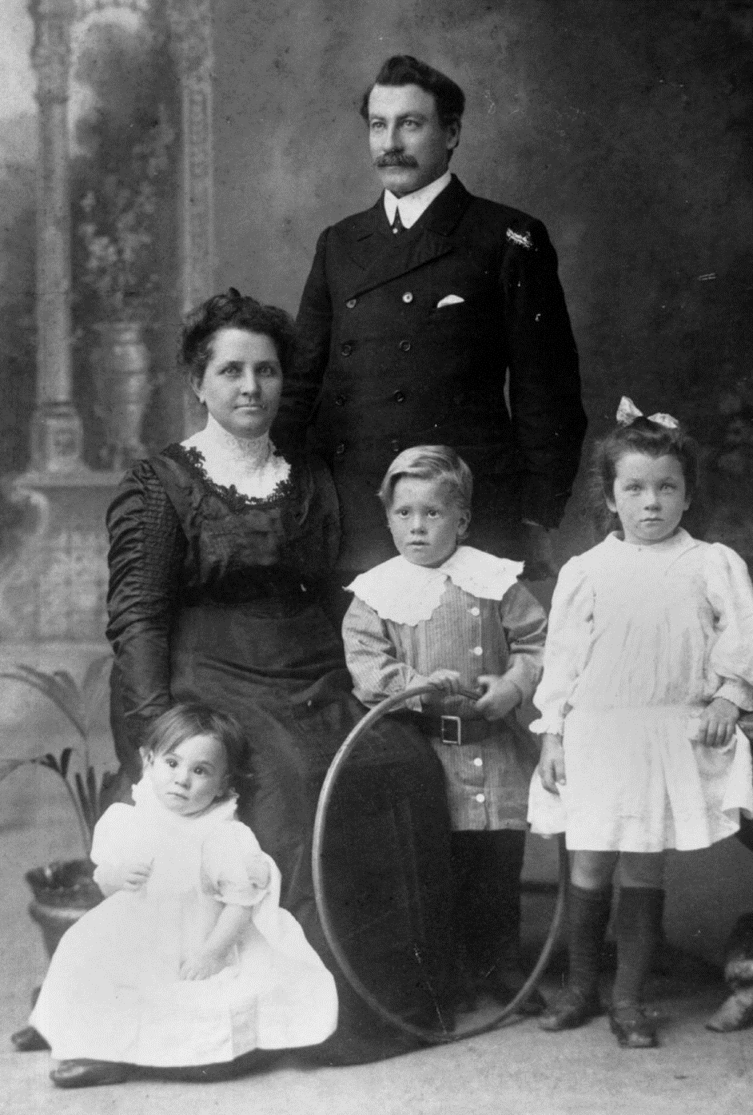
System Considerations
Don’t have a purpose-built archival management system
Do Have
Library Management System
Digital preservation system
Discovery layer
Website built in Drupal
Portrait of Henry and Mary Schlencker with their young family
M 609 John G Cribb and H Percy Schlencker Papers, John Oxley Library, State Library of Queensland
http://hdl.handle.net/10462/eadarc/6876
Notes:
When contemplating a new system, one thing we definitely knew we did not want any more was a process so complex or cumbersome that it got in the way of itself. We asked ourselves the fundamental question- What is the best way to provide access to our archival collections and what is the best way to describe and arrange the collection data in a hierarchical structure?
We looked at various systems in the marketplace and then we looked at what we already had on hand and our options included:
purchasing a new purpose built out of the box archival management system – but this has a huge upfront cost, and wouldn’t be tailored to our specific needs
implementing an open-source system - while ostensibly ‘free’, would still require tailoring (at a cost), and again, not designed with our specific circumstances in mind
retaining and refining the system we had which was heavily dependent on human input, and so prone to human error, and extremely cumbersome to process.
or create our own brand-new purpose-built tool from scratch
None of the first three options were considered viable so we decided to commit to development of an inhouse product – one that would combine data from our existing systems – the library management system and the digital preservation system - and through our discovery layer, deliver the seamless integrated experience we knew we wanted.

Slide 10
Drupal
Powerful and flexible
Hierarchical structure
Ease of navigation
Interoperability
Customisable
In-house expertise
Portrait of Henry and Mary Schlencker with their young family
M 609 John G Cribb and H Percy Schlencker Papers, John Oxley Library, State Library of Queensland
http://hdl.handle.net/10462/eadarc/6876
Notes:
We saw an elegantly simple solution staring us in the face…We had recently implemented Drupal for our website and knew it was both powerful and flexible. Web pages by their very nature are hierarchical in structure, they provide ease of navigation, interoperability, and high degree of customisation. We could create a backend tool using Drupal, which would which would store the data and generate finding aids to our archival collections in HTML and then make these available through the library catalogue.
Having in-house Drupal expertise meant that we could investigate this new world of possibilities. Being a flexible data-store with many API-driven import/export capabilities Drupal provided a good foundation to build a solution tailored to our specific needs. It also meant if organizational needs changed, the tool could be changed along with them and useful features added any time.

Slide 11
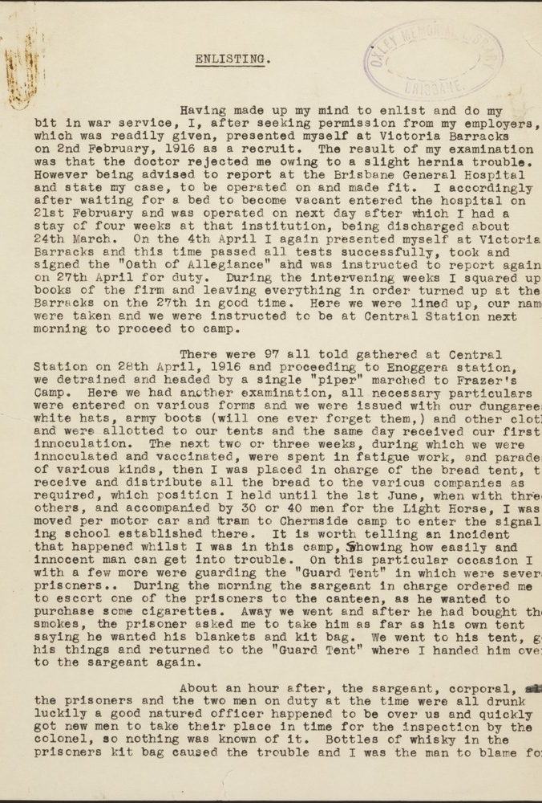
The Process
Staff working group with diverse views
Environmental scan
Development of base requirements
Scoping and viability
Prototype development
Rolling development and improvements based on testing
OM90-88, George H Brigham Diary, John Oxley Library, State Library of Queensland.
http://hdl.handle.net/10462/comp/3868
Notes:
The first step in the process was the formation of a working group including: the stakeholders:
librarians and archivists to focus on archival practices and requirements
librarians with cataloguing expertise to focus on the descriptive metadata, and staff user experience
representatives with a discovery focus to look at the front-end user experience
web developers
representatives from ICT and digital preservation.
Our archivists, metadata specialists, and user experience staff documented what they thought a perfect ‘finding aid’ would look like, how it would behave, and what it would deliver. We looked at finding aids being generated at other libraries, archives and universities around the world and developed a base set of specifications with mandatory, highly desirable, and ‘nice to have’ requirements.
To make the dream a reality, we employed a web developer as a temporary staff member to scope the viability of the project and deliver proof of concept. Employing a temporary staff member for the project meant that 100 per cent of his time was devoted to developing a solution, a luxury our in-house experts could not afford. We also had a relatively short project timeline of 3-6 months.
The base ‘look and feel’ and element structure requirements were quickly built into a ‘proof of concept’ prototype. This was tested to determine if it met the base requirements and if it should be further developed to meet all the mandatory requirements, as well as any ‘desirable' functionality that was identified throughout the development process. Following the acceptance of the prototype, key descriptive staff worked closely with the developer to ensure that all relevant EAD elements were incorporated and that the fields could be used in the expected way. Over the course of six months, the system was rigorously tested, and a rolling system of amendments deployed on a weekly schedule following a continual loop of feedback and improvement.
Another change that emerged as the project progressed was that we came to believe that the term ‘finding aid’ meant little to the average State Library client. We decided on a shift in terminology, from ‘finding aid’ to ‘collection guide’, which was considered a more natural term to help our clients to understand the function of the tool. Internally, we encourage the use of the term ‘collection guide’, but it will take a while for old habits to change, and the two terms are used interchangeably.

Slide 12
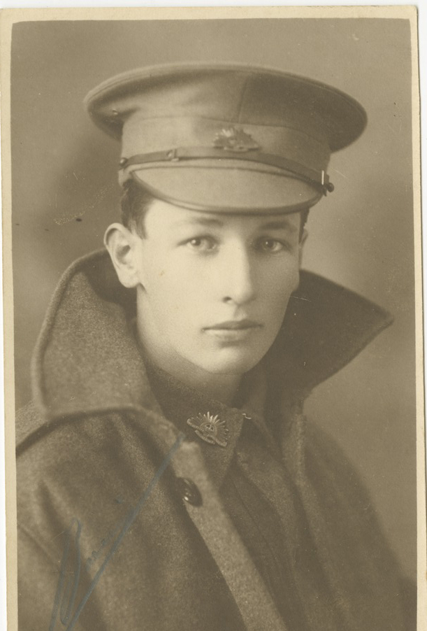
Workflow Considerations
Deliver staff efficiencies
Provide ease of use
Reduce opportunity for error
Ability to make changes on the fly
Staged publication
Capacity for bulk creation and bulk changes
Studio Portrait of Allan Victor Arthur in uniform, Undated, 28939/3
28939, Victor Owen Williams First World War Diaries, Photographs and Personal Papers, John Oxley Library, State Library of Queensland
http://hdl.handle.net/10462/eadarc/8248
Notes:
We wanted to achieve major efficiencies from this system–in staff time in creating guides, in processing time and in turnaround time to making content available to clients. There were multiple pain points in creation, maintenance, and changes to finding aids in the previous system and we mandated processes that would reduce human error.

Slide 13
Workflow Considerations
Utilize the descriptive catalogue record in LMS
Easy to structure to various levels
Plain English/ WYSIWYG interface
Simple to create, edit and delete
Allow for multiple users at one time
Require minimal training.
Studio Portrait of Allan Victor Arthur in uniform, Undated, 28939/3
28939, Victor Owen Williams First World War Diaries, Photographs and Personal Papers, John Oxley Library, State Library of Queensland
http://hdl.handle.net/10462/eadarc/8248
Notes:
To deliver these efficiencies, the new system needed to do a few things
Utilise the descriptive catalogue record in our LMS (Alma)
be easy to structure to various levels as required – box list, series, and series/item
have a plain English/ WYSIWYG interface – no web coding skills required
be simple to create, edit and delete
allow for multiple users at one time
Be easy for staff to use, access and understand
require minimal training.

Slide 14
Drupal page - a templated form
Notes:
To speed up processing and provide consistency, arrangement and description is created in a Drupal page expressed as a templated form to enable data entry, with the elements based on EAD2000 and data entered in the fields in accordance with DACS and RDA. These field elements are labelled in natural language not code

Slide 15
Multi level
Notes:
Separate forms were devised for the creation of series, with or without item lists, and box lists.

Slide 16
Multi level

Slide 17
Elements grouped
Notes:
During the development phase, a decision was made to group ‘like’ elements into tabs. This significantly reduced the amount of scrolling required to work through a series or item arrangement and made the system much more user friendly.

Slide 18
Controlled lists
Notes:
Where possible the forms incorporate the use of drop-down lists of commonly used terms, phrases, and thesauri.

Slide 19
Mandatory elements
Notes:
Again, to ensure consistency of data, the forms have a mix of mandatory and non-mandatory elements depending on the level of description. Some elements – for example location and physical description - were made mandatory at the series level, but not at the item level.
Fields that link back to the collection level catalogue record were incorporated, which use API calls to pull in descriptive metadata from the catalogue to populate required fields and similarly APIs are used to call digital content from Rosetta, reducing the need for double handling and removing the human error element.
During the implementation phase, staff were able to start working in the system (now named ADA - Archival Description Application) with minimal induction, because the system is so easy to use. Its follow your nose design requires very little instruction in actual use of the application for data entry - the main requirement for use of the product is that staff understand descriptive standards and internal work practices – which are skills they already possessed.
The interface itself lets staff toggle from back end to the front-end view of the guide in progress so adjustments can be made if needed. This keeps the client experience always in the forefront as it provides a quick and easy way to see the guide as they will see it.
The ADA system also provides for staged publishing of content, which means collections can be progressively made live as various components are completed. Staff can continue work on the arrangement and description of other parts of the collection while the completed items can be made available for searching and request by clients

Slide 20
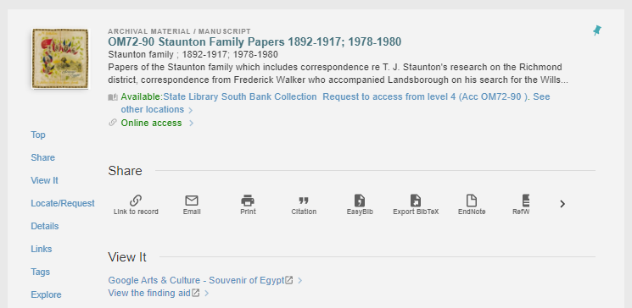
Unique link from catalogue record
Notes:
As soon as a collection guide is completed, it can be made immediately live in the catalogue using its unique URL by linking directly to the HTML finding aid from a specific marc field in the catalogue record and at this point all the data - the archival description, the collection level description and digital objects are all published through to the one central point – the catalogue.
Once live, changes can be made instantly ‘on the fly’ while the collection guide remains available to clients it does not require a separate product to edit and does not need to be taken down and replaced with a newer version. Full version control is integrated in the system.

Slide 21
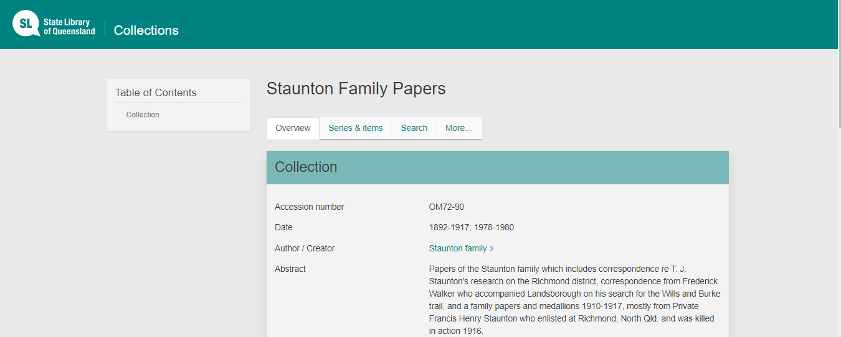
Notes:
The HTML discovery experience being delivered through Drupal is much more accessible. It looks far easier on the eye, incorporating the colours and fonts already found in our online catalogue, One Search, which add to the seamless client experience.

Slide 22
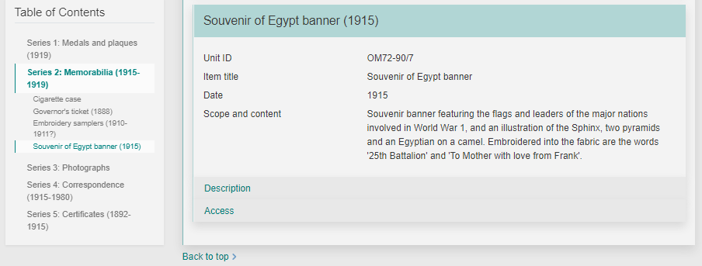
Context sensitive navigation
Notes:
With any large complex structure, easy navigation is vital. There is a table of contents which is responsive to the contents of the page, highlighting exactly where you are, in context and way pointing to where you may want to go.

Slide 23
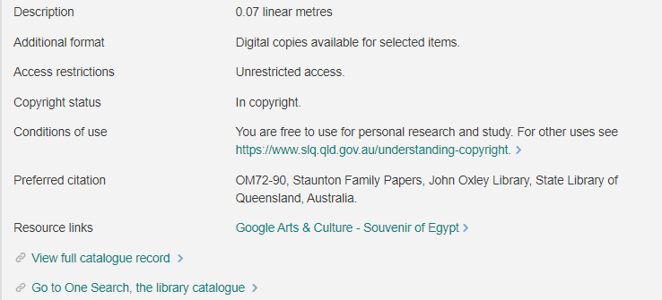
Integration with collection level record
Notes:
Lin the staff view, a tabbed structure is used to help navigate the various parts of the record while keeping the design simple and uncluttered. These provide integration with the collection level record, providing a provide a backward link back to the catalogue record.

Slide 24
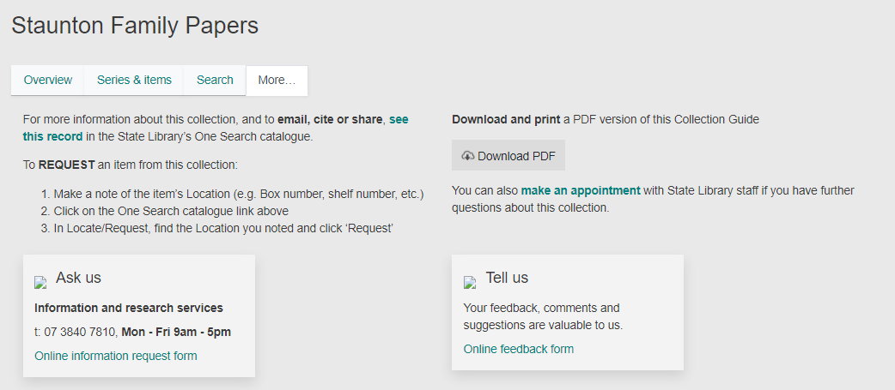
More functions
Notes:
There is the ability to search within the guide, and More functions which provide instructions on how to request physical items, a download option and, avenues for providing feedback.

Slide 25
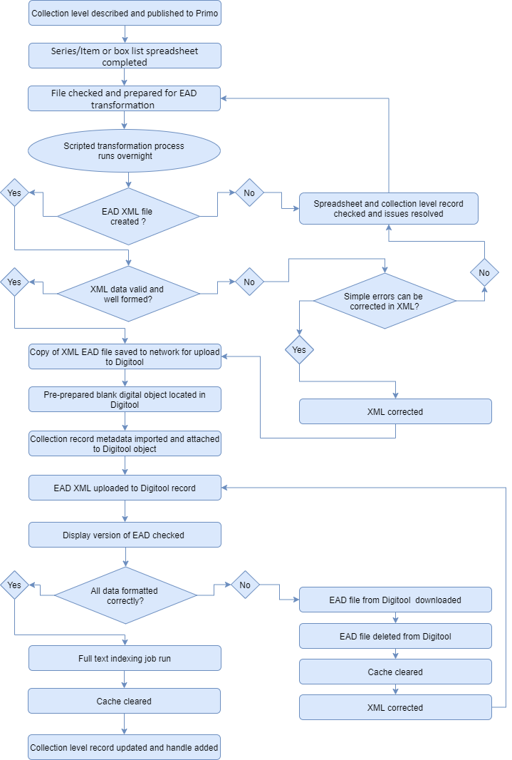
From this To this
Notes:
The actual process of creation of a finding aid went from that 15-step process with interdependencies across four teams that could take anywhere from 2 days to 2 weeks - to a streamlined three-step process, managed within one team and possible to be created and made live immediately.

Slide 26
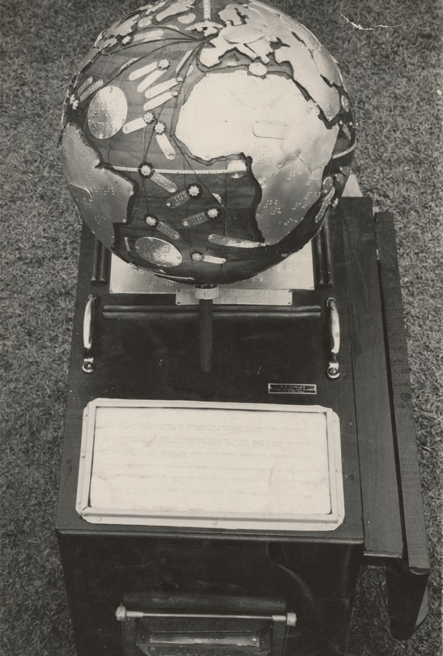
Technical considerations
Adhere to standards and conventions
Data to be compatible and interoperable
Able to be preserved
Integrate with LMS / Discovery layer
Braille globe of the world created by Frank Tunley for the School for the Blind in Annerley, Brisbane, ca. 1950, 29279/21
29279, Narbethong Queensland School for Visually Handicapped Children and Richard Frank Tunley Collection John Oxley Library, State Library of Queensland.
http://hdl.handle.net/10462/eadarc/8523
Notes:
In the development process knew we had to adhere to established standards and conventions - this ensures that all our metadata records are compatible with external systems, easily migrated to a new standard if required, readily utilised for open data sets and adaptable to linked open data usage. All collections are described using RDA and DACS is applied for archival principles
The structure underpinning hierarchical description of archival materials in the application is the EAD data standard, and all the elements of the new application conform to the standard. They simply don’t need to be explicitly expressed that way for staff to be able to use the tool. But this will help fulfil one of our expressed goals which is to be able to export collection guides as EAD files. into a form that can be preserved.
One crucial element was that the application must have some degree of integration with the LMS as the work horse system that houses the collection records, acquisition records and provenance data and allows lending of the collection. Previously the finding aid and the catalogue record were separate entities with duplication of data but no integration so maintaining records that were in ‘sync’ was always a challenge to maintain. One aspiration for the future is to further integrate and allow requesting within the finding aid itself.
Finally there had to be a simple way to integrate digital objects. These are embedded, delivered from any of our systems- for example Rosetta or DigiTool, allowing us to use this solution while digital collections are still being migrated from one system to another and this is accomplished by simply entering the permanent link or handle to the digital object. It does not have to be hardcoded and means we can point to any object or even external resources or website, immediately.

Slide 27
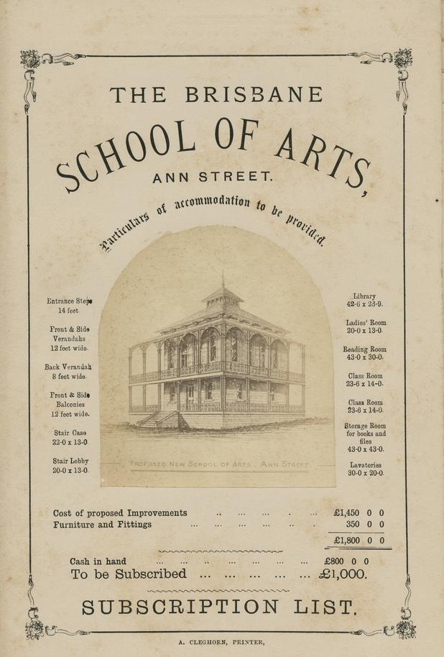
What did we learn?
It’s good to challenge assumptions
Standards are our friends
Business owners + developers working together delivers great result
Integrated points of 'data truth' is achievable
User experience should be pre-eminent (both front end and back end)
10124 Proposed design for new School of Arts 1877. John Oxley Library, State Library of Queensland.
http://hdl.handle.net/10462/eadarc/7592

Slide 28
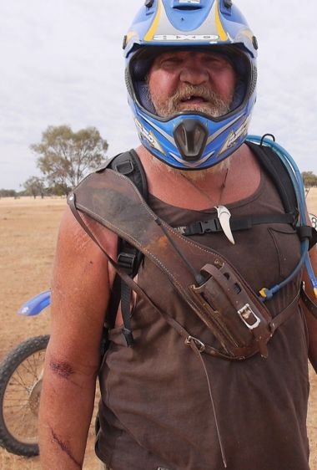
Next steps
Enhancements – front and back end to improve user experience
EAD extract for digital preservation
Ongoing iteration to meet future requirements
Musterers preparing for a camel muster on Charlotte Plains Station, Queensland, 2014.
29693 Dean Saffron Outback Camel Mustering Photographs 2014, John Oxley Library, State Library of Queensland.
http://hdl.handle.net/10462/deriv/300518

Slide 29
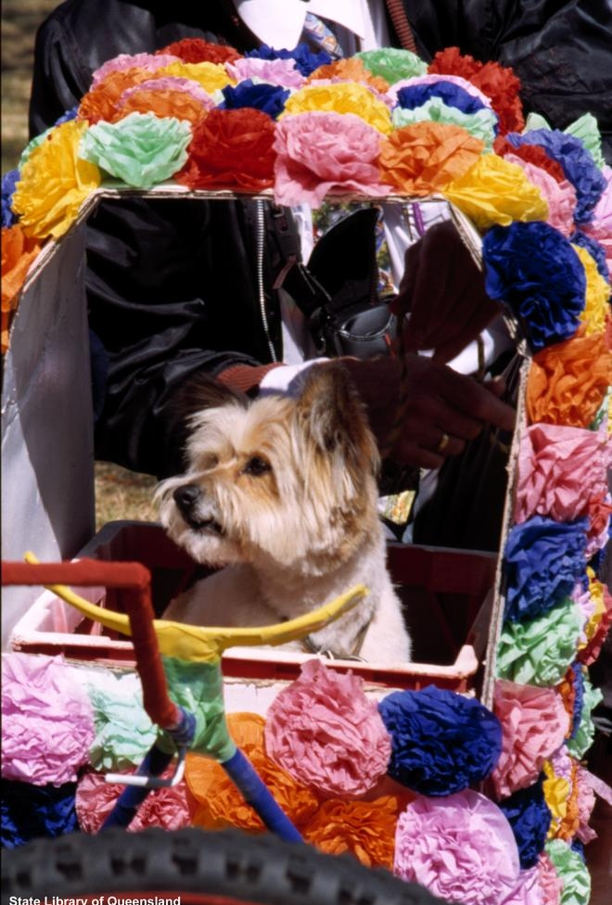
Questions?
Decorated pram participating in the Carnival of Flowers parade, Toowoomba, 2002.
9955 Toowoomba Carnival of Flowers Photographs; John Oxley Library, State Library of Queensland.
http://hdl.handle.net/10462/deriv/28005

Slide 30
Explore
William and Mary Bartie letters and textiles
https://collections.slq.qld.gov.au/guide/32315/overview
Dr Barbara Piscitelli AM Children's Art Archive, 1986-2016; 2020
https://collections.slq.qld.gov.au/guide/7116/overview
Channels of History oral histories
https://collections.slq.qld.gov.au/guide/29880/overview
National Parks Association of Queensland archive
https://collections.slq.qld.gov.au/guide/31641/overview
Exterior of the State Library of Queensland, 2021
Kgbo, CC BY-SA 4.0 <https://creativecommons.org/licenses/by-sa/4.0>, via Wikimedia Commons
https://commons.wikimedia.org/wiki/File:Exterior_of_the_State_Library_of_Queensland,_2021.jpg

