Slide 1
State Library of Queensland
State Library of Queensland supporting STEM teachers

Slide 2
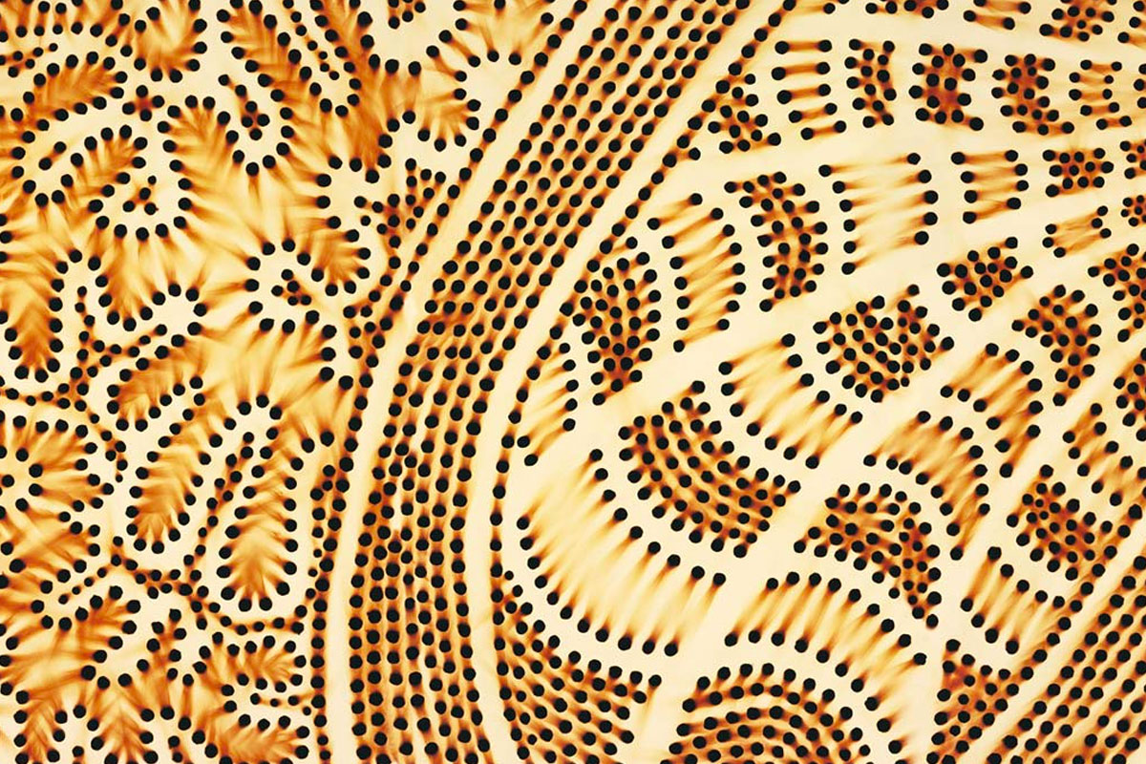
Kurilpa Country by Lilla Watson, photo by Josef Ruckli
Notes:
I would like to respectfully acknowledge the traditional custodians of the land on which Queensland State Library stands, the Yuggera, Jagera and Turrbal peoples whose stories have existed for millennia.

Slide 3
State Library of Queensland
Vision
Inspiring possibilities through knowledge, stories and creativity
State Library building. Photo by Joseph Ruckli 2019.
Notes:
our vision..
State Library of Queensland is the leading reference and research library in Queensland. Situated in Brisbane’s Southbank in the Cultural precinct between Goma and QAG.
We are responsible for collecting and preserving a comprehensive collection of Queensland’s cultural and documentary heritage, providing free access to information for all Queenslanders and for the advancement of public libraries across the State

Slide 4
State Library of Queensland
online resources for teachers
onsite and online opportunities for professional learning
onsite opportunities for schools
State Library building. Photo by Joseph Ruckli 2019.
Notes:
STEM teachers throughout Queensland can confidently reach out to State Library for support, wherever they are in the State.
We have online resources to support classroom learning and onsite opportunities for building teachers’ professional capabilities.

Slide 5
Notes:
Firstly, I’d like to introduce teachers to Curriculum Connect. Curriculum Connect is a new website which now houses all State Library’s education resources in one easy to find location.
It features classroom ready units of work, lesson plans, one-off activities, teacher professional development and opportunities to build research skills.
Curriculum Connect makes finding free, teacher-reviewed, classroom-ready resources simple.

Slide 6
Curriculum Connect
Science
Design
Technologies
Explicit curriculum links
Australian Curriculum
Qld Senior Secondary Syllabus: Design.
Notes:
For STEM teachers Curriculum Connect provides free lesson plans in Science, Design and Technology topics.
Each matching the current Australian Curriculum for years P-10.
Queensland’s Senior Secondary Syllabus in Design has informed the resources for year 11 and 12.

Slide 7
Science
Notes:
Here are some of the resources for hands-on making lessons aligning with Science.
These are all 30 mins or less in duration so perfect for kicking off a unit of work or to generate curiosity as part of a larger sequence of lessons you already have planned. They can be elaborated on and combined with Design and Technologies by adding design thinking strategies into the approach taken in the delivery of them. For instance, add a hypothetical client and a brief, spend a lesson researching the topic, use design thinking strategies to explore design options and iterations that meet a client’s needs.

Slide 8
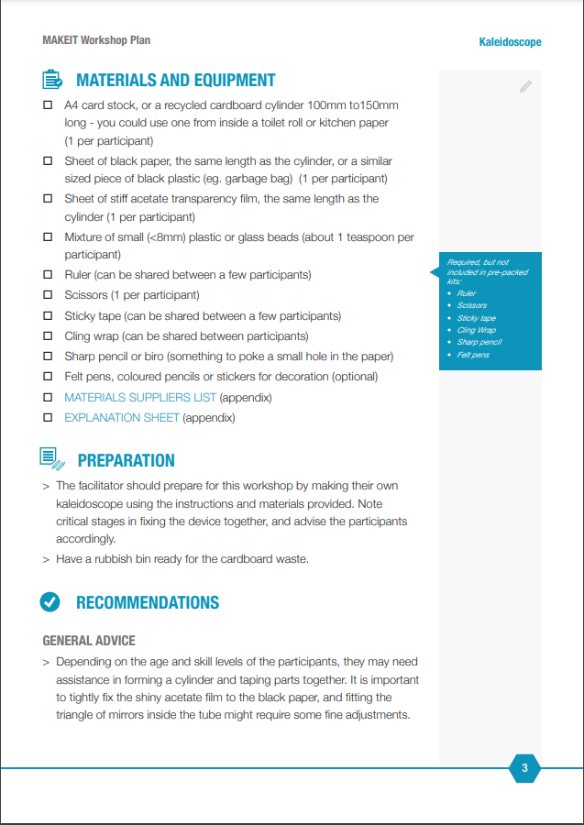
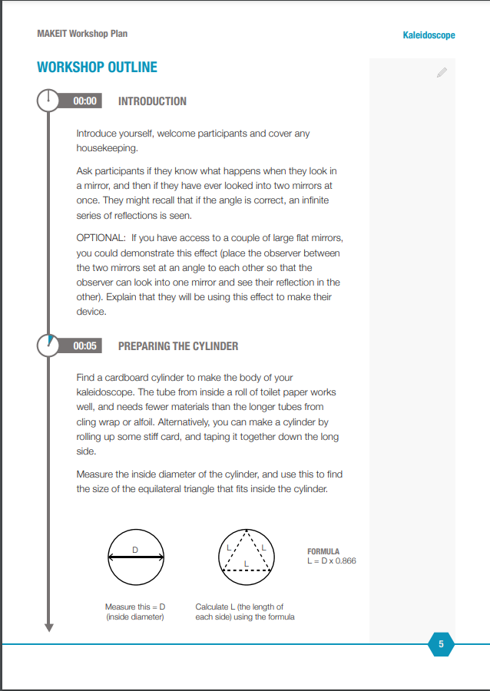
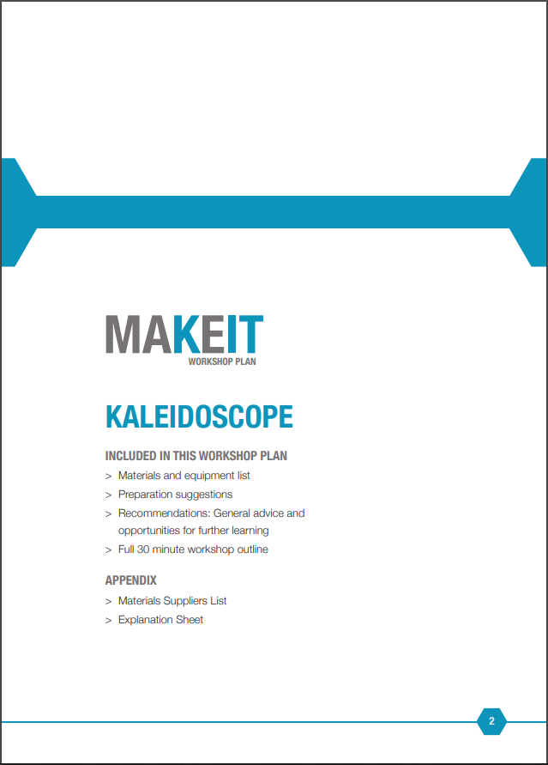
Notes:
Each resource contains an overview, including curriculum links, step by step instructions and a materials list for delivering the activity in a classroom setting.
They have been tried and tested in workshop situations.

Slide 9
Design and technologies
Notes:
Some of you will be familiar with the valued Design Minds Resources that have lived on the Design Online website for many years.
Design online is slowly being decommissioned and we are currently in the process of migrating the Design Minds resources to Curriculum Connect. In the process of doing this we are ensuring they align with current curriculum, including some which have been specifically rewritten to align with the new Queensland Senior Secondary Syllabus in Design.
These resources were originally developed by educators who have used them in their classrooms. They are tried and tested. They have been revised by practicing educators and refined to meet new current curriculum content descriptions or objectives. .
Many of these resources are interdisciplinary. So, they may include content descriptions from two or more Australian Curriculum learning Areas, and several are also appropriately linked to more than one Australian Curriculum band- you can make them useful across the curriculum.

Slide 10
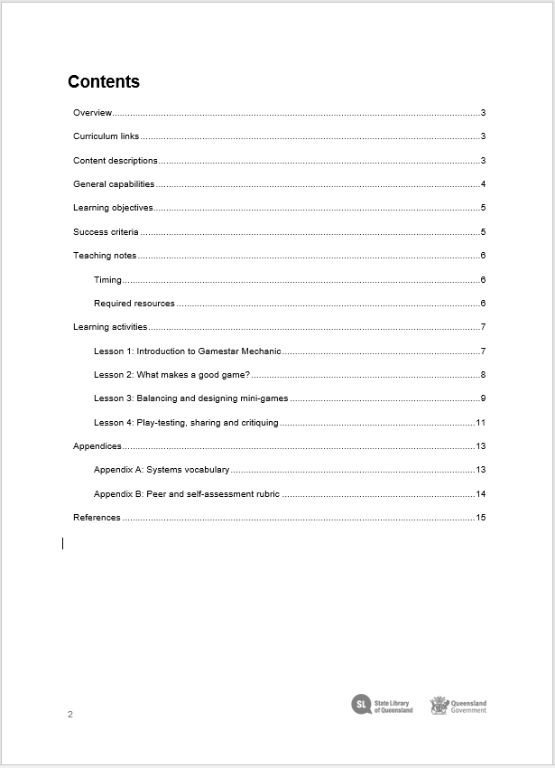
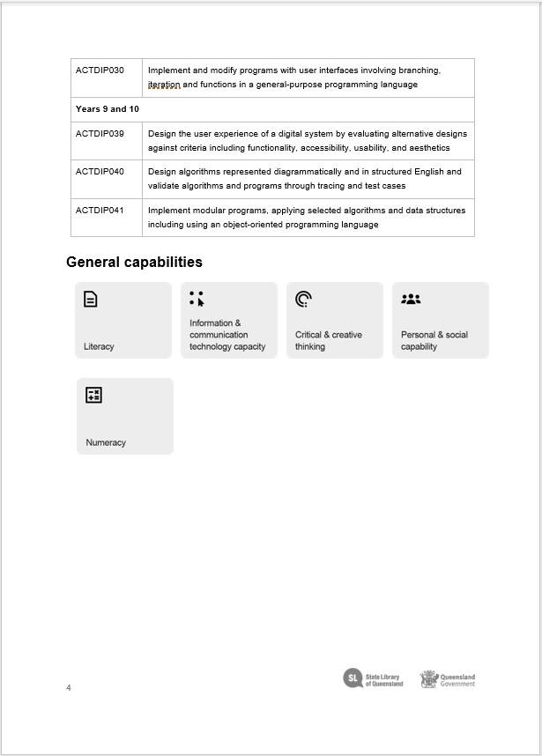
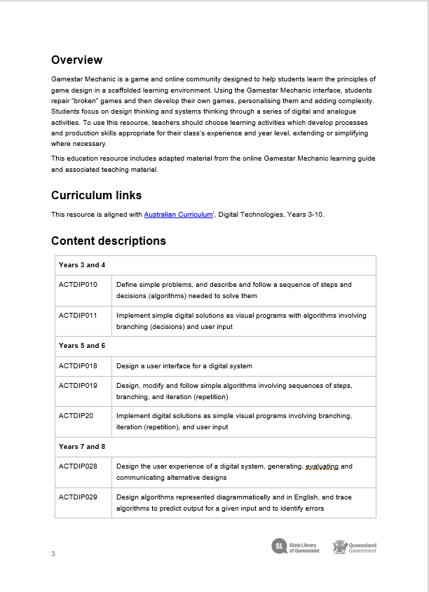
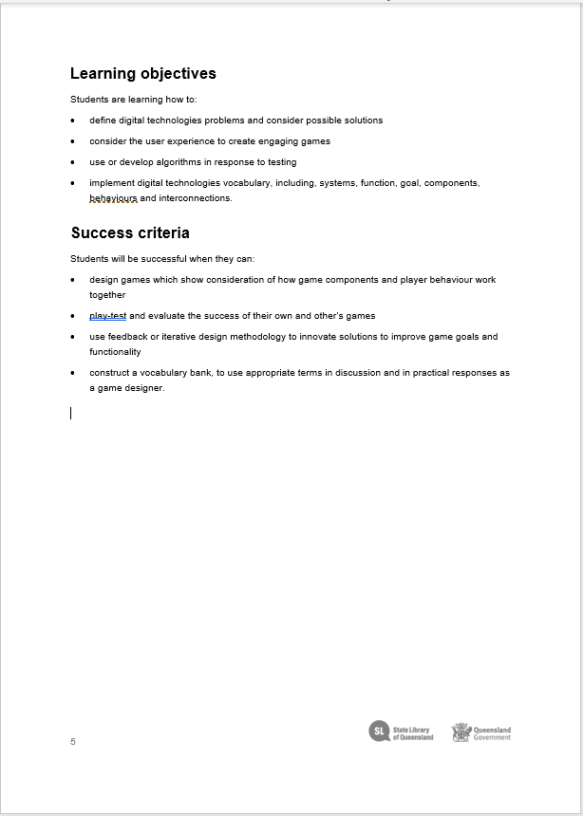
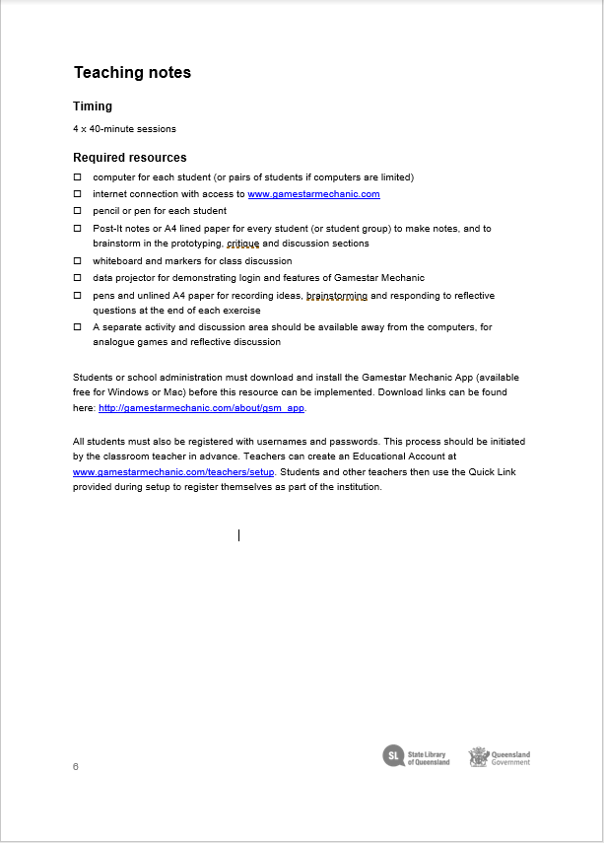
Notes:
This example uses the online platform called Gamestar mechanic, as it’s topic .
It has been revised to align with multiple year levels in Digital Technologies in the Australian Curriculum. To use this resource, teachers are encouraged to adapt the processes and production skills appropriate for their class’s experience and year level, extending or simplifying where necessary.
Using the Gamestar Mechanic interface, students repair “broken” games and then develop their own games, personalising them and adding complexity. Students focus on design thinking and systems, thinking through a series of digital and analogue activities.
Each Design Minds can be downloaded as a PDF or a word document- allowing teachers to adapt the content to their own context and needs.
This is an example of the useful lay out of each resource which includes a helpful table of contents, a detailed list material required, a list of each Content Description covered in the learning activities, a list of the general capabilities, learning objectives, success criteria covered by the sequence of lessons, detailed learning notes that include step-by-step lesson plans.
Teachers can basically pick up a resource and walk into the classroom ready to go.

Slide 11
Features of Curriculum Connect
Currently 60+ resources and growing
Professional development
Information literacy
Become a member of State Library to save and share your favourite resources.
Easy to find- Google SLQ Curriculum Connect
Notes:
Features of Curriculum Connect
Currently 60+ resources and growing
Information literacy- videos to assist you and your students in how to search for reference material using One search, the library catalogue
Become a member of State Library to save lists of your favourite resources on Curriculum Connect and share them.
Curriculum connect - Easy to find- Google SLQ Curriculum Connect

Slide 12
Feedback from teachers
Notes:
Feedback from all teachers has been very positive.
It is especially useful for teachers who are in the early stages of their career, or who are in small schools in rural or remote areas.

Slide 13
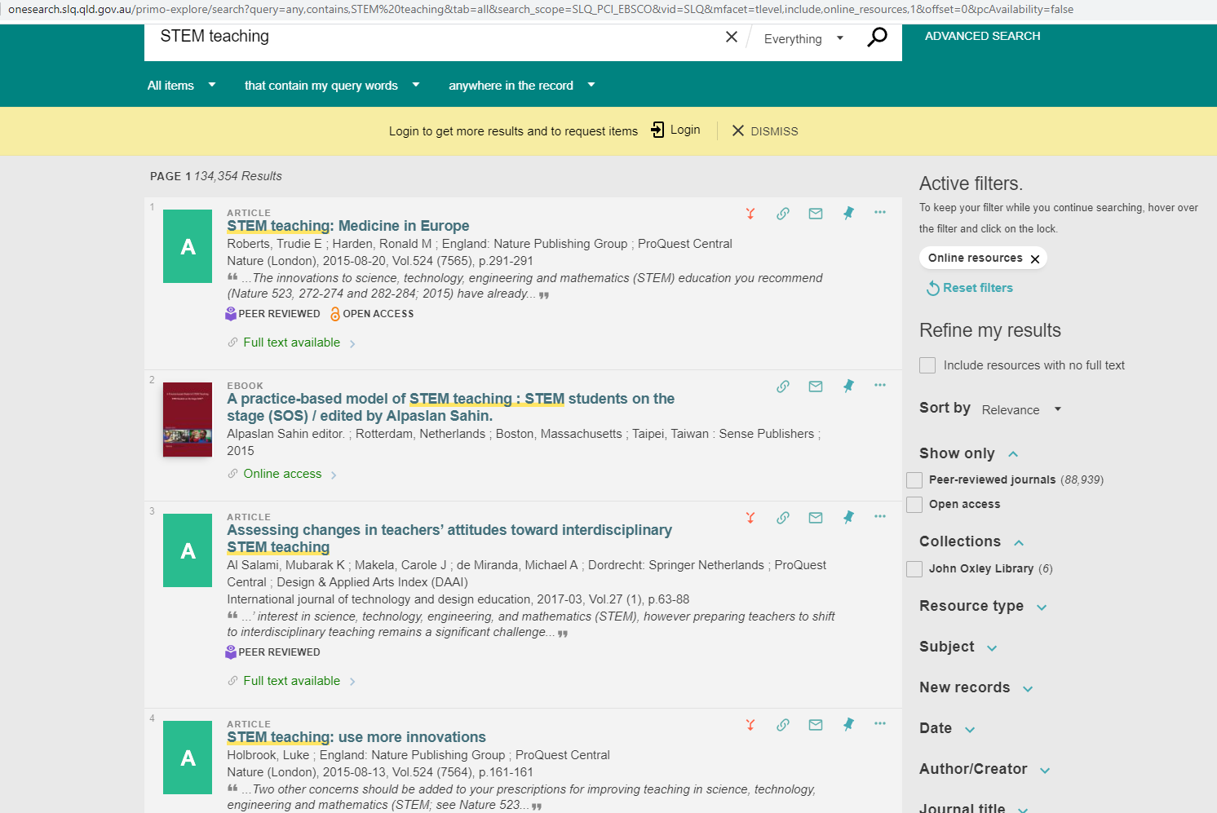
Search State Library catalogue for professional reading
Notes:
Search State Library catalogue for eresources to support your teaching of STEM.
Through State Library you have access to thousands of ejournals and ebooks on STEM teaching from all over the world.
As a member of State Library you can access a wide range of eresources from home including: databases, online journals, newspapers, magazines, websites, online training courses, company information, legislation, music scores and recordings, and encyclopedias.

Slide 14
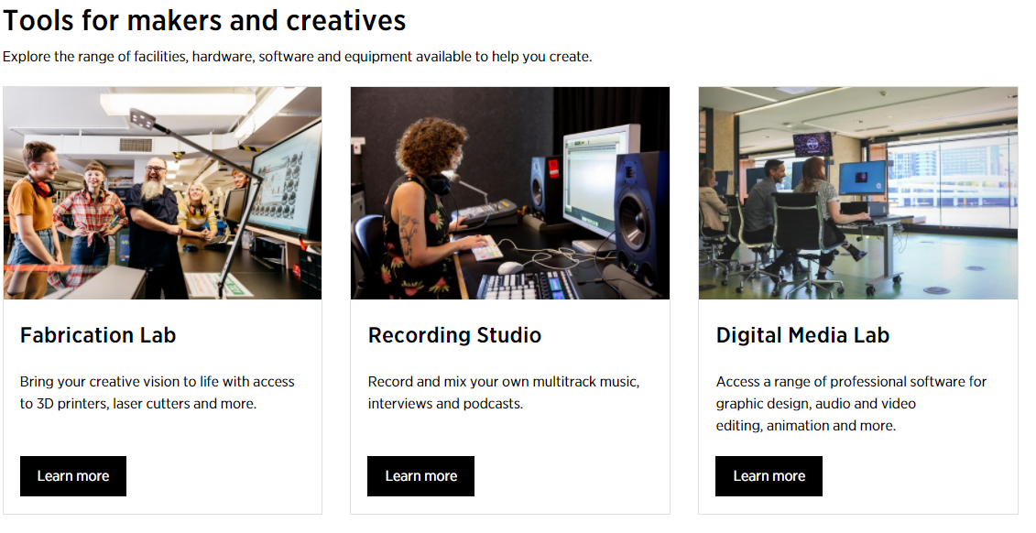
The Edge
Notes:
Onsite at State Library you can visit the Edge. Great opportunities to develop your professional knowledge and support your students.
The Edge is a unique space for creativity, ideas and experimentation. These are all fundamental characteristics of STEM education.
The Edge onsite has a fabrication lab that is open to the public. In order to book and use resources you must:
Be over 16
Become a member
Attend the relevant inductions by booking here
Read the booking terms & conditions (PDF 296 KB)
There is a recording studio
Reserve the Recording Studio
Record, edit and mix sound like a professional.
Mon-Fri 12-3pm & 4-7pm
Inductions required: Recording Studio Induction
digital Media lab access a suite of workstations with a range of professional and free software for your creative idea.
Booking required
sessions up to 4 hours a day.
log in with your membership username and password
access to creative and industry standard software for design, 3D modelling, web and app development and image, audio and video editing, as well as a range of audio and design equipment. Check the full list here
access to equipment, including midi keyboards, Wacom design tablets and much more to assist in the development of your project.

Slide 15
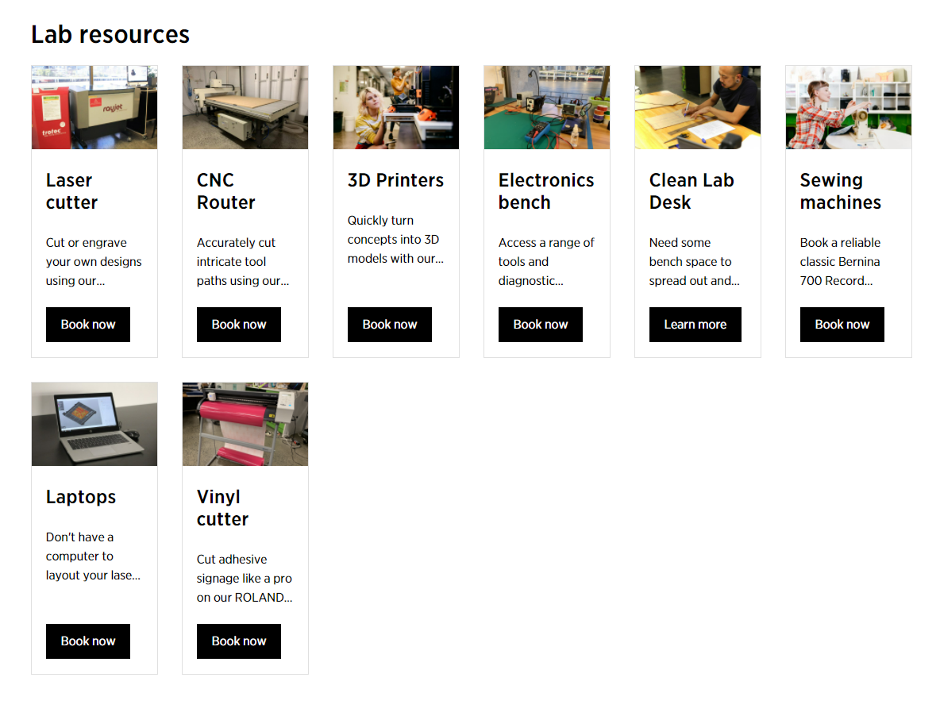
The Edge: Fabrication Lab
https://www.slq.qld.gov.au/plan-my-visit/spaces-visit/edge/fabrication-lab
Notes:
The Fabrication Lab supports a community of makers.
Increase your skills and develop your professional knowledge in using the equipment onsite in the Fabrication Lab.
Once you have done an induction you can use the equipment.
The Edge provides access to a digital Fabrication Lab while supporting public libraries across Queensland to do the same, with a wide variety of opportunities to be involved.
The Fabrication Lab is located at The Edge on level Zero. Open to the public Wednesday, Thursday (and soon on a Saturday) the space provides access to 3D printing, laser cutting, CNC routers and tools for digital prototyping, sewing machines and more. The Applied Creativity team manages and delivers a year-round public program that provides opportunities to learn and engage with the community of makers centred around the space.
Opening hours
Open Lab: 12–6pm Wednesday, Thursday and Saturday.
Hack the Evening: 6–8pm Thursday.

Slide 16
The Edge: Make and design blog
https://www.slq.qld.gov.au/blog/make-and-design
Notes:
A useful resource for you and your students.
Read about what ‘s happening at the Edge, new processes in making and designing, creative approaches and great ideas for creative projects.

Slide 17
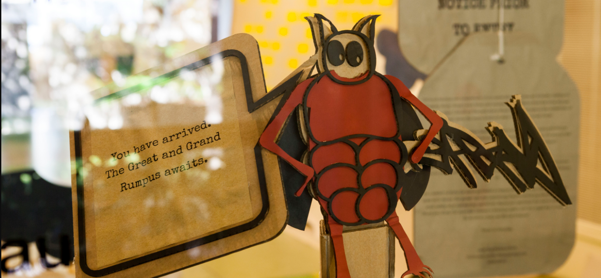
SLQ Wiki
Platform for sharing State Library’s intellectual property
https://wiki.slq.qld.gov.au/doku.php
Notes:
What is the SLQ Wiki?
This platform is for sharing intellectual property
Why use the SLQ Wiki?
As a working knowledge-base, the SLQ Wiki is used to capture the development and delivery of workshops, engagements and facilities, alongside the decision making logic.
This ensures that practitioners and professionals accessing the platform can understand the reason why decisions were made, and learn from State Library's experience. They also have the chance to contribute their own learnings.
Published on a wiki platform, these documents can be edited and improved on by community, shared, exported or printed freely. All content is release under a CC Attribution 4.0 International license.
How does it Work?
The SLQ Wiki is built on the open source platform Dokuwiki and hosted by State Library. Local and regional library workers will be able to edit, create and upload content.
What this means for STEM teachers is that there is a diverse selection of activities that can be freely sourced from the wiki and adapted to your own classroom needs and requirements- accessible all over the state.

Slide 18
Great and Grand Rumpus
Notes:
The GRUMPUS is a fifteen-month community engagement project that’s happening at the State Library of Queensland in 2021-22.
The project will culminate in The Great and Grand Rumpus exhibition of beautiful sculptural, digital and immersive installation that captures a sense of play and whimsy in the SLQ Gallery Level 2, opening in December 2021 and running until April 2022.
The project is grounded in the limitless imaginations of children. Children from around Brisbane are being encouraged to exercise and expand their imaginations, and in doing to dream up and catalogue a collection of the most fantastic, astonishing and magical things you could expect to see in the Great and Grand Rumpus - a make-believe place that will spill from the SLQ Gallery at State Library during the exhibition. School workshops.
The ideas (which we call Imagined Things) are currently being teased out of the children's imaginations and collected, catalogued and placed into The Well, a digital repository of things on the SLQ Wiki. From here a community of Makers, Volunteers and creative industries, arts and design students are being invited to bring these things to life as a series of giant sculptural and interactive installations.
Activate your imagination and join us in the GRUMPUS!
Visit the exhibition on site with your students in 2022 . Look out for special schools’ curator’s tours.
Borrow the Grumpus model of socially engaged practice in your own schools.

Slide 19
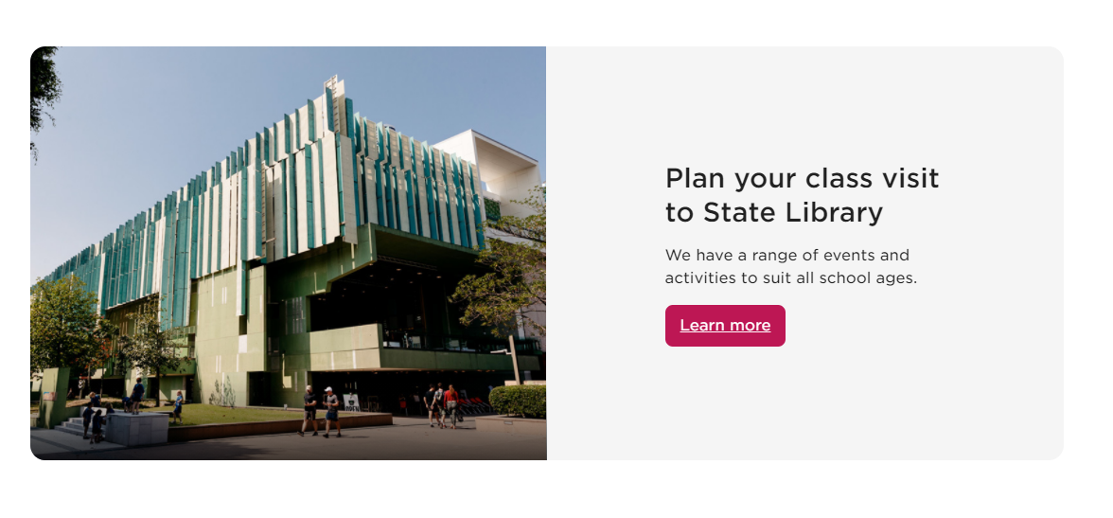
Onsite learning at State Library of Queensland
Book into one of our many options.
https://www.slq.qld.gov.au/school-visits

Slide 20
State Library of Queensland
School’s engagement team is here to help
Teacher in Residence
Jo-Anne Hine
jo-anne.hine@slq.qld.gov.au
3842 9817

